Slide 1
Protein folding fun

Slide 2
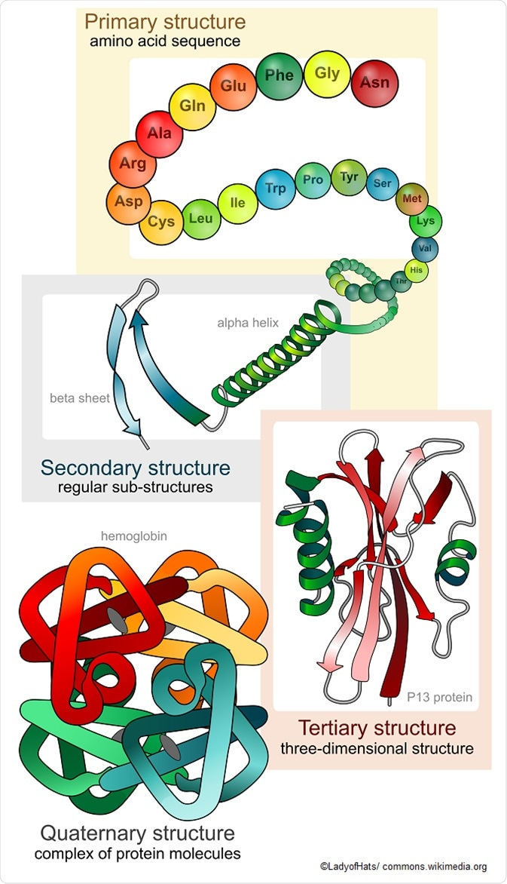

Slide 3
Video
Protein folding
Protein folding 2
Fold it

