Slide 1
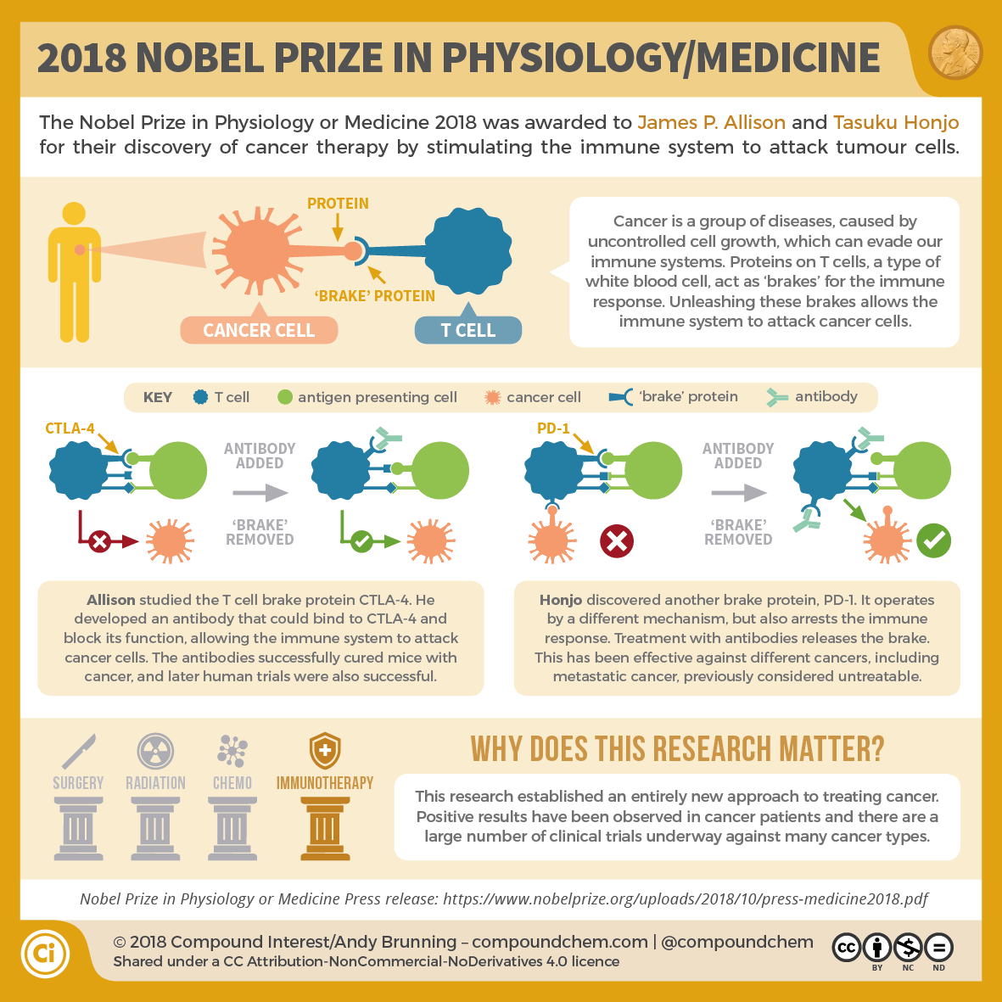

Slide 2
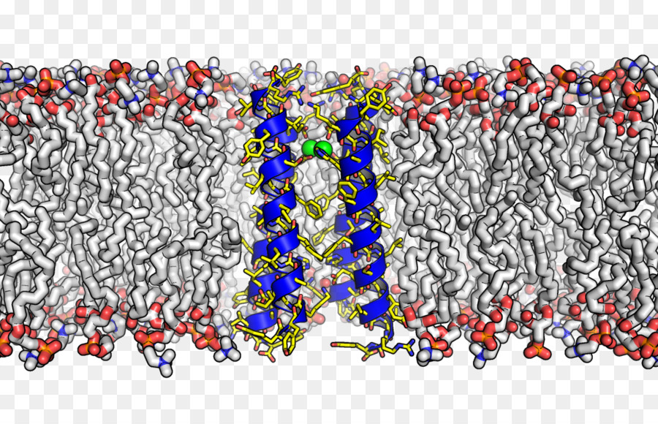
Plasma Membrane

Slide 3
Plasma membrane
Noun
a microscopic membrane of lipids and proteins that forms the external boundary of the cytoplasm of a cell or encloses a vacuole, and that regulates the passage of molecules in and out of the cytoplasm.

Slide 4
The Plasma membrane (write on pg 8)
Made of phospholipids plus proteins, carbohydrates and cholesterol (a lipid protein)
Creates a boundary between the cytoplasm and the extracellular (outside the cell) area
Regulates molecules entering and exiting the cell by being selectively permeable
All cells have cell membranes

Slide 5
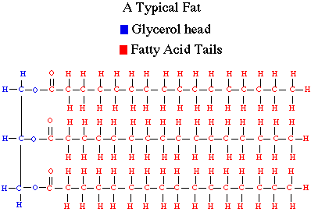
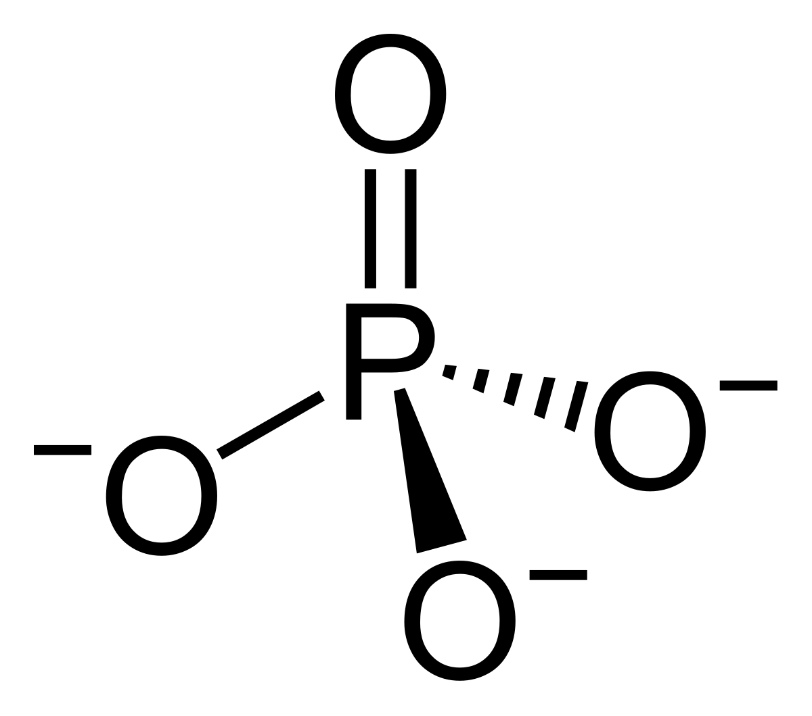
Phospholipids
What is a lipid?
What is a phosphate group?

Slide 6
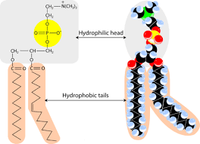
Phospholipid structure (write on pg 8)
- Lipids are hydrophobic (fear water) and form a “tail”
Phosphate group are hydrophilic (loves water) and forms a “head”

Slide 7
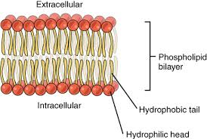
Phospholipid Bilayer
Like attracts like
This arrangement helps keep the inside of the cell separate from the outside of the cell

Slide 8
What else is in the Plasma membrane? (write in notes)
Proteins - surface proteins, intermembrane proteins, intracellular proteins
6 main functions of membrane proteins
Transport
Enzymatic activity
Signal Transduction (“talking”)
Cell to cell recognition
Joining with other cells
Attaching to cytoskeleton and stuff outside the cell (aka extracellular matrix)
Surface proteins
- do not interact with the hydrophobic center
- signal transfer between exterior and interior of the cell
- move molecules across the surface of the cell
surface protein link

Slide 9
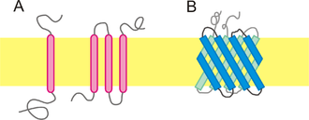
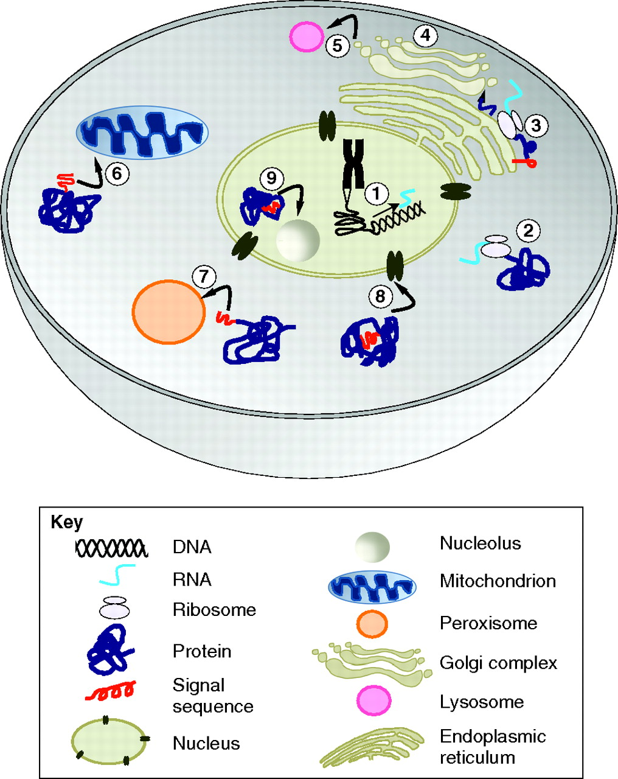
What else is in the Plasma membrane? (write in notes)
Intermembrane Proteins (aka integral membrane protein)
Transporters, Channels, Linkers, and receptors
Intracellular proteins
Made in the in cell
Help with intercellular functions
Provide support for organelles

Slide 10
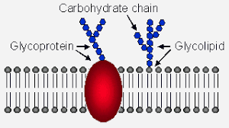
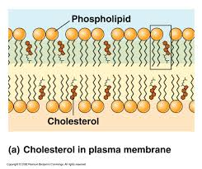
What else is in the Plasma membrane? (write in notes)
Carbohydrates
Attached to the surface of the membrane
Help cells identify one another
Help attract enzymes and water
Cholesterols
Helps stabilize and strengthen the membrane
Helps make membrane less soluble to very small water-soluble molecules
Are embedded in the membrane
OH aka hydroxyl groups orientent to the outside of the cell

Slide 11
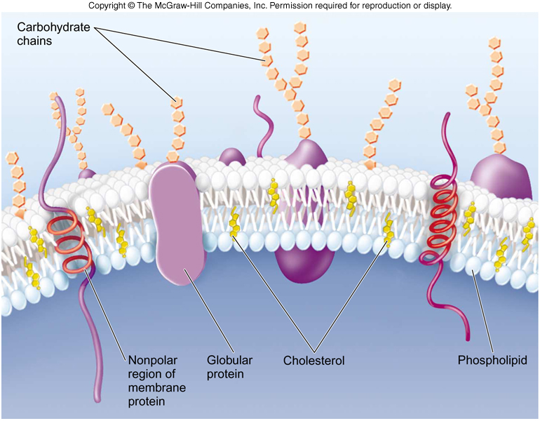

Slide 12
What do you recognize now?
The Inner Life of the Cell

