Slide 1
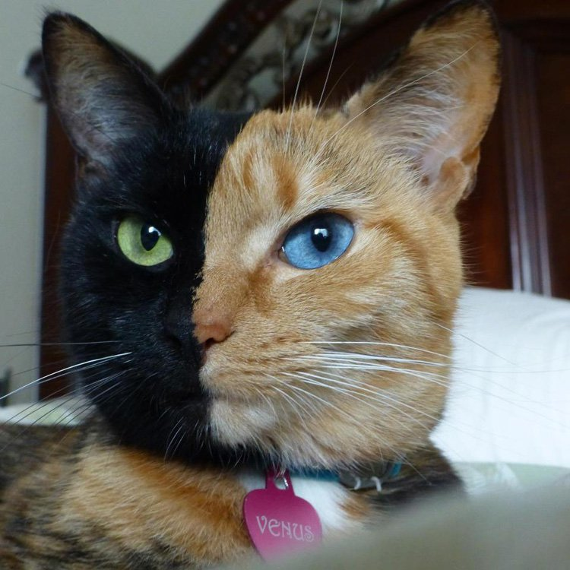
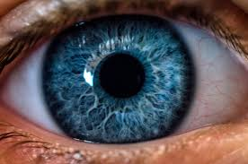
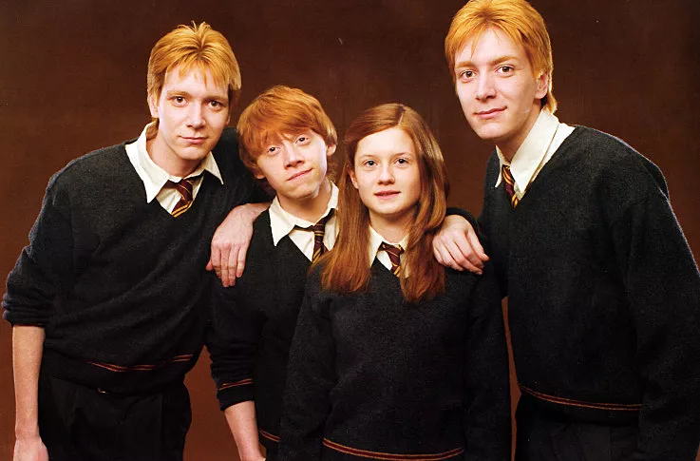
Mutations

Slide 2
Mutations (pg8)
Mutations - permanent alterations of DNA sequence
Caused by
Inaccurate copies of DNA
Ultraviolet light
Specific chemicals
Radiation

Slide 3
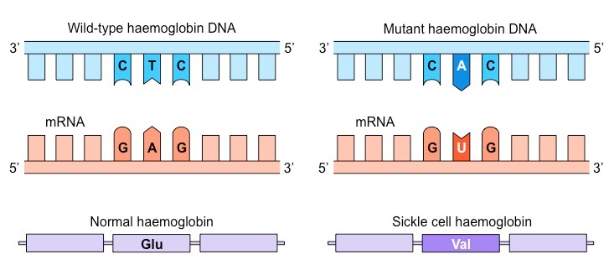
Types of Mutations
Point mutation - a single base pair is inserted, deleted, or substituted
Substituted - a single base pair is switched
Sickle Cell Anemia is an example of substitution

Slide 4
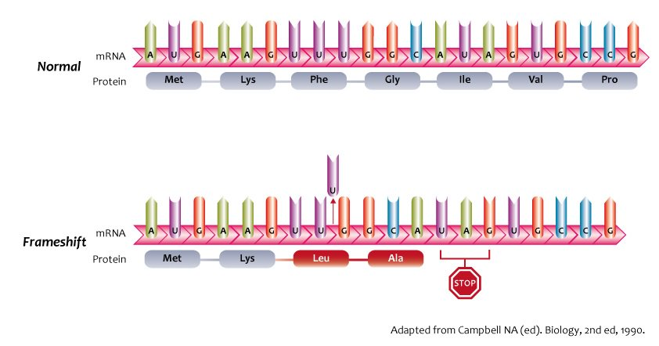
Insertions and deletions - cause frameshift mutations, can be one or more bases, changes the amino acids
Shifts the order of the bases causing changes in amino acids

Slide 6
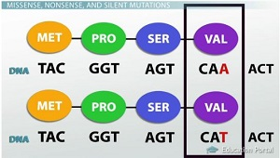
Silent Mutation - changes in base pairs that do not change the amino acid

Slide 7
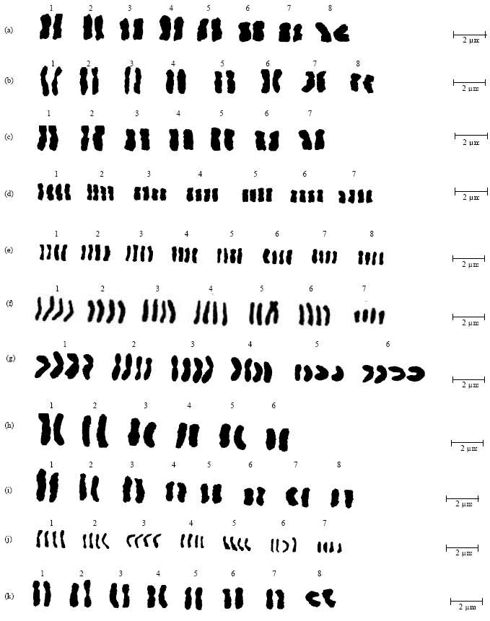
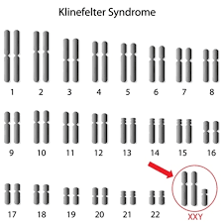
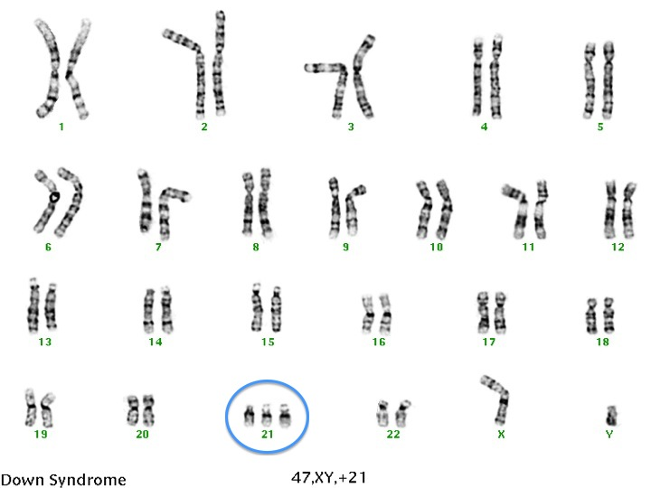
Chromosomal Mutations
Extra chromosome - trisomy Down Syndrome 3 Chromosome 21
One chromosome - monosomy
Plants - Polyploidy - extra copy of all chromosomes

