Slide 1
Extraction, PCR and Electrophoresis
Analyzing DNA

Slide 2
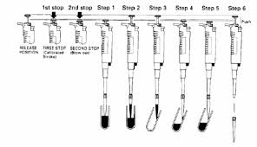
Micropipette - Tool of Science

Slide 3
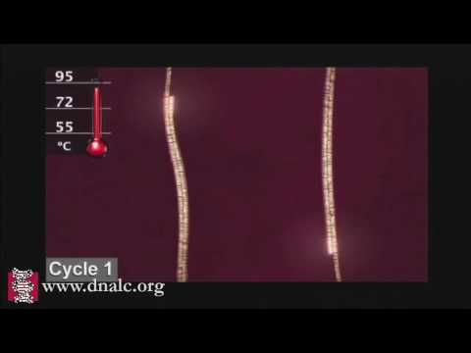
PCR - Polymer chain reaction

Slide 4
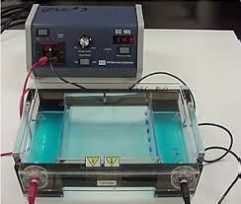
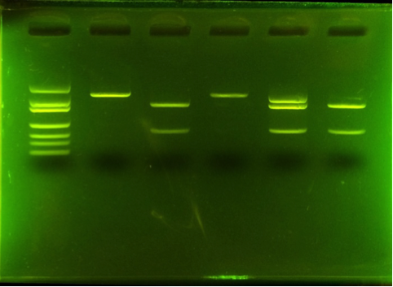
Electrophoresis

