Slide 1
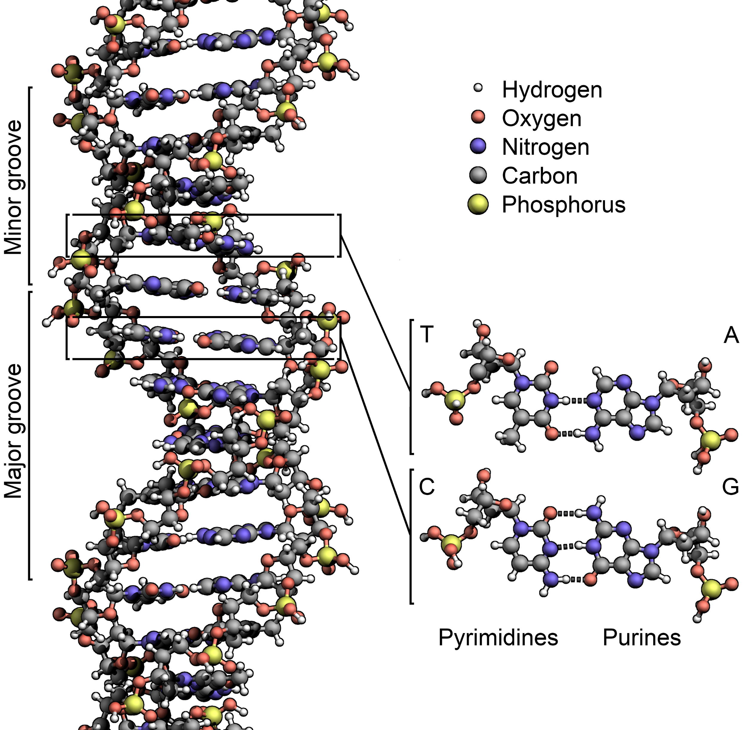
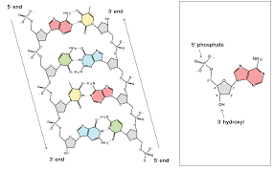
DNA Structure (pg2)

Slide 2
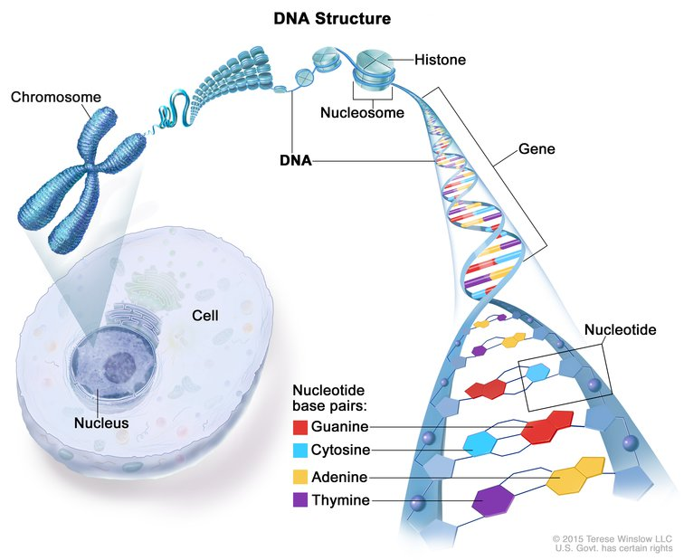
What we already know
DNA is (pg 2)
made of sugars, phosphates, and nitrogen bases
A double helix
Transfers genetic information

Slide 3
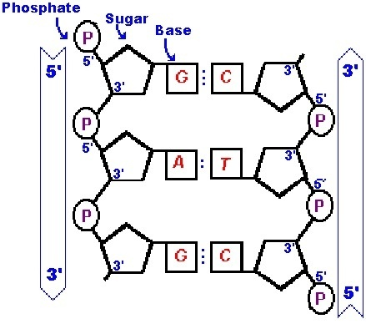
The strands
Antiparallel
In opposite directions

Slide 4
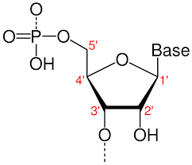
Phosphate sugar backbone (do not write)
5’ ( ‘ = prime) end - carbon from sugar attached to phosphate
3’ (‘= prime) end - carbon from sugar attaches to OH group
H
Remember when nucleotides combine get water H2O

Slide 5
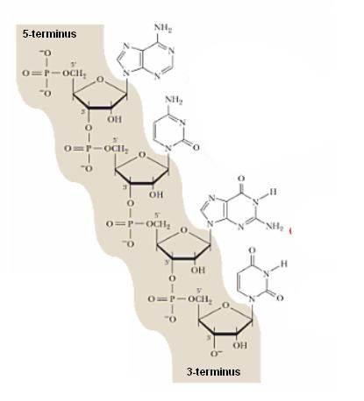
Phosphate sugar backbone (pg2)
Alternating Deoxyribose and Phosphates
Phosphate groups are negatively charged
Hydrophilic
Can form bonds with water

Slide 6
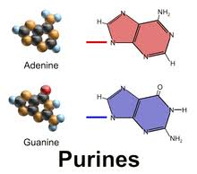
It’s all about the bases
4 bases
Purines
-Adenine
-Guanine

Slide 7
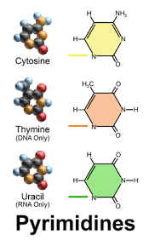
Bases continued
Pyrimidines
Thymine
Cytosine

Slide 8
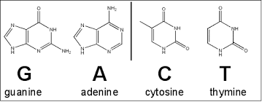

Slide 9
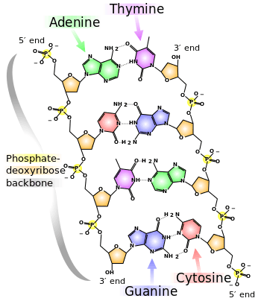

Slide 10
Activity (pg 3 only use top half to draw)
Draw a short strand of DNA with all four bases
Label and color the phosphate groups, the sugars and the bases
Include dashed lines to represent the hydrogen bonding

Slide 11
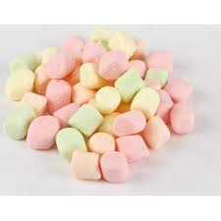
Building the Double Helix (pg 3)
Using licorice and marshmallows (do not eat) build a short chain of dna
The licorice is the backbone
Toothpicks are the bonds
Marshmallows are the bases
Green = ?
Pink = ?
Orange = ?
Yellow = ?
Pink =
Yellow =
Green =
Orange =
Must write and what everything is representing on pg 3

