Slide 1
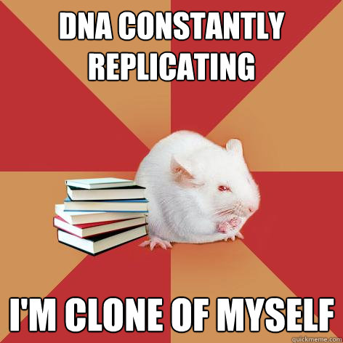
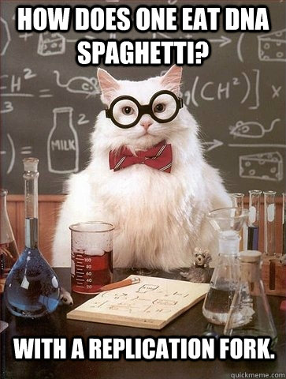
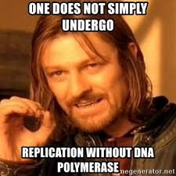
DNA Replication

Slide 2
Why Replicate DNA?
Let’s get ready to Replicate!!!!!!!!!

Slide 3
Replication of DNA (pg 4)
DNA Replication = process of producing two identical replicas of DNA from one original strand.
Occurs in all living organisms
Basis for biological inheritance
Interphase

Slide 4
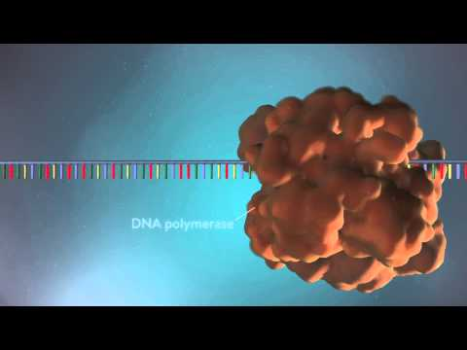
Steps of Replication
Initiation
Elongation
Termination

Slide 5
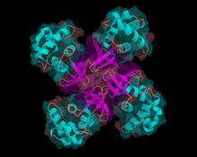
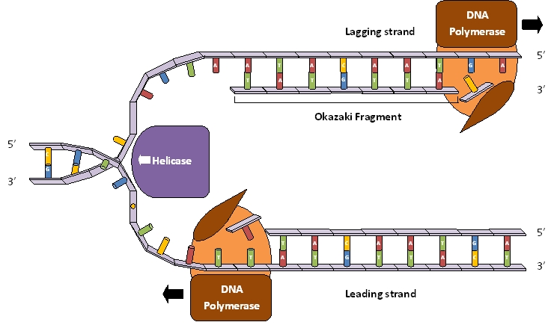
Initiation (pg 4)
Helicase ( a protein) binds to the DNA and unwinds and separates it making replication forks

Slide 6
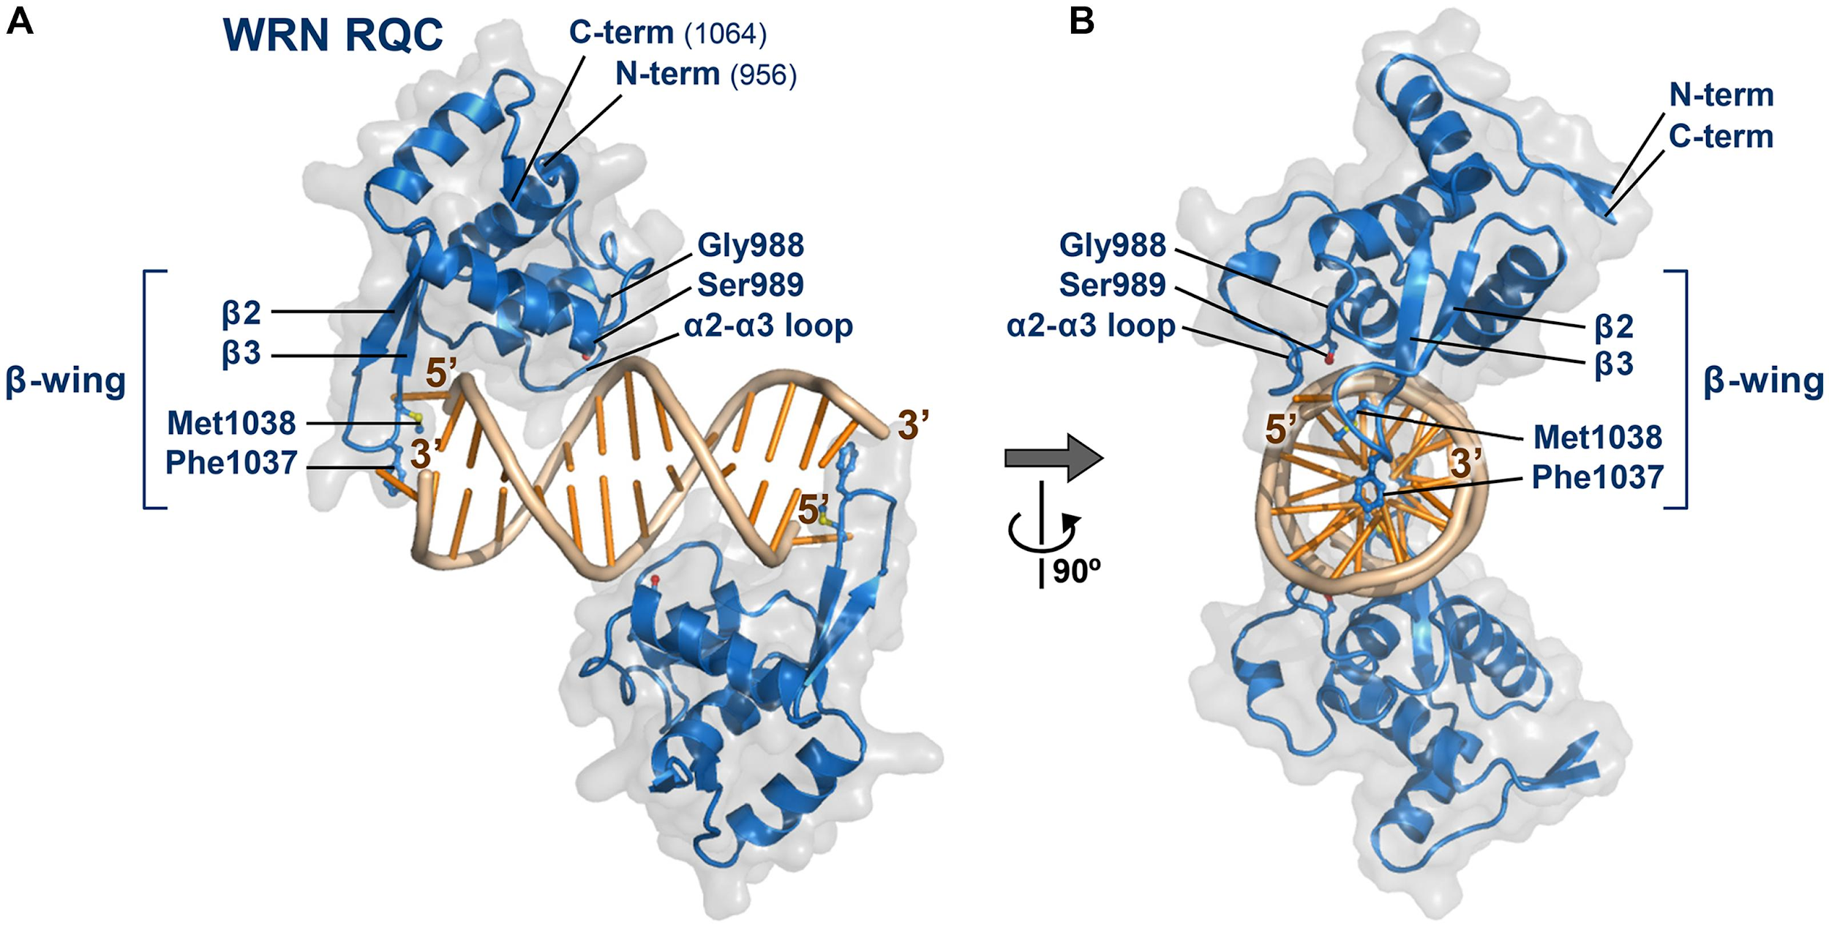

Slide 7
Elongation (pg 4)
Primase - attaches a primer (a short sequence of RNA) marks where to start
DNA Polymerase - adds bases to the strand and proofreads

Slide 8
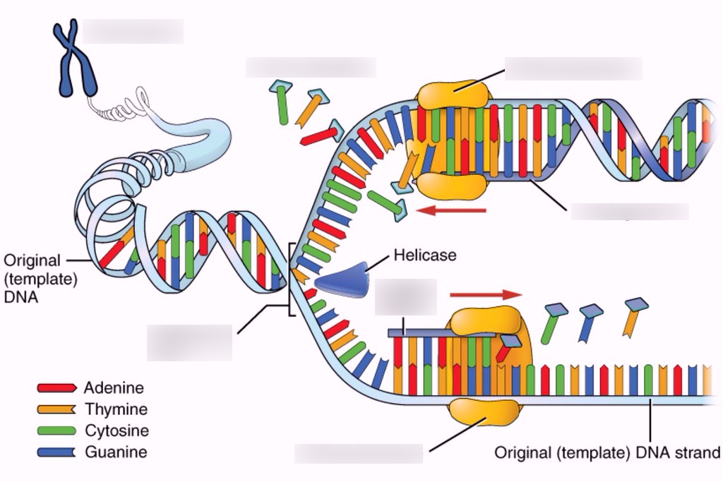

Slide 9
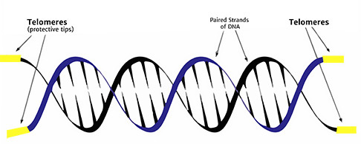
Termination (pg4)
Telomeres - a compound structure at the end of a chromosome

Slide 10
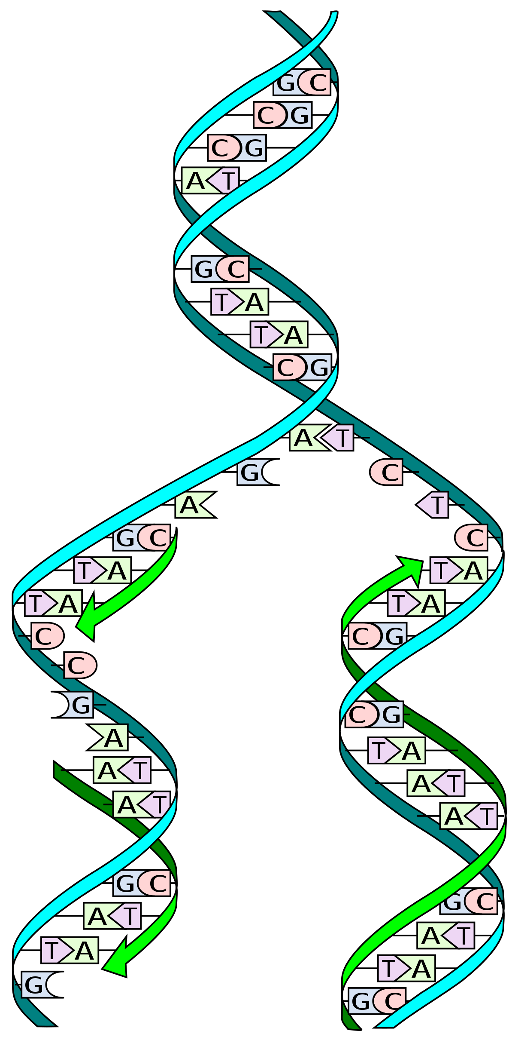
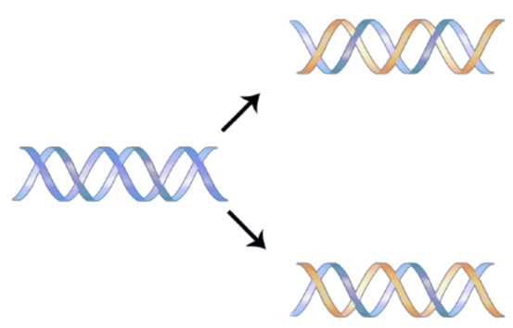

Slide 11
DNA Replication Activity (pg 5)
1. Cut out the nucleotides and enzymes on the purple sheet
2. Make a strand of DNA with the sequence: CAACGT
3. Fill in the complementary bases
4. Use helicase to break the hydrogen bonds between the bases and split them apart.
5. Use DNA polymerase to add new bases to the lowest 2

