Slide 1
Cell Differentiation
aka Cell Fate
(pg 14, the last page of notes for the cell unit)

Slide 2
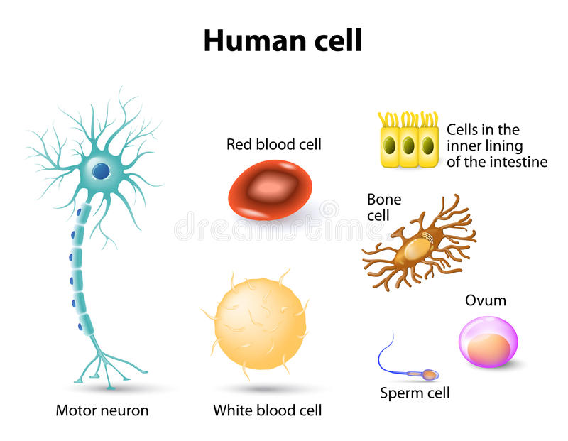
Differentiation - to make different

Slide 3
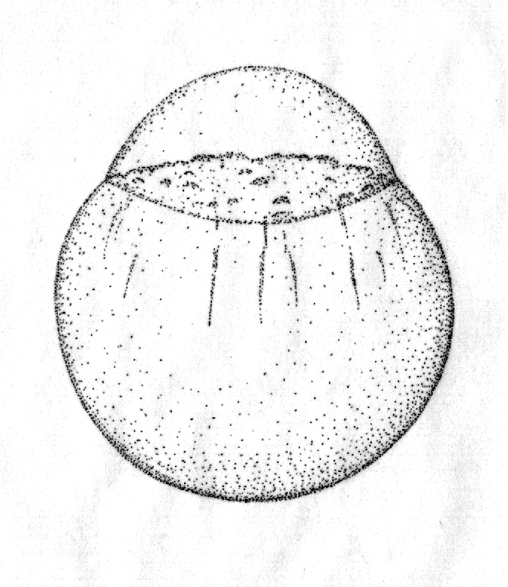
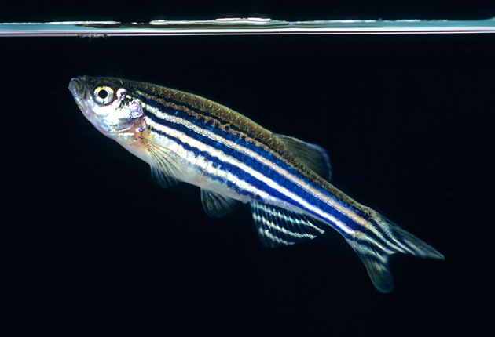
24 hours

Slide 4
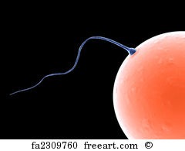
50% DNA from egg
50% DNA from sperm
Total = 100% in first cell
All Cells have the same DNA in them!

Slide 5
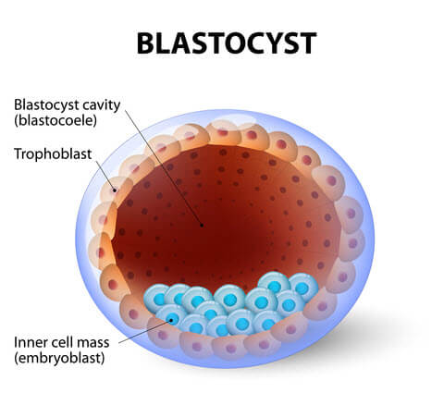
Transcription factors
proteins that help turn specific genes "on" or "off" by binding to nearby DNA.

Slide 6
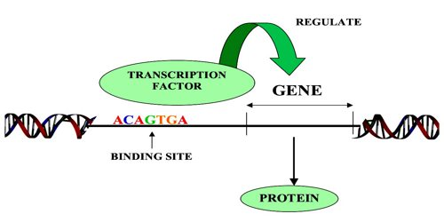

Slide 7
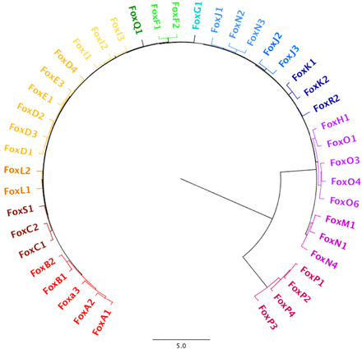

Slide 8
Stem Cells - undifferentiated cells that are able to differentiate into specialized cell types.
Stem cells can become any cell in a body
Pluripotent - multiple potential

Slide 9
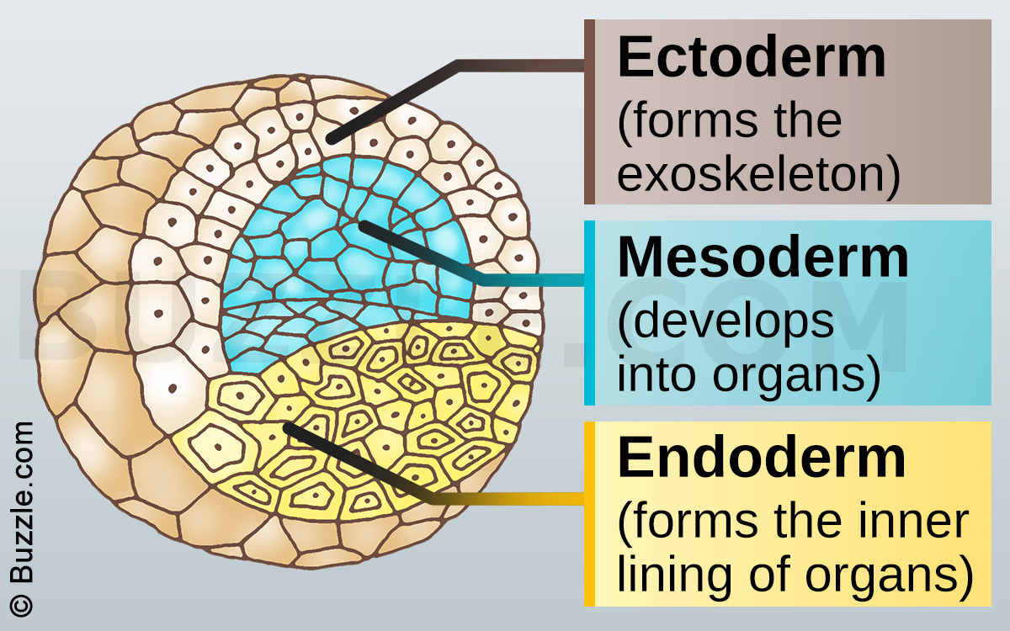

Slide 10
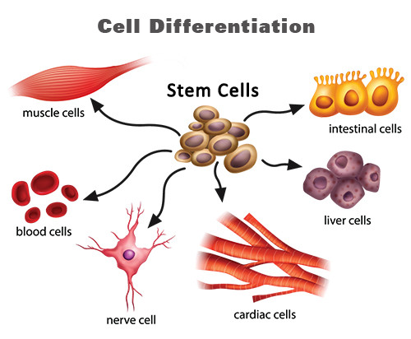

Slide 11
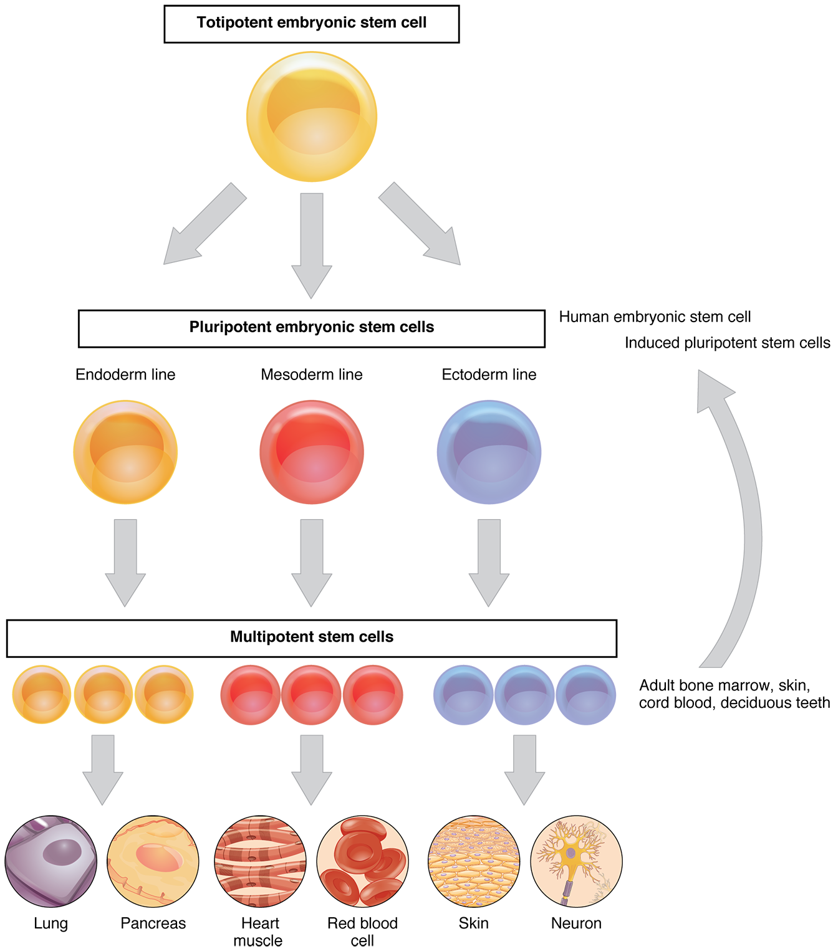

Slide 12
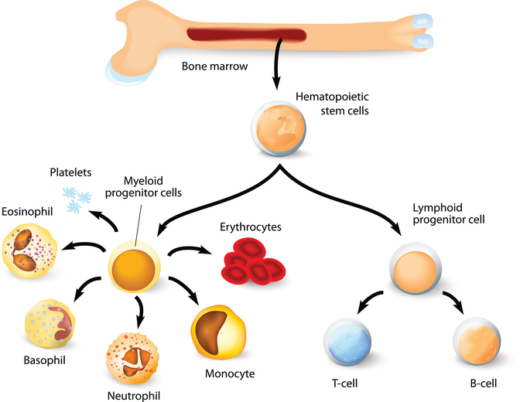
Bone Marrow Transplant

