Slide 1
Macromolecules

Slide 2
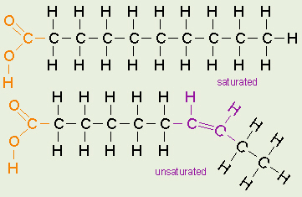
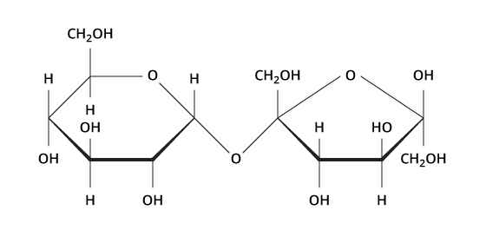
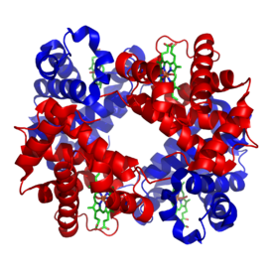
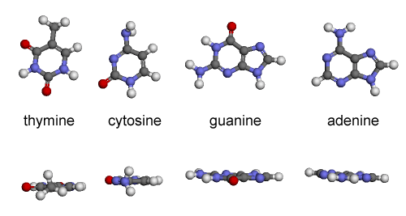
Macromolecules

Slide 3
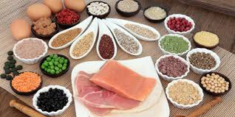
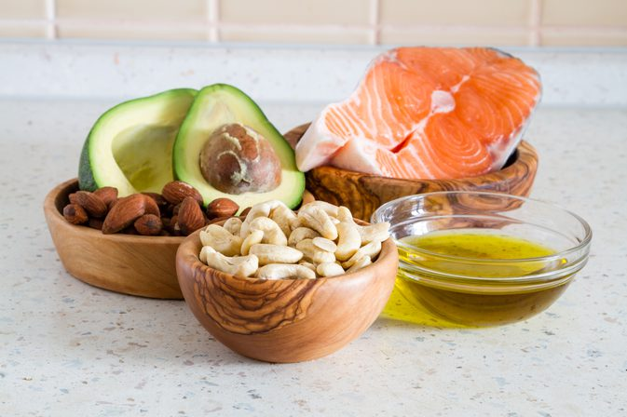
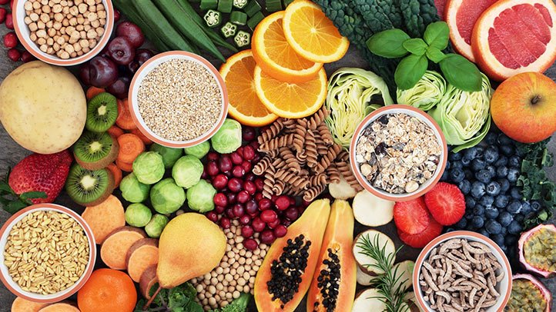
Macromolecules

Slide 4
Macromolecule (Info to write in notes)
Large Molecule
Made from carbon ( C ) compounds
Monomers: small subunits or “building blocks”
Polymers: large units composed of multiple monomers

Slide 5
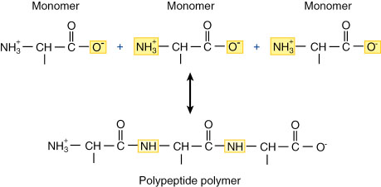
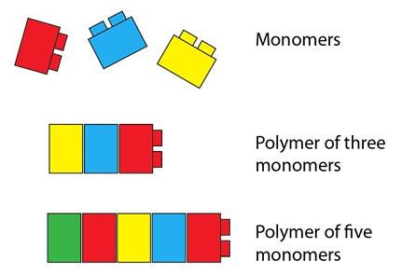
Monomer and Polymer
Mono - = one
Poly - = many
-mer = subunit

Slide 6
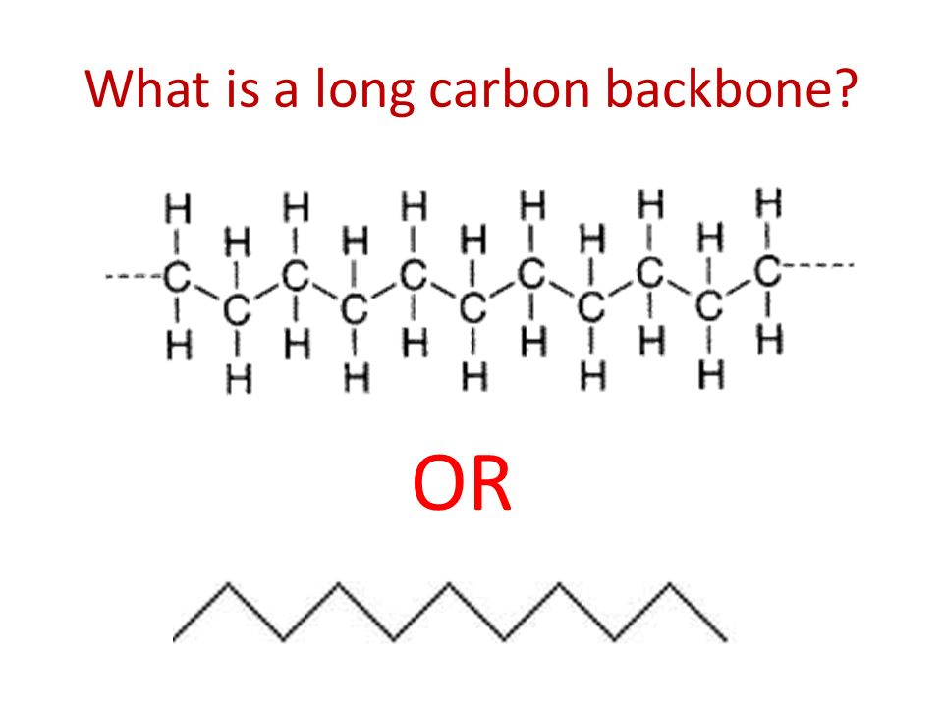
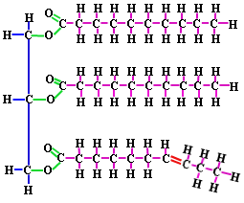
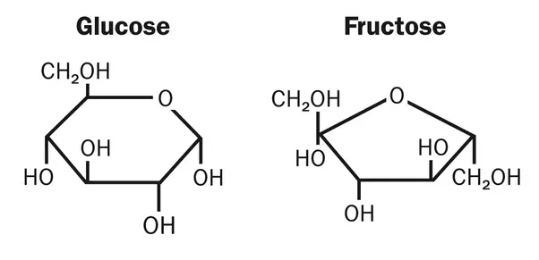
Carbon in macromolecules (write in notes)
Carbon can form 3 major types of structures
Long chain 2) Branched 3) Ring

Slide 7
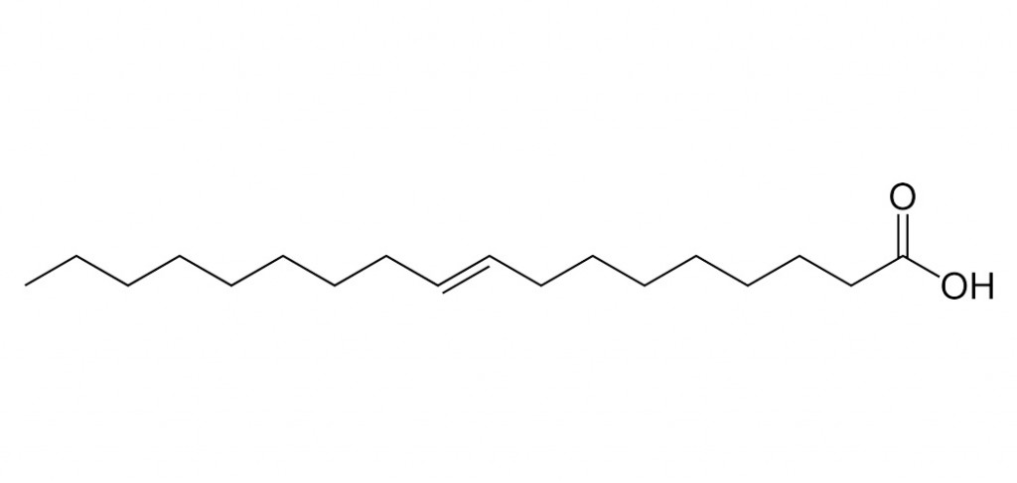
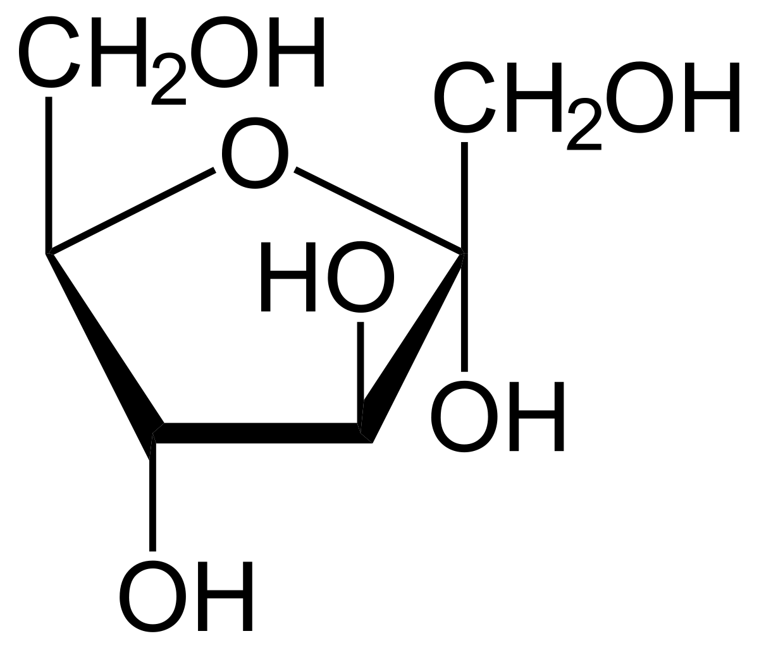
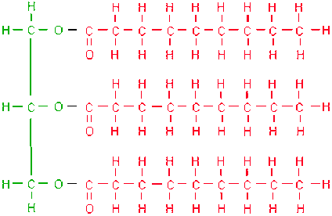
Question time! (do not need to write in notebook)
Which image is an example of a branched chain? Ring? Long chain?
B
A
C

Slide 8
4 Main Categories (write in notes)
Carbohydrates
Lipids
Proteins
Nucleic Acids

Slide 9
Carbohydrates (write in notes)
Structure
Made of Carbon, hydrogen and oxygen (CH2O)n
There are two types - Monosaccharides and polysaccharides ( saccharide = sugar)
Naming -
monomers are called monosaccharides, polymers are called polysaccharides, two monomers together is called a disaccharide
Often end in -ose examples: sucrose, glucose, fructose, lactose, cellulose, amylose
Subunits = sugars (saccharides)

Slide 10
Carbohydrates (write in notes)
Function
Short term or quick energy like glycogen and starch
Structural supports like cellulose in plants
Carbohydrates you know and love

Slide 11
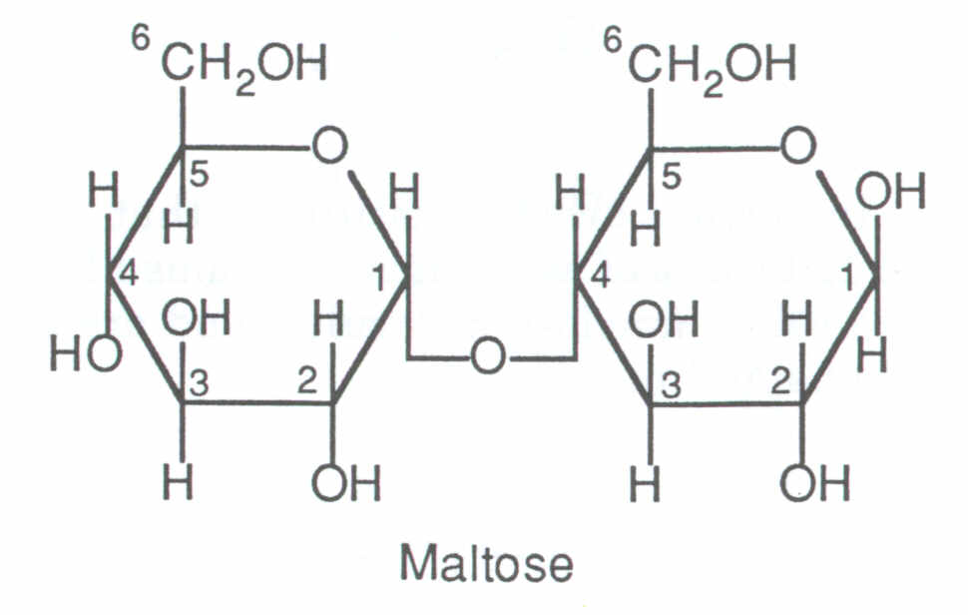
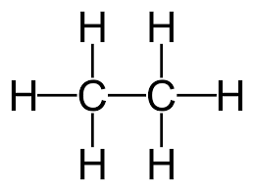
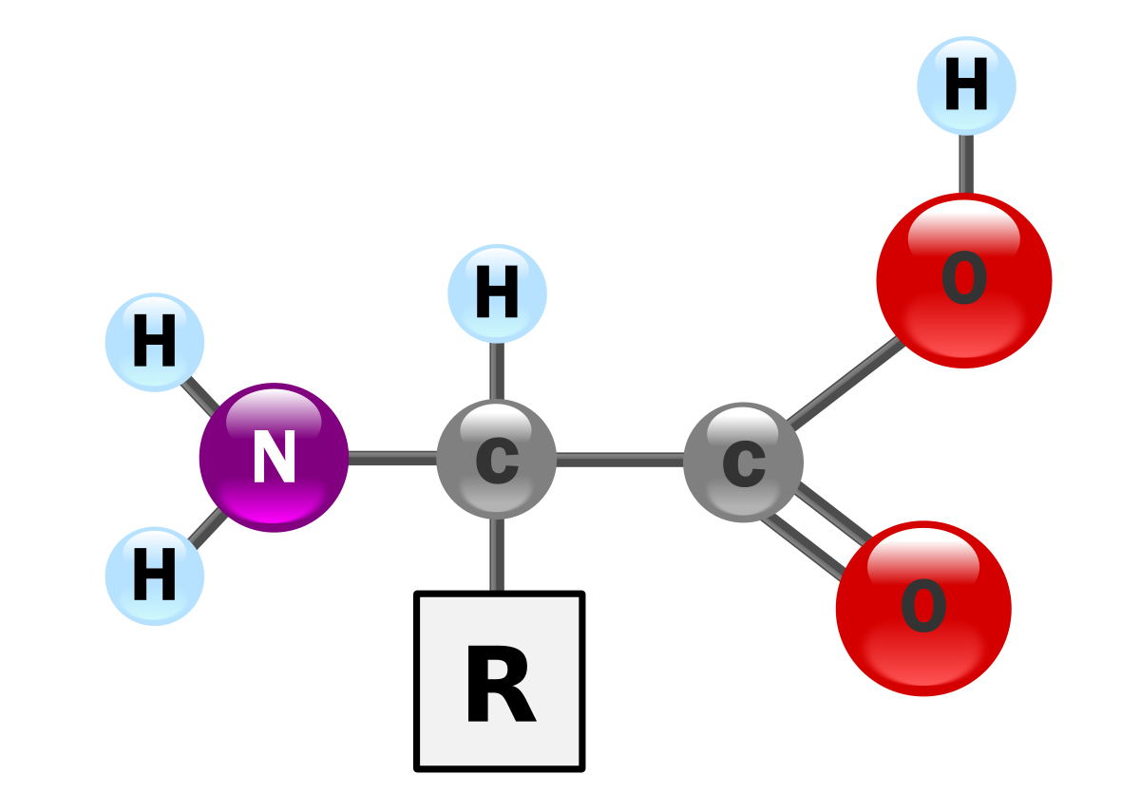
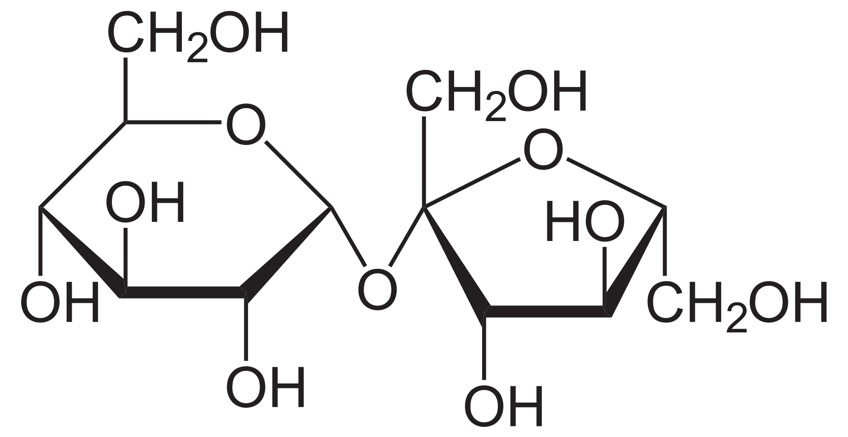
Question Time!!!!
Is this a monomer or polymer?
2) Which one is a carbohydrate?
A
B
C

Slide 12
Let’s draw a carbohydrate!!! (in your notes)

Slide 13
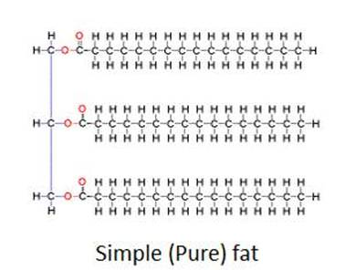
Lipids (write in notes)
Structure
Subunits are made of fatty acids
Made of carbon, hydrogen and some oxygen
Nonpolar (Does not dissolve in water)
Composed of fatty acid chains attached to a glycerol
Long carbon chains or rings

Slide 14
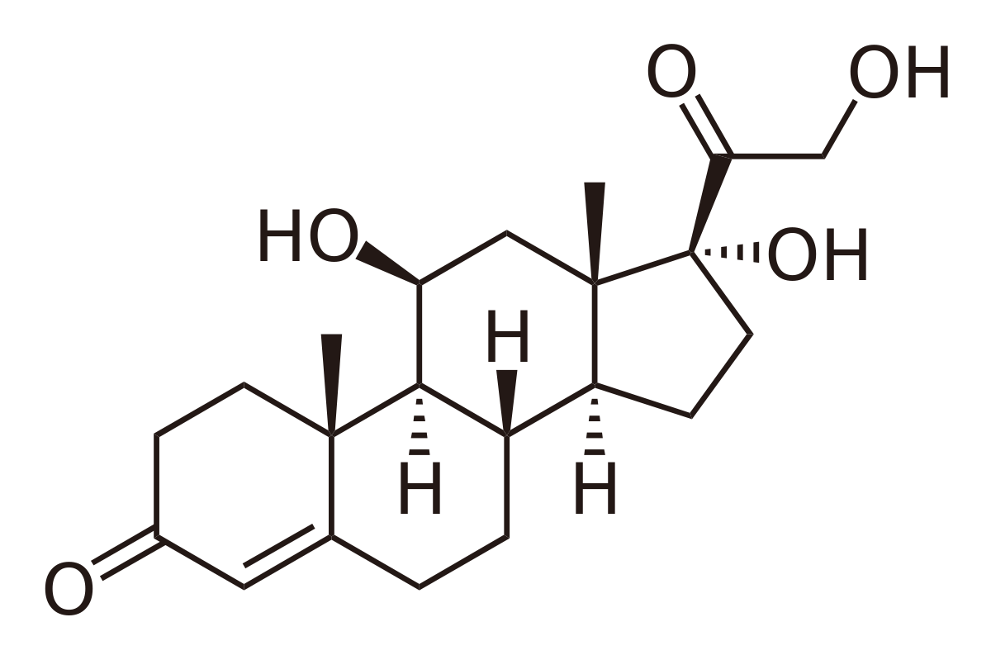
Lipids (write in notes)
Function
Long-term energy storage example glycogen
Forms cell membranes example phospholipids
Used to create hormones like cholesterol and cortisol
Insulation

Slide 15
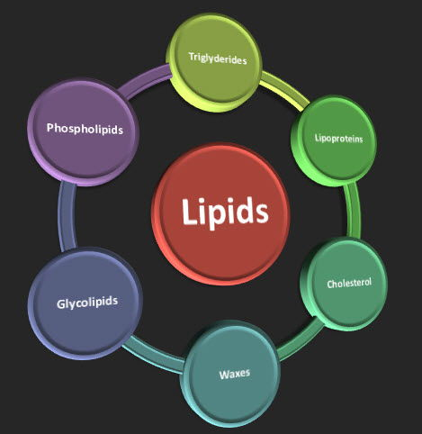

Slide 16
Let’s Draw a Lipid!!!!! (in your notes)

Slide 17
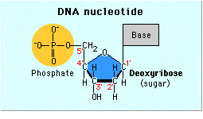
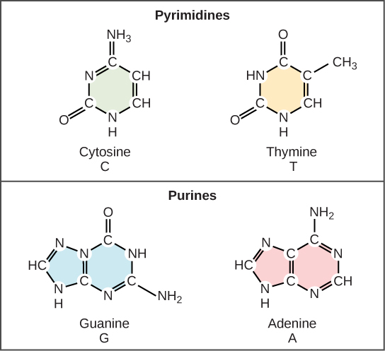
Nucleic Acids (write in notes)
Structure
Polymer of nucleotides
Each nucleotide is composed of 3 parts
5 carbon sugar
Nitrogenous base
Phosphate group
The 4 nitrogenous bases are
Cystine
Thymine
Adenine
Guanine

Slide 18
Nucleic Acids (write in notes)
Function
Store and transmit genetic information like are DNA and RNA
Build Proteins
ATGGCTCGGTTCGGAGACGAAGTGCCGGCCAGGTACGGCGGCGGCGGCGGCGGGGGCTCC GGTCAGGGGGGACCCGGCCGCGGCGGCAGCAGGCAGGGCGGCCCGCCAGGGGCCCAGAGG ATGTACAAGCAATCGATGGCCCAGAGAGCCCGGACCATGGCCATCTACAACCCTATCCCG GTCCGACAGAACTGCCTGACGGTCAACCGCTCTCTCTTTCTCTTCAGTGAAGACAACATA GTGAGAAAATACGCCAAAAAGATCACCGAATGGCC

Slide 19
Let’s draw a nucleic acid!! (in your notes)

Slide 20
Proteins (write in notes)
Structure
Polymers of amino acid monomers
Contain NCHOPS - nitrogen, carbon, hydrogen, oxygen, phosphorus and sulfur
Also called polypeptides (due to amino acids linked by a peptide bond)
Long chains of amino acids that fold up into complex structures

Slide 21
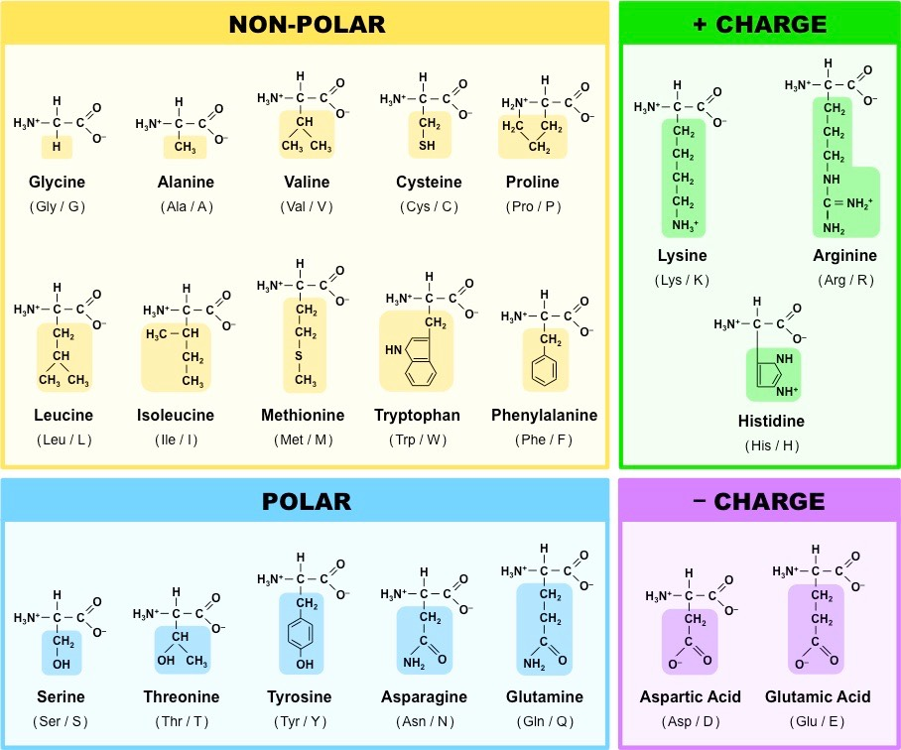
20 Common Amino Acids

Slide 22
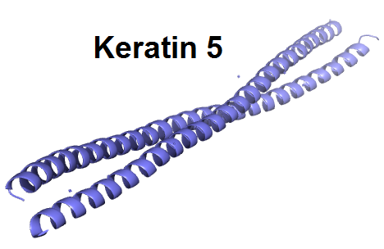
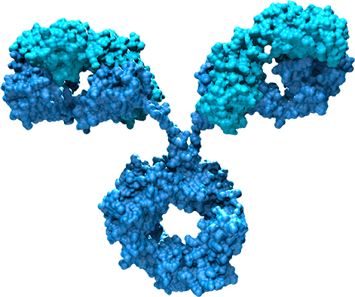
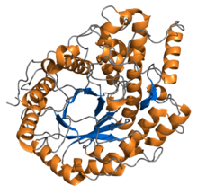
Proteins (write in notes)
Function
Transport - move things in and out of cells
Structural - provides support like keratin on the outer layer of the skin
Enzymes - speed up chemical reactions
Defense - antibodies

Slide 23
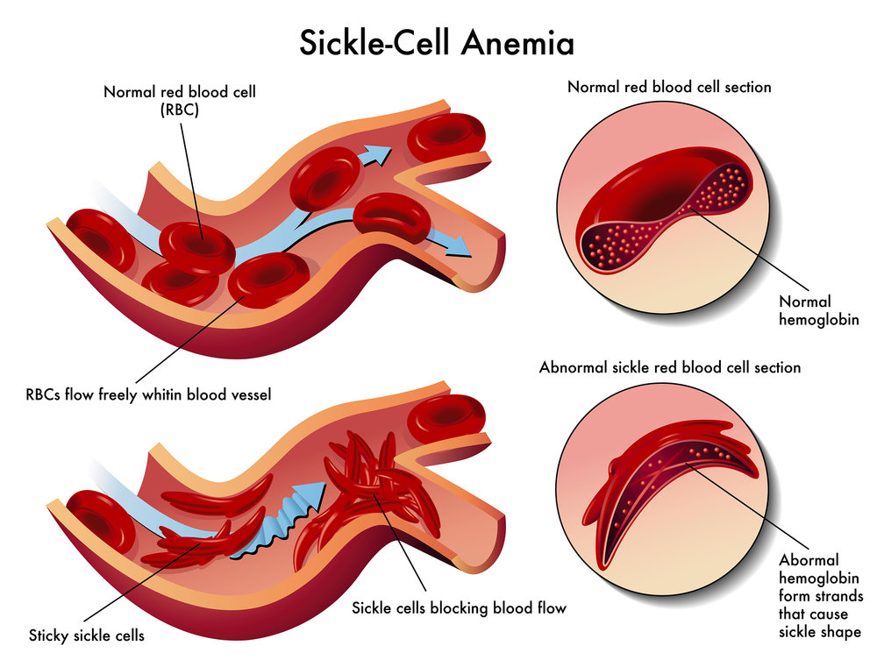
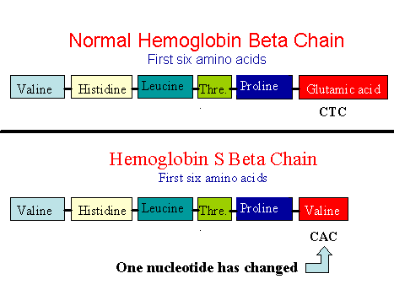
When things don’t go as planned
When an incorrect amino acid is used the structure and the function of protein is changed.
Example: Sickle cell blood cells occur when a valine replaces a glutamic acid in a hemoglobin protein.

Slide 24
Question Time!!!!!
Which macromolecule is used for structure and energy storage
Carbohydrate
Nucleic Acid
Protein
Lipid

Slide 25
Which macromolecule is made up of a phosphate group, a 5 sugar ring and a base?
Carbohydrate
Nucleic Acid
Protein
Lipid

Slide 26
Which macromolecule makes up membrane boundaries?
Carbohydrate
Nucleic Acid
Protein
Lipid

Slide 27
Which macromolecule transports things in and out of cells?
Carbohydrate
Nucleic Acid
Protein
Lipid

Slide 28
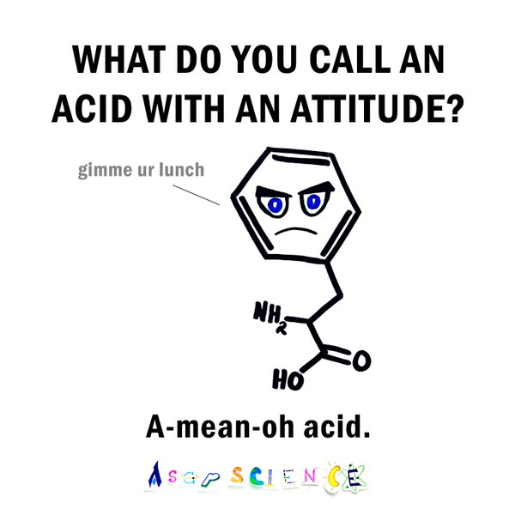
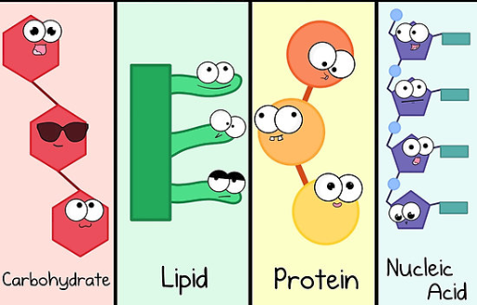

Slide 29
Help Wanted Ad (pg 7)
•Write a “help wanted” ad for a macromolecule
•Include:
1.A description of the job
2.The location of the job
3.The characteristics the macromolecule needs to do the job well
Example:
Protein Needed! We need a fast, efficient protein to transport items in and out of a liver cell. You will work in the plasma membrane. Previous experience transporting glucose molecules a plus. You must be made of amino acids, have a complicated shape, and be ready to work hard!

