Slide 1
Notes: Plasma Membrane (page 8)

Slide 2
Notes: Plasma Membrane (page 8)
Maintains the proper concentration of materials inside a cell by controlling the passage of materials in and out of the cell

Slide 3
Notes: Plasma Membrane (page 8)
Maintains the proper concentration of materials inside a cell by controlling the passage of materials in and out of the cell
Selectively permeable: allows some materials to pass through while keeping others out

Slide 4
Notes: Plasma Membrane (page 8)
Maintains the proper concentration of materials inside a cell by controlling the passage of materials in and out of the cell
Selectively permeable: allows some materials to pass through while keeping others out
All cells have a plasma membrane

Slide 5
Notes: Plasma Membrane (page 8)
Maintains the proper concentration of materials inside a cell by controlling the passage of materials in and out of the cell
Selectively permeable: allows some materials to pass through while keeping others out
All cells have a plasma membrane
Made of phospholipids plus proteins, carbohydrates, and cholesterol

Slide 6
Phospholipids
“Head” end hydrophilic (loves water)

Slide 7
Phospholipids
“Head” end hydrophilic (loves water)
“Tail” end hydrophobic (hates water)

Slide 8
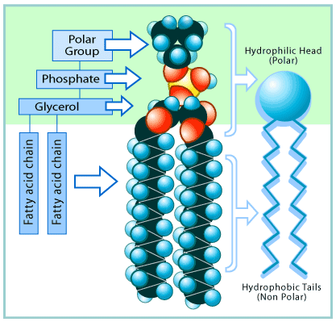
Phospholipids
“Head” end hydrophilic (loves water)
“Tail” end hydrophobic (hates water)

Slide 9
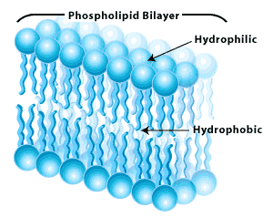
Phospholipids
“Head” end hydrophilic (loves water)
“Tail” end hydrophobic (hates water)
Form a bi-layer with hydrophobic tails in the middle and hydrophilic heads pointed outward

Slide 10
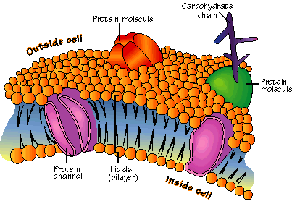
Proteins
Can be attached to the surface or embedded in the membrane

Slide 11
Proteins
Can be attached to the surface or embedded in the membrane
Involved in transport through the membrane

Slide 12
Proteins
Can be attached to the surface or embedded in the membrane
Involved in transport through the membrane
Channel proteins form “tunnels” that allow substances through the membrane

Slide 13
Proteins
Can be attached to the surface or embedded in the membrane
Involved in transport through the membrane
Channel proteins form “tunnels” that allow substances through the membrane
Carrier proteins bind to substances and carry them through the membrane

Slide 14
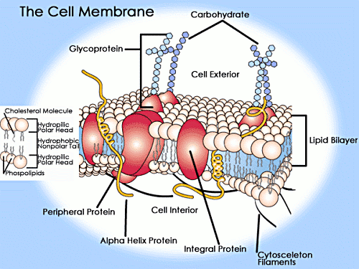
Carbohydrates
Attached to the surface of the cell

Slide 15
Carbohydrates
Attached to the surface of the cell
Help cells to identify other cells

Slide 16
Cholesterol
Embedded in membrane

Slide 17
Cholesterol
Embedded in membrane
Helps stabilize and strengthen the cell membrane

Slide 18
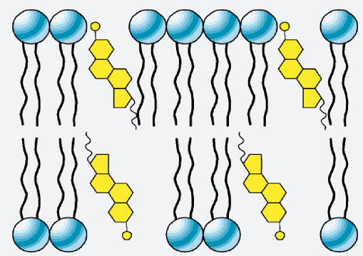
Cholesterol
Embedded in membrane
Helps stabilize and strengthen the cell membrane
Hydroxyl (OH) group is oriented to the outside

