Slide 1
Macromolecules (pg 6)
* Leave space in the margin to draw the molecules

Slide 2
Macromolecules (pg 6)
Large molecules. Made of subunits.

Slide 3
1. Carbohydrates
Subunits = Sugars

Slide 4
Carbohydrates
Subunits = Sugars
Contain C,H,O arranged in rings

Slide 5
Carbohydrates
Subunits = Sugars
Contain C,H,O arranged in rings
Examples:
Monosaccharides: Glucose, Fructose

Slide 6
Carbohydrates
Subunits = Sugars
Contain C,H,O arranged in rings
Examples:
Monosaccharides: Glucose, Fructose
Disaccharides: Sucrose (table sugar), Lactose

Slide 7
Carbohydrates
Subunits = Sugars
Contain C,H,O arranged in rings
Examples:
Monosaccharides: Glucose, Fructose
Disaccharides: Sucrose (table sugar), Lactose
Polysaccharides: Starch, Glycogen

Slide 8
Carbohydrates
Subunits = Sugars
Contain C,H,O arranged in rings
Examples:
Monosaccharides: Glucose, Fructose
Disaccharides: Sucrose (table sugar), Lactose
Polysaccharides: Starch, Glycogen
Functions:
Energy, food storage, cell identification

Slide 9
2. Lipids
Subunits = Fatty acids

Slide 10
Lipids
Subunits = Fatty acids
Made almost entirely of C and H

Slide 11
Lipids
Subunits = Fatty acids
Made almost entirely of C and H
Long carbon chains or rings

Slide 12
Lipids
Subunits = Fatty acids
Made almost entirely of C and H
Long carbon chains or rings
Functions: Energy storage, insulation, cell membranes, hormone precursors

Slide 13
3. Nucleic acids
Subunits = Nucleotides

Slide 14
Nucleic acids
Subunits = Nucleotides
Structure = Sugar + Phosphate + Base

Slide 15
Nucleic acids
Subunits = Nucleotides
Structure = Sugar + Phosphate + Base
Examples: DNA, RNA

Slide 16
Nucleic acids
Subunits = Nucleotides
Structure = Sugar + Phosphate + Base
Examples: DNA, RNA
Function: Store genetic information

Slide 17
4. Proteins
Subunits = Amino acids

Slide 18
Proteins
Subunits = Amino acids
Contain C,H,O,N,P,S

Slide 19
Proteins
Subunits = Amino acids
Contain C,H,O,N,P,S
Long chains of amino acids that fold up into complex shapes

Slide 20
Proteins
Subunits = Amino acids
Contain C,H,O,N,P,S
Long chains of amino acids that fold up into complex shapes
Functions:
Transport (move things in and out of cells)

Slide 21
Proteins
Subunits = Amino acids
Contain C,H,O,N,P,S
Long chains of amino acids that fold up into complex shapes
Functions:
Transport (move things in and out of cells)
Structural (Keratin forms outer layer of skin)

Slide 22
Proteins
Subunits = Amino acids
Contain C,H,O,N,P,S
Long chains of amino acids that fold up into complex shapes
Functions:
Transport (move things in and out of cells)
Structural (Keratin forms outer layer of skin)
Enzymes (speed up chemical reactions)

Slide 23
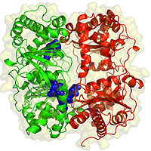

Slide 24
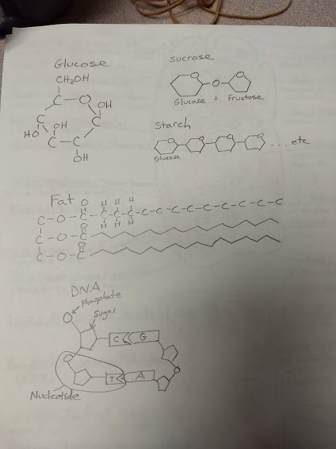
Drawings (put in margin on pg 6)

Slide 25
Output (pg 7)
Write a “help wanted” ad for a macromolecule
Include:
A description of the job
The location of the job
The characteristics the macromolecule needs to do the job well
Example:
Protein Needed! We need a fast, efficient protein to transport items in and out of a liver cell. You will work in the plasma membrane. Previous experience transporting glucose molecules a plus. You must be made of amino acids, have a complicated shape, and be ready to work hard!

