Slide 1
Experimental Design (pg 4)

Slide 2
Experimental Design (pg 4)
Science: an organized way of gathering and analyzing evidence about the natural (not the supernatural) world

Slide 3
Experimental Design (pg 4)
Science: an organized way of gathering and analyzing evidence about the natural (not the supernatural) world
Scientists ask testable questions, then design experiments to answer those questions

Slide 4
Experimental Design (pg 4)
Science: an organized way of gathering and analyzing evidence about the natural (not the supernatural) world
Scientists ask testable questions, then design experiments to answer those questions
Controlled experiment: Keep all variables the same except for the variable being tested

Slide 5
Example
Does fertilizer increase growth rate of marsh grasses?

Slide 6
Example
Does fertilizer increase growth rate of marsh grasses?
Independent variable: fertilizer added to half the plots

Slide 7
Example
Does fertilizer increase growth rate of marsh grasses?
Independent variable: fertilizer added to half the plots
Dependent variable: Growth rate

Slide 8
Example
Does fertilizer increase growth rate of marsh grasses?
Independent variable: fertilizer added to half the plots
Dependent variable: Growth rate
Controlled variables:

Slide 9
Example
Does fertilizer increase growth rate of marsh grasses?
Independent variable: fertilizer added to half the plots
Controlled Variables: starting plant size, plant density, sunlight, water, soil type, climate

Slide 10
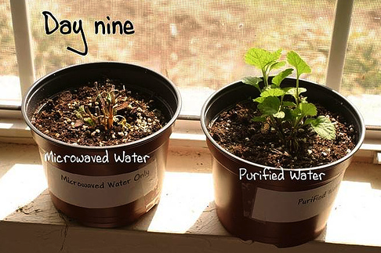
Microwave experiment

Slide 11
Microwave experiment
What factors need to be held constant?

Slide 12
Microwave experiment
What factors need to be held constant?
soil, sunlight, amount of water, temperature of water, starting plant size

Slide 13
Replication
Good experiments always have at least 3 replicates

Slide 14
Types of Observations
Quantitative = Includes numbers
Example: 3.3 cm long, weighs 14
grams, has 7 stripes

Slide 15
Quantitative = Includes numbers
Example: 3.3 cm long, weighs 14
grams, has 7 stripes
Qualitative = No numbers
Example: Blue, heavy, soft

Slide 16
Absolute = Refers to only 1 object
Example: Object A is 17 cm long

Slide 17
Absolute = Refers to only 1 object
Example: Object A is 17 cm long
Relative = Compares 2 or more objects
Example: Object A is 2 cm longer than Object B

Slide 18
Design an Experiment (pg 5)
Testable question:
Independent variable:
Factors that will be kept constant:

Slide 19
Design an Experiment (pg 5)
Testable question: Does sugar dissolve faster in hot water or cold?
Independent variable:
Factors that will be kept constant:

Slide 20
Design an Experiment (pg 5)
Testable question: Does sugar dissolve faster in hot water or cold?
Independent variable: Water temperature
Factors that will be kept constant:
Amount of water
Amount of sugar
Rate of stirring
Type of sugar
Size of container

Slide 21
Design an Experiment (pg 5)
Write step by step instructions of how you will perform this experiment. Include amounts of water and sugar
Create a data table to record your data

