Slide 1
Vertebrae and Ribs (pg 6)

Slide 2
Vertebrae
Vertebral column (spine) contains 26 vertebrae

Slide 3
Vertebrae
Vertebral column (spine) contains 26 vertebrae
Functions: encloses and protects the spinal cord, supports the head, serves as attachment point for ribs, pelvis, and muscles of the back

Slide 4
Regions of the Vertebral Column
Cervical Vertebrae (7): Neck region

Slide 5
Regions of the Vertebral Column
Cervical Vertebrae (7): Neck region
Thoracic Vertebrae (12): Posterior to thoracic cavity. Articulate with ribs

Slide 6
Regions of the Vertebral Column
Cervical Vertebrae (7): Neck region
Thoracic Vertebrae (12): Posterior to thoracic cavity. Articulate with ribs
Lumbar Vertebrae (5): Lower back

Slide 7
Regions of the Vertebral Column
Cervical Vertebrae (7): Neck region
Thoracic Vertebrae (12): Posterior to thoracic cavity. Articulate with ribs
Lumbar Vertebrae (5): Lower back
Sacrum (1): Five fused vertebrae. Articulates with pelvis

Slide 8
Regions of the Vertebral Column
Cervical Vertebrae (7): Neck region
Thoracic Vertebrae (12): Posterior to thoracic cavity. Articulate with ribs
Lumbar Vertebrae (5): Lower back
Sacrum (1): Five fused vertebrae. Articulates with pelvis
Coccyx (1): Tailbone. Four fused vertebrae

Slide 9
Specialized Vertebrae
Atlas (C1): Holds up the skull and allows you to nod “yes”

Slide 10
Specialized Vertebrae
Atlas (C1): Holds up the skull and allows you to nod “yes”
Axis (C2): Allows you to rotate your head from side to side to say “no”

Slide 11
Intervertebral Discs
Outer ring of fibrocartilage and a soft, elastic interior

Slide 12
Intervertebral Discs
Outer ring of fibrocartilage and a soft, elastic interior
Form cushions between adjacent vertebrae, allow spinal movement, and absorb shocks

Slide 13
Structure of a vertebra

Slide 14
Sternum
Breastbone

Slide 15
Sternum
Breastbone
Articulates with clavicles and ribs

Slide 16
Sternum
Breastbone
Articulates with clavicles and ribs
3 parts:
Manubrium: upper, triangular shaped

Slide 17
Sternum
Breastbone
Articulates with clavicles and ribs
3 parts:
Manubrium: upper, triangular shaped
Body: middle, largest part

Slide 18
Sternum
Breastbone
Articulates with clavicles and ribs
3 parts:
Manubrium: upper, triangular shaped
Body: middle, largest part
Xiphoid process: lowest, smallest part

Slide 19
Ribs
12 pairs

Slide 20
Ribs
12 pairs
True ribs: Upper 7 pairs. Attach directly to sternum

Slide 21
Ribs
12 pairs
True ribs: Upper 7 pairs. Attach directly to sternum
False ribs: Lower 5 pairs
Vertebrochondral (3 pairs): attach to sternum by joining with the cartilages of the ribs above

Slide 22
Ribs
12 pairs
True ribs: Upper 7 pairs. Attach directly to sternum
False ribs: Lower 5 pairs
Vertebrochondral (3 pairs): attach to sternum by joining with the cartilages of the ribs above
Floating (2 pairs): lowermost ribs. Do not attach to sternum at all

Slide 23
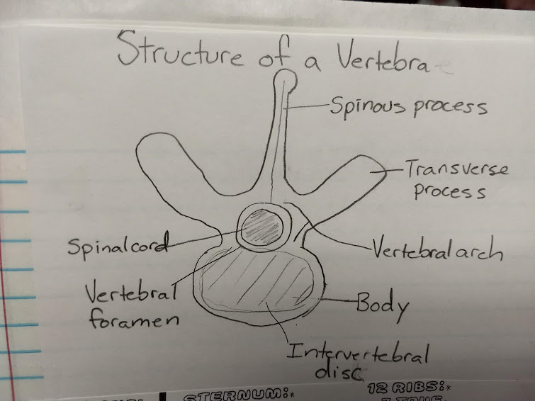
Structure of a vertebra (pg 7)

