Slide 1
Neuroglia (pg 4)

Slide 2
Neuroglia (pg 4)
“Nerve glue”

Slide 3
Neuroglia (pg 4)
“Nerve glue”
Do not conduct impulses

Slide 4
Neuroglia (pg 4)
“Nerve glue”
Do not conduct impulses
Support, nourish, and protect the neurons

Slide 5
Neuroglia (pg 4)
“Nerve glue”
Do not conduct impulses
Support, nourish, and protect the neurons
Capable of mitosis

Slide 6
Neuroglia (pg 4)
“Nerve glue”
Do not conduct impulses
Support, nourish, and protect the neurons
Capable of mitosis
Much more numerous than neurons

Slide 7
Types of Neuroglia Cells
Astrocytes: Bind blood vessels to neurons. Form blood-brain barrier. Star shaped with numerous arms attached to blood vessels and neurons. In CNS.

Slide 8
Types of Neuroglia Cells
Astrocytes: Bind blood vessels to nerves. Form blood-brain barrier. Star shaped with numerous arms attached to blood vessels and neurons. In CNS.
Ependymal cells: Form and circulate cerebrospinal fluid. Columnar cells with cilia. In CNS.

Slide 9
Types of Neuroglia Cells
Astrocytes: Bind blood vessels to nerves. Form blood-brain barrier. Star shaped with numerous arms attached to blood vessels and neurons. In CNS.
Ependymal cells: Form and circulate cerebrospinal fluid. Columnar cells with cilia. In CNS.
Microglia: Mobile, phagocytic cells. Protect neurons by engulfing bacteria and other invaders. Small unattached cells with numerous arms. In CNS

Slide 10
Types of Neuroglia Cells
Astrocytes: Bind blood vessels to nerves. Form blood-brain barrier. Star shaped with numerous arms attached to blood vessels and nerurons. In CNS.
Ependymal cells: Form and circulate cerebrospinal fluid. Columnar cells with cilia. In CNS.
Microglia: Mobile, phagocytic cells. Protect neurons by engulfing bacteria and other invaders. Small unattached cells with numerous arms. In CNS
Oligodendrocytes: Form myelin sheaths around axons in the CNS. Small cells with a few long arms attached to myelin sheath

Slide 11
Types of Neuroglia Cells
5. Schwann cells: Form myelin sheaths around axons in the PNS. Involved in nerve fiber regeneration

Slide 12
Types of Neuroglia Cells
5. Schwann cells: Form myelin sheaths around axons in the PNS. Involved in nerve fiber regeneration
6. Satellite cells: Support nerve cell bodies within ganglia. In PNS

Slide 13
Types of Neuroglia Cells

Slide 14
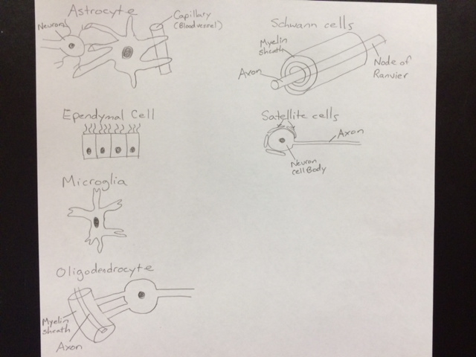

Slide 15
Neuroglia Superhero (pg 5)
Pick one of the neuroglia cell types
Create a superhero including a color drawing and his/her
Name
Superpower (based on cell’s function)
Origin story

