Slide 1
Nerve Impulses (pg 6)

Slide 2
Nerve Impulses (pg 6)
All functions associated with the nervous system are based on two characteristics of neurons: excitability and conductivity

Slide 3
Nerve Impulses (pg 6)
All functions associated with the nervous system are based on two characteristics of neurons: excitability and conductivity
Excitability: Ability to respond to a stimulus. Neurons respond to stimuli by generating action potentials

Slide 4
Nerve Impulses (pg 6)
All functions associated with the nervous system are based on two characteristics of neurons: excitability and conductivity
Excitability: Ability to respond to a stimulus. Neurons respond to stimuli by generating action potentials
Conductivity: ability to transmit an impulse from one point to another

Slide 5
Generation of an Action Potential

Slide 6
Generation of an Action Potential
1. Resting: Neuron cell membrane is impermeable to Na⁺ and K⁺. High concentration of Na⁺ outside cell and K⁺ inside cell. Also lots of negative ions inside cell, so it has a negative charge (-70 mv)

Slide 7
2. Depolarization: Stimulus causes Na⁺ channels in the membrane to open. Na⁺ rushes into the cell, driven by concentration gradient and the negative charge inside the cell. Results in depolarization (0 mv)

Slide 8
3. Reverse polarization: So much Na+ rushes into the cell that the polarity of the membrane becomes reversed (positive on the inside, negative on the outside). +30 mv

Slide 9
4. Repolarization: Na+ channels close, so no more Na+ gets into the cell. K+ channels open and K+ rushes out of the cell, driven by the concentration gradient. Cell becomes negative on the inside (-70 mv)

Slide 10
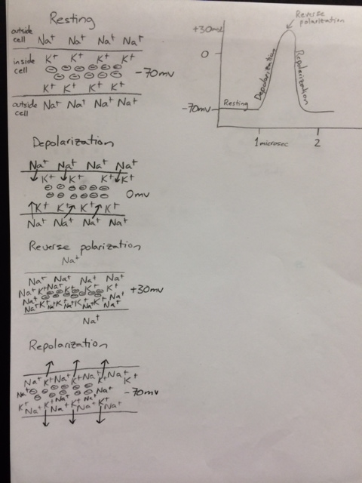

Slide 11
Conduction along a neuron
Once an action potential has been generated, it must be propagated along the length of the neuron

Slide 12
Conduction along a neuron
Once an action potential has been generated, it must be propagated along the length of the neuron
The reverse polarity at one point of the neuron acts as a stimulus to the next point on the neuron, causing it to go through an action potential

Slide 13
Conduction along a neuron
Once an action potential has been generated, it must be propagated along the length of the neuron
The reverse polarity at one point of the neuron acts as a stimulus to the next point on the neuron, causing it to go through an action potential
In unmyelinated axons this process is continuous, in myelinated fibers, the impulse jumps from node to node

Slide 14
Conduction across a Synapse
Synapse = Region of communication between two neurons

Slide 15
Conduction across a Synapse
Synapse = Region of communication between two neurons
Neurons are separated by a space called the synaptic cleft. When a nerve impulse reaches the end of an axon it causes neurotransmitter molecules to be released into the cleft. The neurotransmitters diffuse over to the other neuron, where they cause an action potential.

Slide 16
