Slide 1
Construct Interactive Notes
8 pages of binder paper
On cover, write
Chapter 7: Nervous System
Name, period, seat #
Color illustration

Slide 2
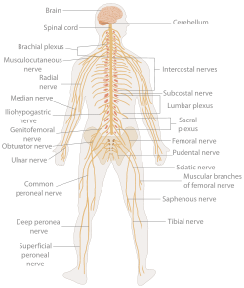
Introduction to the Nervous System (pg 2)

Slide 3
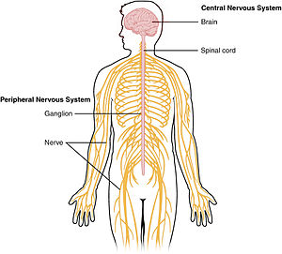
Structures
Central Nervous System (CNS)

Slide 4
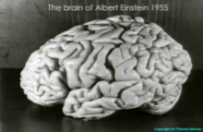
Structures
Central Nervous System (CNS)
Brain: 100 billion neurons

Slide 5
Structures
Central Nervous System (CNS)
Brain: 100 billion neurons
Spinal cord: 100 million neurons

Slide 6
Structures
Central Nervous System (CNS)
Brain: 100 billion neurons
Spinal cord: 100 million neurons
Peripheral Nervous System (PNS)

Slide 7
Structures
Central Nervous System (CNS)
Brain: 100 billion neurons
Spinal cord: 100 million neurons
Peripheral Nervous System (PNS)
Nerves: bundles of 100-1000 axons

Slide 8
Structures
Central Nervous System (CNS)
Brain: 100 billion neurons
Spinal cord: 100 million neurons
Peripheral Nervous System (PNS)
Nerves: bundles of 100-1000 axons
Ganglia: Small masses of neuron cell bodies located outside the CNS.

Slide 9
Structures
Central Nervous System (CNS)
Brain: 100 billion neurons
Spinal cord: 100 million neurons
Peripheral Nervous System (PNS)
Nerves: bundles of 100-1000 axons
Ganglia: Small masses of neuron cell bodies located outside the CNS.
Sensory receptors: Located in skin, eyes, ears, nose, and mouth

Slide 10
Functions
Sensory input: Receptors detect external and internal stimuli. This information is carried to the brain via nerves.

Slide 11
Functions
Sensory input: Receptors detect external and internal stimuli. This information is carried to the brain via nerves.
Integration: The brain processes and analyzes the sensory information and decides on appropriate responses

Slide 12
Functions
Sensory Input: Receptors detect external and internal stimuli. This information is carried to the brain via nerves.
Integration: The brain processes and analyzes the sensory information and decides on appropriate responses
Motor output: The nervous system causes a response by stimulating effectors (muscles and glands)

Slide 13
Functions
Sensory input: Receptors detect external and internal stimuli. This information is carried to the brain via nerves.
Integration: The brain processes and analyzes the sensory information and decides on appropriate responses
Motor output: The nervous system causes a response by stimulating effectors (muscles and glands)
Example: You are driving and see a red light (sensory input). Your brain integrates this information (red light means “stop”) and your foot goes for the brake (motor output)

Slide 14
Neurons
Conduct electrical impulses

Slide 15
Neurons
Conduct electrical impulses
Neurons in CNS are amitotic ( can’t divide)

Slide 16
Neurons
Conduct electrical impulses
Neurons in CNS are amitotic (can’t divide)
Three parts:
Cell body: Contains nucleus and organelles

Slide 17
Neurons
Conduct electrical impulses
Neurons in CNS are amitotic
Three parts:
Cell body: Contains nucleus and organelles
Dendrites: Short, highly branched extensions. Receive input and transfer impulses to the cell body

Slide 18
Neurons
Conduct electrical impulses
Neurons in CNS are amitotic
Three parts:
Cell body: Contains nucleus and organelles
Dendrites: Short, highly branched extensions. Receive input and transfer impulses to the cell body
Axon: Only 1 per neuron. Long branch that carries impulses away from cell body. Often covered by a segmented, fatty myelin sheath

Slide 19
Types of neurons
Type | Transmits impulses: | Structure | Location
Sensory | From sense receptors to CNS | Long dendrites, short axon | Dendrites: PNS Cell Body: Ganglia (PNS) Axon: CNS
Motor | From CNS to muscles and glands | Short dendrites, long axon | Dendrites and Cell Body: CNS Axon: PNS
Association | From sensory neurons to motor neurons | Variable | Dendrites, Cell Body, and Axon: CNS

Slide 20
Output (pg 3)
Draw a sensory neuron and a motor neuron
Label the dendrites, cell body, and axon in each and say whether each part is located in the CNS or the PNS

Slide 21
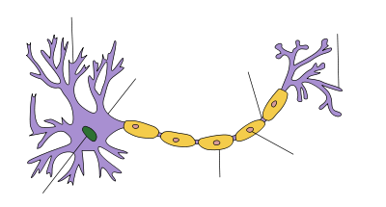
Draw a diagram of a neuron

