Slide 1
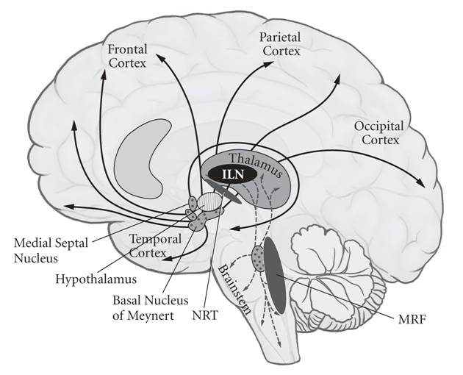
Brain, part 2 (pg 12)

Slide 2
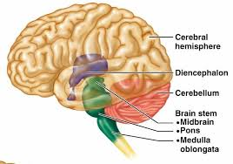
Diencephalon
In center of brain, under limbic lobe

Slide 3
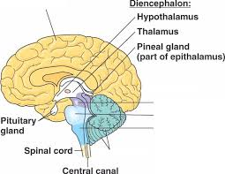
Diencephalon
In center of brain, under limbic lobe
Contains:
Thalamus: Relays sensory impulses (except smell) to the correct part of the cerebral cortex for analysis

Slide 4
Diencephalon
In center of brain, under limbic lobe
Contains:
Thalamus: Relays sensory impulses (except smell) to the correct part of the cerebral cortex for analysis
Hypothalamus: Controls autonomic nervous system, Regulates emotional responses, behavior, body temperature, food intake, water balance, thirst, sleep-wake cycles, and the endocrine system

Slide 5
Diencephalon
In center of brain, under limbic lobe
Contains:
Thalamus: Relays sensory impulses (except smell) to the correct part of the cerebral cortex for analysis
Hypothalamus: Controls autonomic nervous system, Regulates emotional responses, behavior, body temperature, food intake, water balance, thirst, sleep-wake cycles, and the endocrine system
Epithalamus: Contains pineal gland, which produces melatonin (causes sleepiness)

Slide 6
Brain Stem
Region between the diencephalon and the spinal cord

Slide 7
Brain Stem
Region between the diencephalon and the spinal cord
Contains
Midbrain: Most superior portion. Contains auditory and visual reflex centers

Slide 8
Brain Stem
Region between the diencephalon and the spinal cord
Contains
Midbrain: Most superior portion. Contains auditory and visual reflex centers
Pons: Bulging middle portion of brain stem. Forms a bridge connecting the two sides of the cerebellum and connecting the cerebrum with the spinal cord. Helps regulate breathing movements

Slide 9
Brain Stem
3. Medulla oblongata: Continuous with the spinal cord at the foramen magnum. Area where motor nerve fibers cross over, so that the right side of the brain controls the left side of the body and vice versa. Contains cardiac center (adjusts heart rate), vasomotor center (regulates blood pressure by changing the diameter of the blood vessels) and the respiratory center (regulates breathing). Also contains centers involved in coughing, sneezing, swallowing, and vomiting

Slide 10
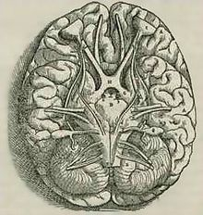
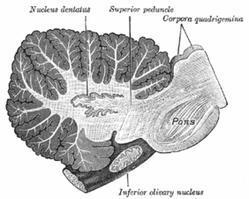
Cerebellum
Second largest portion of the brain

Slide 11
Cerebellum
Second largest portion of the brain
Located below the occipital lobe

Slide 12
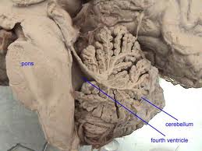
Cerebellum
Second largest portion of the brain
Located below the occipital lobe
Consists of white matter covered with a thin layer of gray matter, the cerebellar cortex. White matter forms branches called the arbor vitae

Slide 13
Cerebellum
Second largest portion of the brain
Located below the occipital lobe
Consists of white matter covered with a thin layer of gray matter, the cerebellar cortex. White matter forms branches called the arbor vitae
Controls subconscious contractions of skeletal muscles necessary for coordination, posture, and balance

Slide 14
Cerebellum
Second largest portion of the brain
Located below the occipital lobe
Consists of white matter covered with a thin layer of gray matter, the cerebellar cortex. White matter forms branches called the arbor vitae
Controls subconscious contractions of skeletal muscles necessary for coordination, posture, and balance
Coordinates skeletal muscles to produce smooth muscle movement, rather than jerky, trembling motion

