Slide 1
Construct Ch 4 Interactive Notes
Need 6 pages of binder paper
On Cover, write:
Chapter 4: Integumentary System
Your name, period, seat number
A color picture (the integumentary system includes skin, hair, and nails)

Slide 2
Notes: Skin Structure (pg 2)

Slide 3
Notes: Skin Structure (pg 2)
In an average person, skin weighs 5 kg, has a surface area of 2m², and varies in thickness from 0.5 to 4 mm

Slide 4
Notes: Skin Structure (pg 2)
In an average person, skin weighs 5 kg, has a surface area of 2m², and varies in thickness from 0.5 to 4 mm
Consists of 2 layers
Epidermis: outer layer. Stratified squamous epithelium. No blood vessels or nerves

Slide 5
Notes: Skin Structure (pg 2)
In an average person, skin weighs 5 kg, has a surface area of 2m², and varies in thickness from 0.5 to 4 mm
Consists of 2 layers
Epidermis: outer layer. Stratified squamous epithelium. No blood vessels or nerves
Dermis: inner layer. Connective tissue with collagen and elastic fibers. Numerous blood vessels and nerves. Usually thicker than the epidermis

Slide 6
Epidermal Regions
Stratum corneum: outermost region. 20 to 30 layers of flattened, dead, completely keratinized cells. Function: protection and prevention of water loss

Slide 7
Epidermal Regions
Stratum corneum: outermost region. 20 to 30 layers of flattened, dead, completely keratinized cells. Function: protection and prevention of water loss
Stratum lucidum: a few layers of cells with no nuclei. Present only in thick skin

Slide 8
Epidermal Regions
Stratum corneum: outermost region. 20 to 30 layers of flattened, dead, completely keratinized cells. Function: protection and prevention of water loss
Stratum lucidum: a few layers of cells with no nuclei. Present only in thick skin
Stratum granulosum: 2-3 layers of flattened cells. Keratinization begins in this layer

Slide 9
Epidermal Regions
Stratum corneum: outermost region. 20 to 30 layers of flattened, dead, completely keratinized cells. Function: protection and prevention of water loss
Stratum lucidum: a few layers of cells with no nuclei. Present only in thick skin
Stratum granulosum: 2-3 layers of flattened cells. Keratinization begins in this layer
Stratum spinosum: Several layers of cells with spiny projections that connect them to the other cells

Slide 10
Epidermal Regions
Stratum corneum: outermost region. 20 to 30 layers of flattened, dead, completely keratinized cells. Function: protection and prevention of water loss
Stratum lucidum: a few layers of cells with no nuclei. Present only in thick skin
Stratum granulosum: 2-3 layers of flattened cells. Keratinization begins in this layer
Statum spinosum: Several layers of cells with spiny projections that connect them to the other cells
Stratum basale: Single layer of actively dividing columnar cells. Function: Makes new skin cells. Contains melanocytes, which make the skin pigment melanin

Slide 11
Regions of the Dermis
Papillary region: contains numerous papillae, which are projections that extend into the epidermis, making the surface of the dermis “bumpy”. Papillae form fingerprints.

Slide 12
Regions of the Dermis
Papillary region: contains numerous papillae, which are projections that extend into the epidermis, making the surface of the dermis “bumpy”. Papillae form fingerprints.
Reticular region: deeper and thicker than the papillary region. Contains bundles of connective tissue fibers

Slide 13
Subcutaneous layer (hypodermis)
Layer below the skin. Contains loose connective tissue and adipose tissue. Anchors the skin, cushions, and insulates the body.

Slide 14
Skin Color
Depends on genetic and environmental factors

Slide 15
Skin Color
Depends on genetic and environmental factors
Everyone has about the same number of melanocytes, but how active they are is genetically controlled

Slide 16
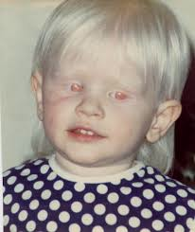
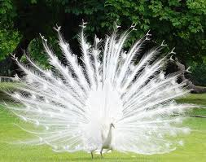
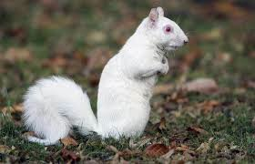
Skin Color
Depends on genetic and environmental factors
Everyone has about the same number of melanocytes, but how active they are is genetically controlled
Inability to make melanin = Albinism

Slide 17
Skin Color
Depends on genetic and environmental factors
Everyone has about the same number of melanocytes, but how active they are is genetically controlled
Inability to make melanin = Albinism
UV light increases melanocyte activity (suntan)

