Slide 1
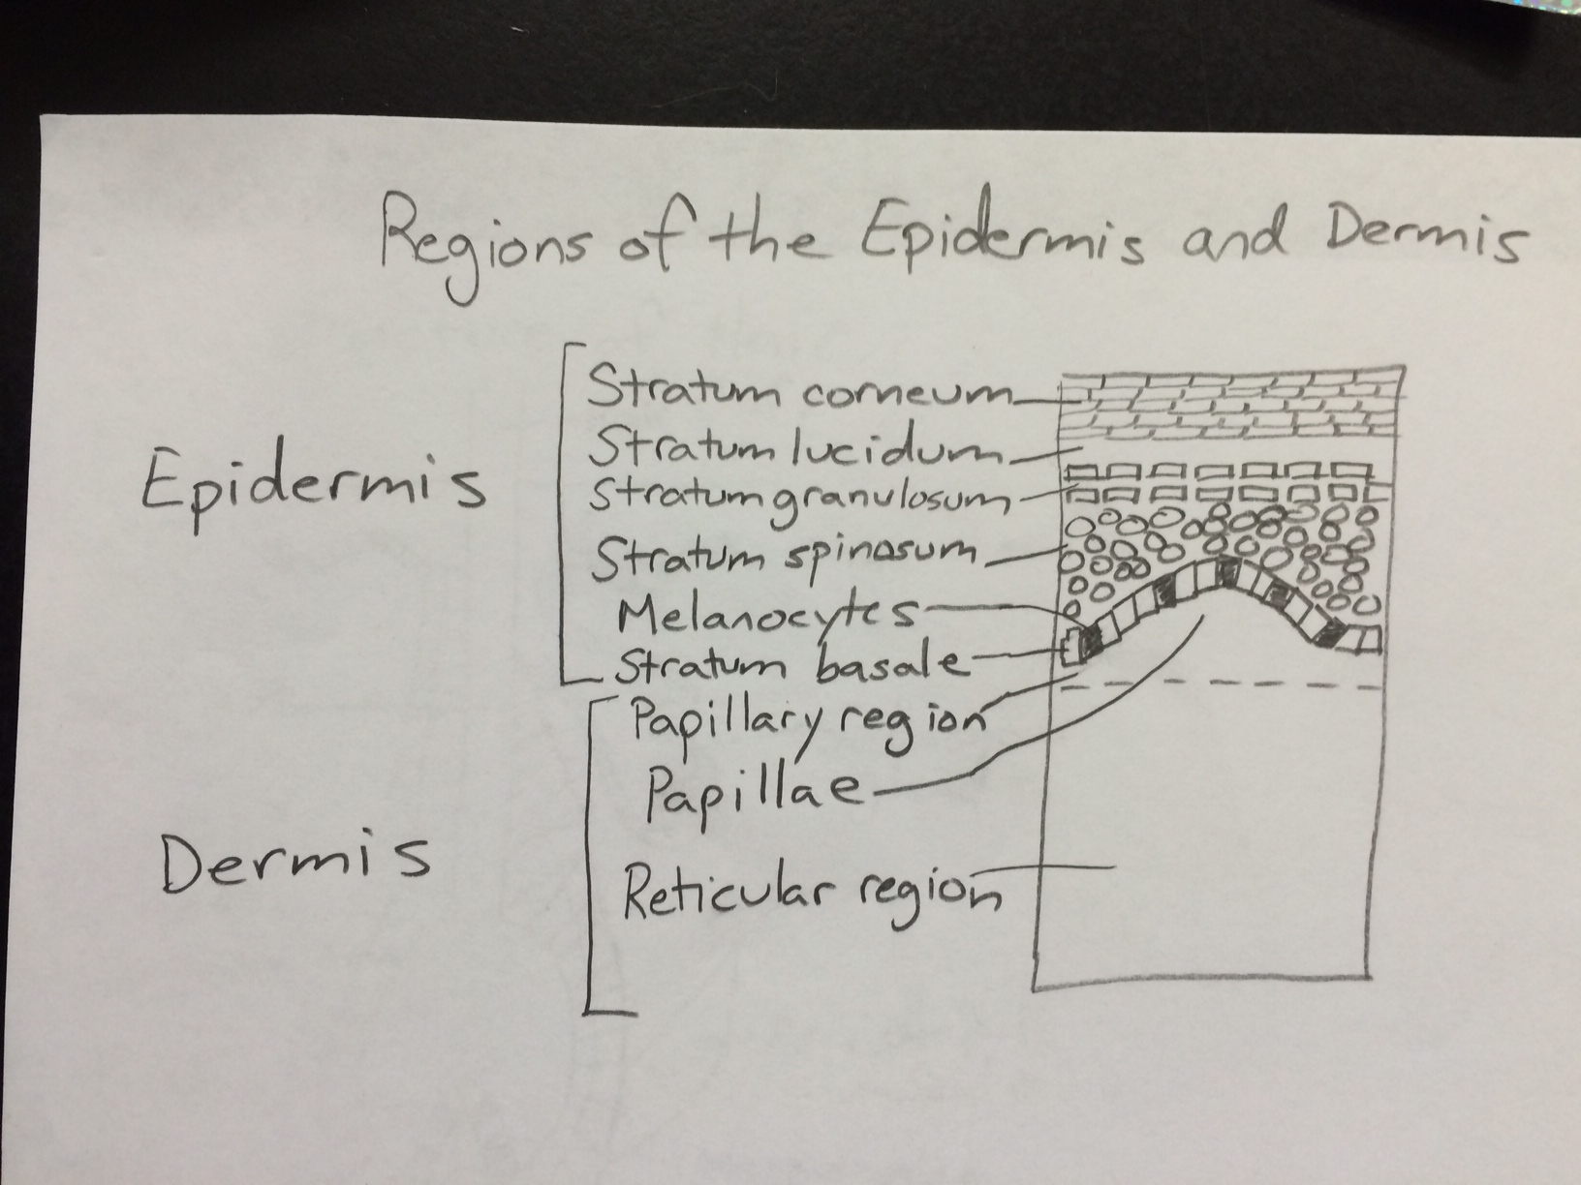
Skin Structure Drawings (pg 3)

Slide 2
