Slide 1
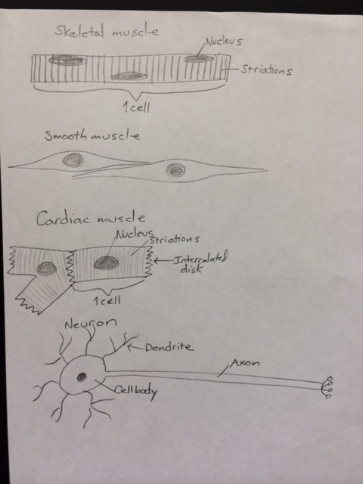
Muscle and Nervous Tissue Drawings (pg 10)

