Slide 1
Notes: Mitosis (pg 8)

Slide 2
Notes: Mitosis (pg 8)
Mitosis: a body cell divides to form two “daughter cells,” each identical to the parent cell
Necessary for body growth, repair, and maintenance
Takes place in 5 steps

Slide 3
1. Interphase
Period between cell divisions. Cell grows, metabolizes, and makes a copy of its DNA. The DNA is in long slender strands (chromatin).

Slide 4
2. Prophase
DNA condenses into chromosomes, spindle fibers form, nuclear membrane disappears

Slide 5
3. Metaphase
Chromosomes align themselves along the center of the cell

Slide 6
4. Anaphase
Spindle fibers shorten, pulling half the chromosomes toward one side of the cell and half toward the other

Slide 7
5. Telophase & Cytokinesis
New nuclear membrane forms, spindle fibers disappear, chromosomes start to uncoil. Cytokinesis = division of cell cytoplasm. Cell is pinched in half, creating two separate cells.

Slide 8
Drawings

Slide 9
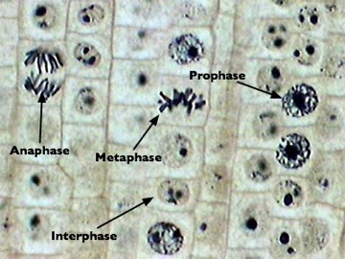

Slide 10
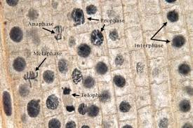

Slide 11
The Biology of Cancer

Slide 12
The Biology of Cancer
Cancer = uncontrolled cell division

Slide 13
The Biology of Cancer
Cancer = uncontrolled cell division
Normally, cells undergo mitosis only when necessary (to replace old cells, during growth, etc.)

Slide 14
The Biology of Cancer
Cancer = uncontrolled cell division
Normally, cells undergo mitosis only when necessary (to replace old cells, during growth, etc.)
In cancer, cells divide constantly, forming a large mass (tumor) that disrupts other organs

Slide 15
The Biology of Cancer
Cancer = uncontrolled cell division
Normally, cells undergo mitosis only when necessary (to replace old cells, during growth, etc.)
In cancer, cells divide constantly, forming a large mass (tumor) that disrupts other organs
Caused by mutations in “checkpoint” genes that prevent cells from dividing

