Slide 1
Welcome Back!
Have your signed course info sheet ready to hand in
Get out 7 sheets of binder paper

Slide 2
Interactive Notes

Slide 3
Interactive Notes
On the blank side of the cover write:
Chapter 1: Introduction to the Human Body
Name, period, seat #
Draw a color picture related to the chapter topic

Slide 4
Place 7 pages of notebook paper behind the cover
Staple 3 times down the side so it opens like a book

Slide 5
Number the pages
1
Back of cover First lined page

Slide 6
Number the pages
2 3

Slide 7
Write “Warm-ups” at the top of page 1
Write “homework” at the top of pages 12, 13, and 14
Write “Input” at the top of the even number pages
Write “Output” at the top of the odd number pages

Slide 8
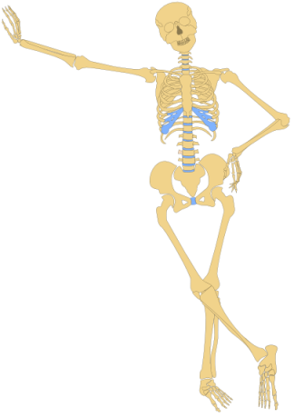
Notes: Levels of Organization (pg 2)

Slide 9
Anatomy = Structure
Physiology = Function

Slide 10
Anatomy = Structure
Physiology = Function
Example: Heart
Structure (Anatomy)=Strong muscle with 4 chambers
Function (Physiology)=Pumping blood through the body

Slide 11
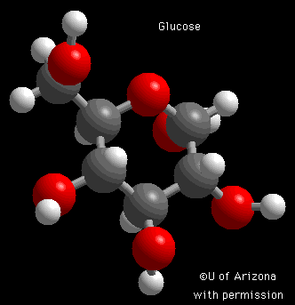
Levels of Organization
1. Chemical: Atoms, molecules, compounds

Slide 12
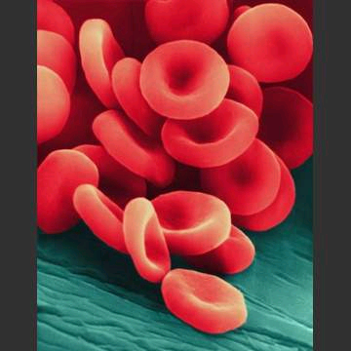
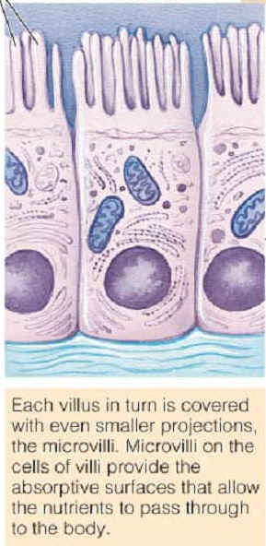
Levels of Organization
1. Chemical: Atoms, molecules, compounds
2. Cellular: Basic unit of life. Many shapes and sizes

Slide 13
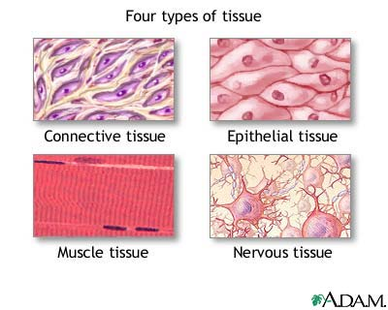
Levels of Organization
1. Chemical: Atoms, molecules, compounds
2. Cellular: Basic unit of life. Many shapes and sizes
3. Tissue: Collection of cells with the same structure and function

Slide 14
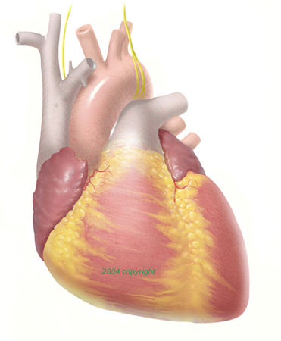
Levels of Organization
1. Chemical: Atoms, molecules, compounds
2. Cellular: Basic unit of life. Many shapes and sizes
3. Tissue: Collection of cells with similar structure and function
4. Organ: 2 or more tissue types that form a more complex structure and work together to perform one or more functions

Slide 15
Levels of Organization
1. Chemical: Atoms, molecules, compounds
2. Cellular: Basic unit of life. Many shapes and sizes
3. Tissue: Collection of cells with similar structure and function
4. Organ: 2 or more tissue types that form a more complex structure and work together to perform one or more functions
5. System: Several organs that work together to accomplish a set of functions (Example: The nervous system includes the brain, spinal cord, and nerves)

Slide 16
Levels of Organization
1. Chemical: Atoms, molecules, compounds
2. Cellular: Basic unit of life. Many shapes and sizes
3. Tissue: Collection of cells with similar structure and function
4. Organ: 2 or more tissue types that form a more complex structure and work together to perform one or more functions
5. System: Several organs that work together to accomplish a set of functions (Example: The nervous system includes the brain, spinal cord, and nerves)
6. Organism: A complete living thing

Slide 17
Output (pg 3)
Pick an organism and draw its levels of organization
Must be in color
Draw organism,system (choose either nervous, cardiovascular, or skeletal system) and organ on your own. We will do the remaining levels together.

