Slide 1
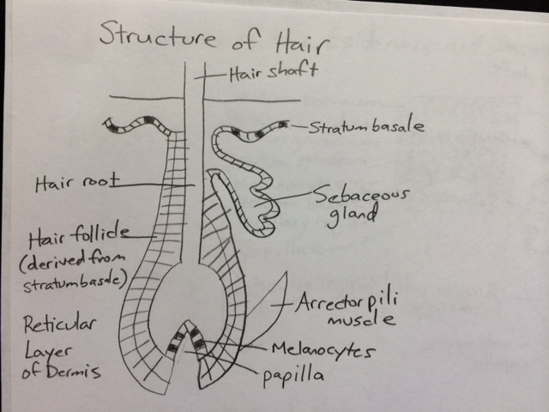
Epidermal Derivative Drawings (pg 7)

Slide 2
