Slide 1
Rebecca Kammerer
By: Rebecca Kammerer
Notes:
Hi, I’m Rebecca Kammerer and here is a little information about me.

Slide 2
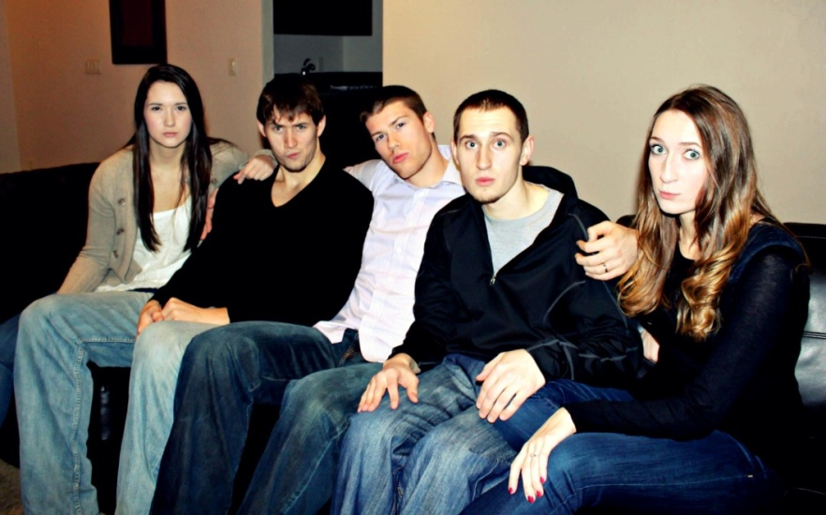
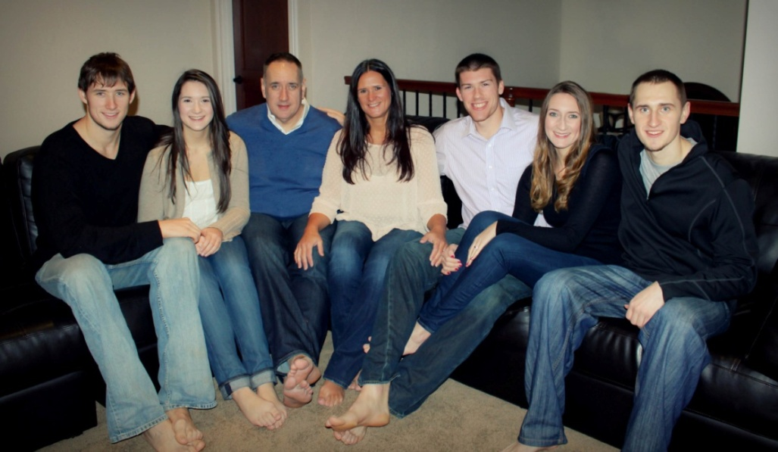
Personal Information
Birthday: November 3rd, 1997
Family:
Mom (Sherrie), Dad (David),
Joe, Jon, Kristina, and Brian.
Hobbies:
Basketball
Spending time with family
Watching movies
Notes:
I was born November 3rd, 1997.
My moms name is Sherrie and my dads is David. They have been married happily for 25 years.
My sister Kristina is 23 and got married over the summer to Brian Conklin.
My brother Joe is 22 and goes to the University of Idaho, where he plays basketball.
My brother Jon is 20 and works at Champs.
I play basketball every chance I get, I really enjoy spending time with my family and I watch movies all the time.

Slide 3
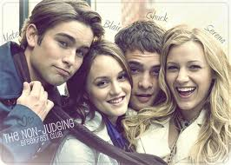
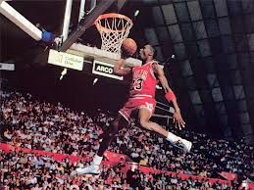
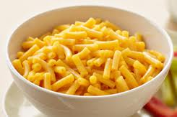
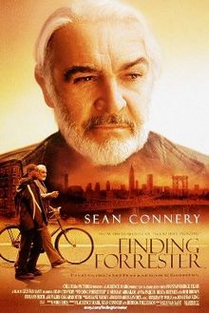
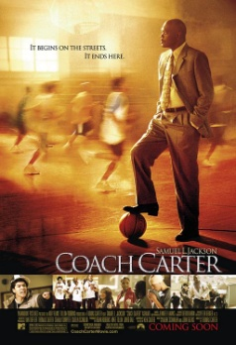
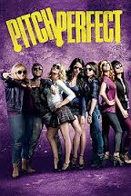
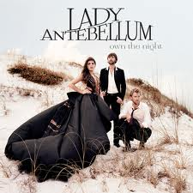
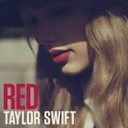
The Favorites
Restaurant: Kowloon’s
Snack: Mac & Cheese
Sport: Basketball
TV Show: Gossip Girl
Book: Hunger Games
Song: Country
Movie: Across the Universe
& Pitch Perfect
Notes:
My all time favorite restaurant is Kowloon’s.
My favorite snacks are mac & cheese and brownie.
My favorite sport is obviously basketball.
My favorite TV show is Gossip Girl, even though it’s over.
My favorite book is the Hunger Games.
My favorite song right now is Daylight by Maroon 5, but my favorite genre of music is country.
Last, but certainly not least, my favorite movies are Across the Universe, Finding Forrester, Coach Carter, and Pitch Perfect.

Slide 4
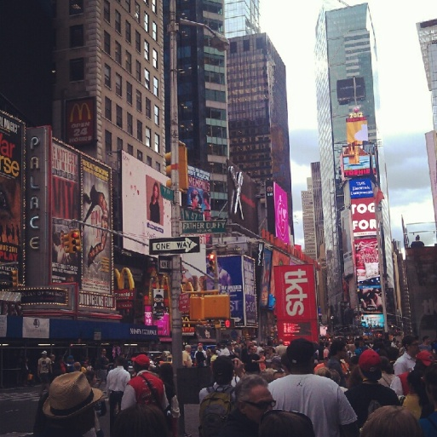
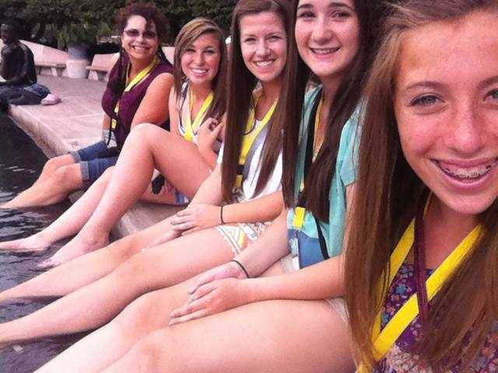
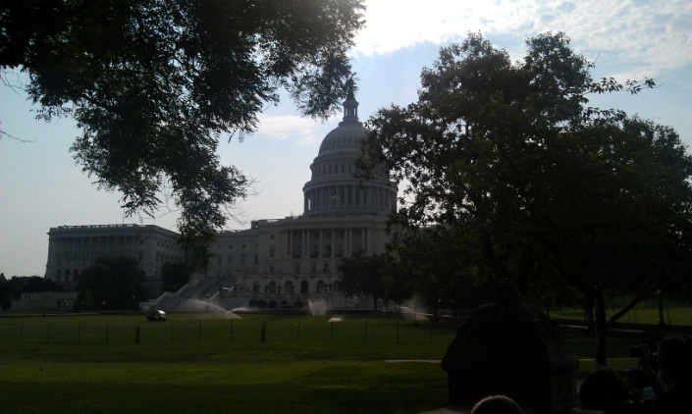
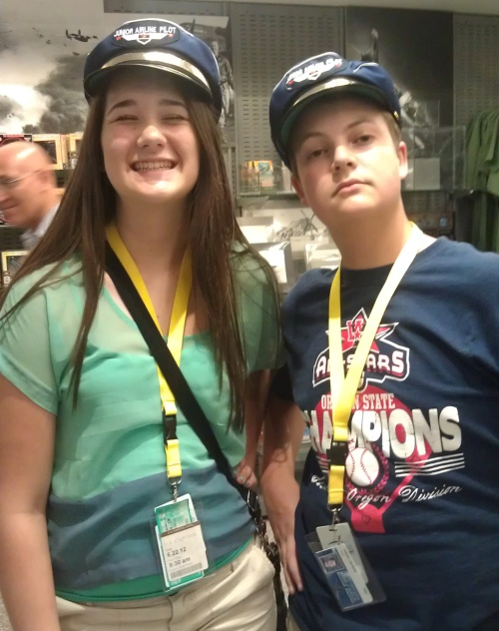
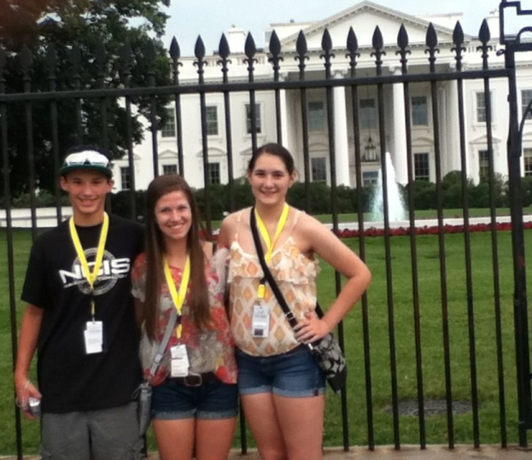
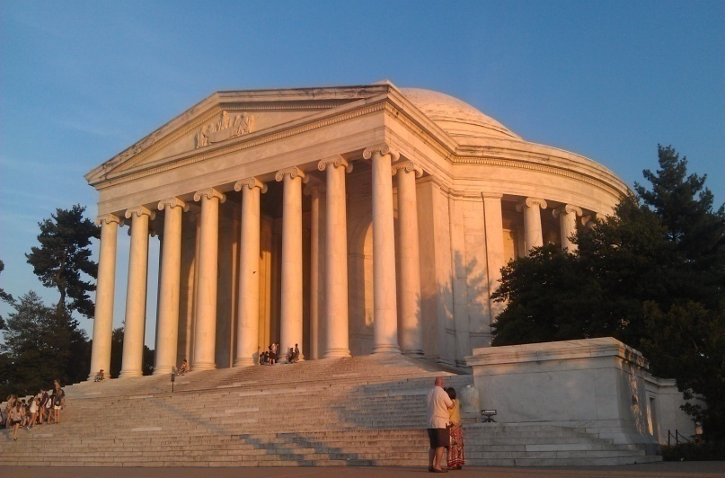
Best Vacation
DC, New York, & Philadelphia
Notes:
The most recent and most fun vacation I went on was when I went to DC, New York, and Philly this summer. It was a school trip, so I got to go with many of my good friends and do many things. We went to so many monuments that I couldn’t even keep track, but my favorite place was Times Square; the excitement and crowdedness there was so fascinating.

Slide 5
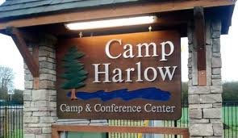
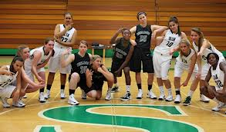
High School Goals
Maintain good grades
Enjoy my classes
Take risks
Volunteer
Join a club
Play basketball on varsity
Receive college credit
Notes:
In high school I would like to get good grades, like most people, and play varsity basketball. If I get the chance I want to join a club and volunteer, preferably at Camp Harlow. I hope to really enjoy and appreciate the experiences I get in all my classes and also get as much college credit as I can.

Slide 6
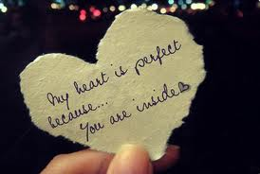
After High School Plans
Go to college
Basketball scholarship
UCLA, Stanford, or North Carolina
Get a job
Score/soundtrack movies
Be successful
Fall in love
Have a family
Notes:
Right after high school the plan is to get a basketball scholarship at a 4-year college, hopefully from UCLA, Stanford, or North Carolina.
After I get a degree I hope to get a job scoring and making soundtracks to movies.
And somewhere along the way I want to fall in love and have a family.

Slide 7
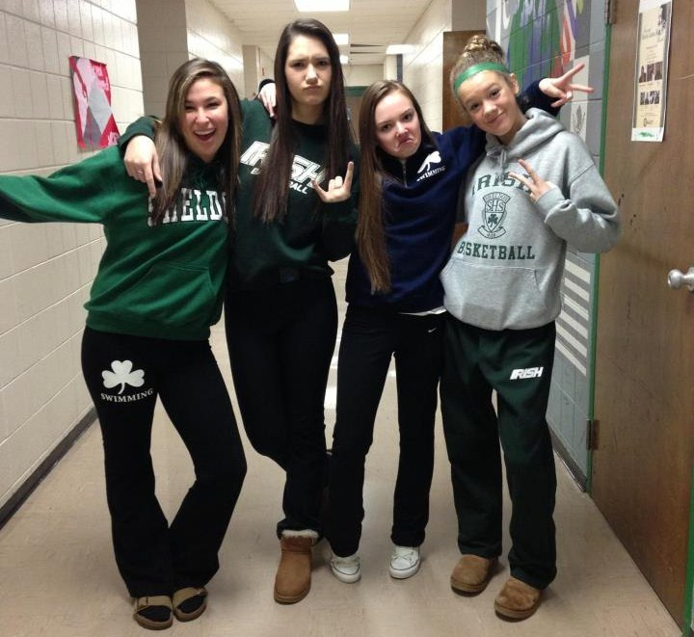
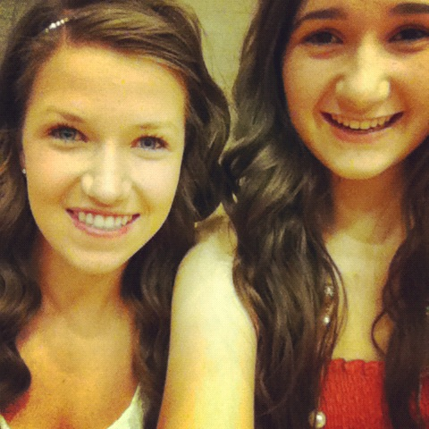
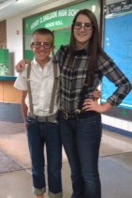
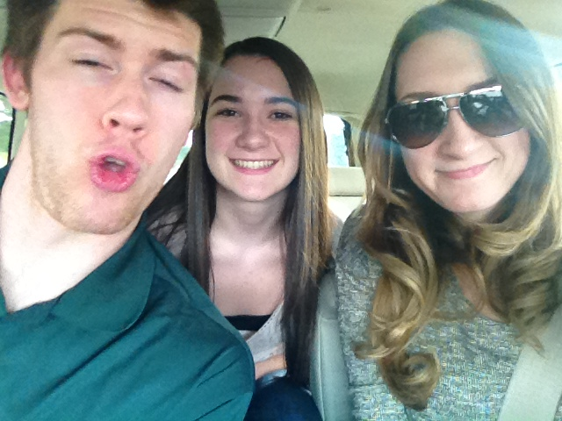
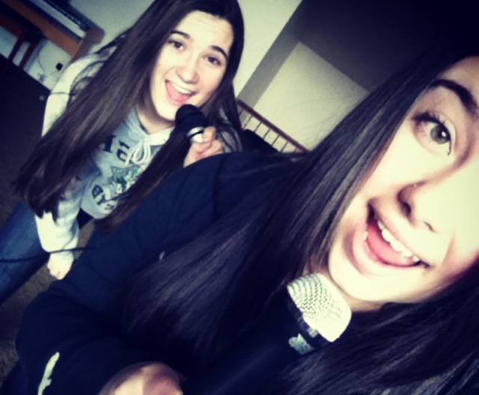
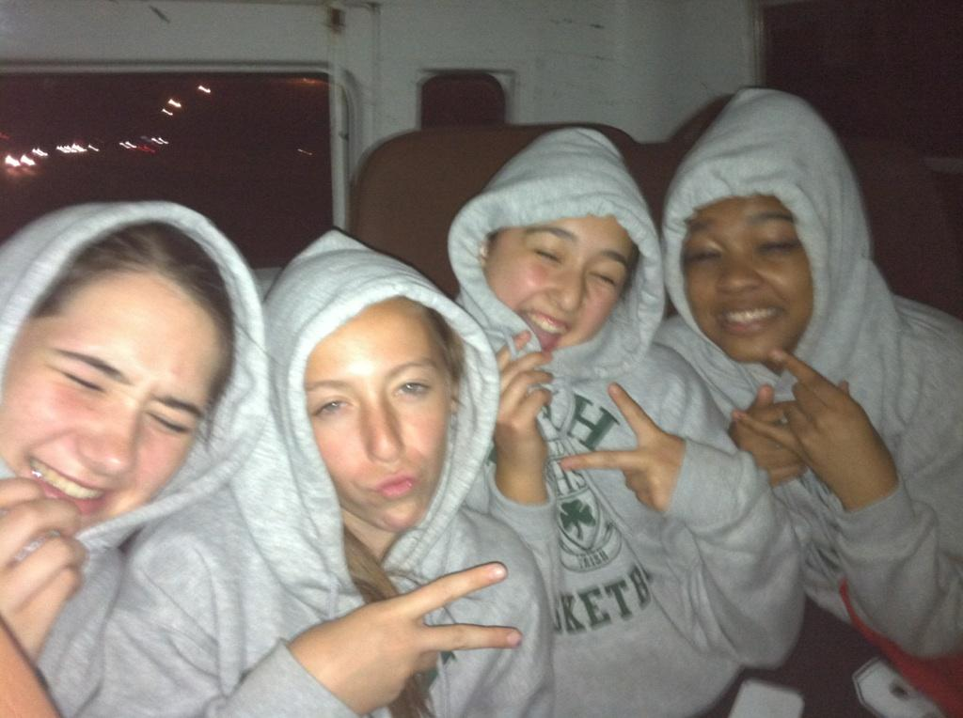
The Conclusion
Notes:
Thank you so much for watching and I hope you enjoyed learning some things about me!

