Slide 1
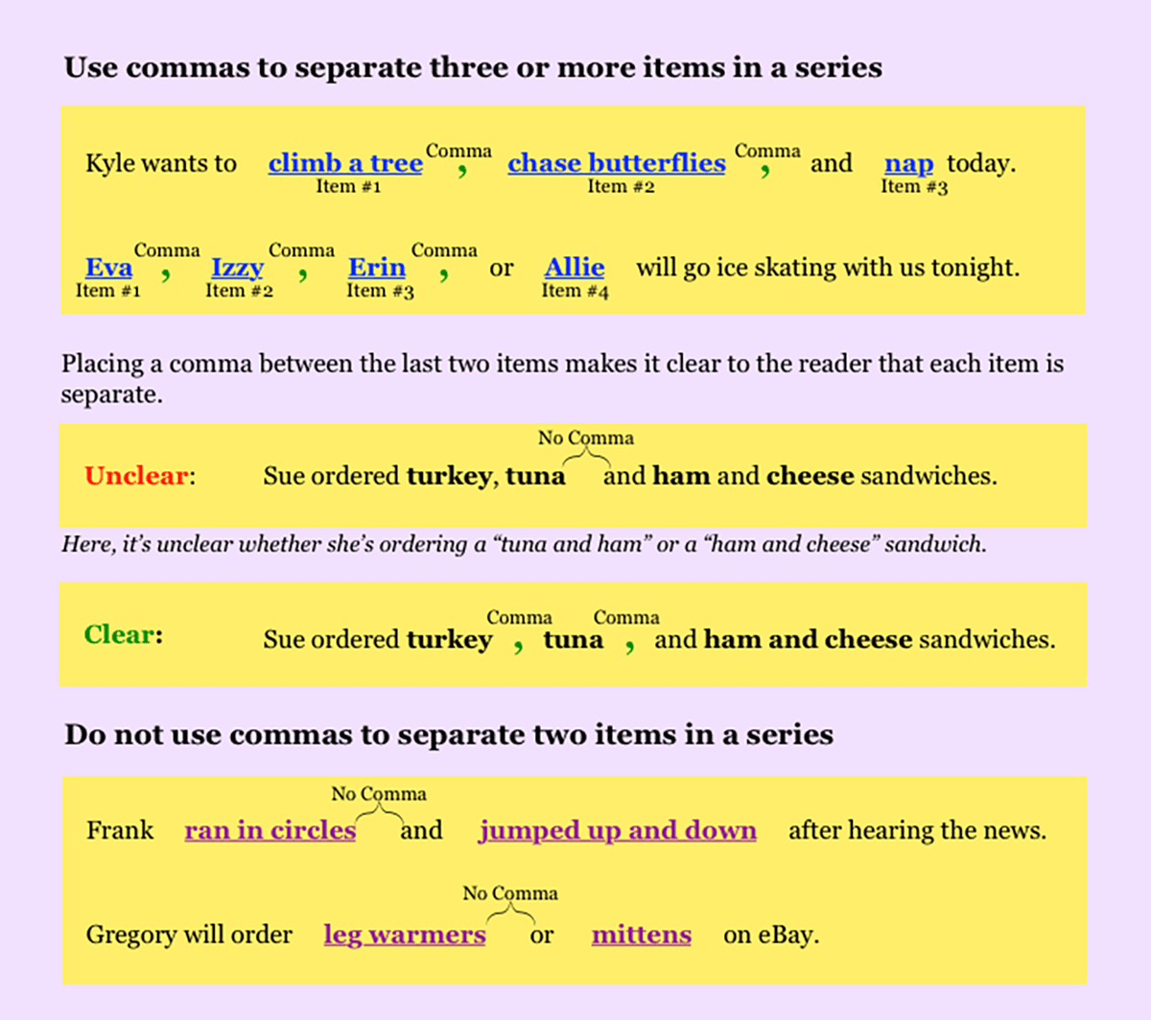

Slide 3
Add or remove commas if necessary
Either Adele’s guinea pig ferret or hamster ate her math homework last night.
Either Adele’s guinea pig, ferret, or hamster ate her math homework last night.
Mrs. Prince, and her gerbil often go on long walks.
Mrs. Prince_ and her gerbil often go on long walks.
On hot days, Austen likes to sip lemonade, and lounge by the swimming pool.
On hot days, Austen likes to sip lemonade_ and lounge by the swimming pool.

Slide 4
Add or remove commas if necessary
Alexander Hughes PhD taught Ruth Bader Ginsberg about underwater volcanoes.
Alexander Hughes, PhD, taught Ruth Bader Ginsberg about underwater volcanoes.
The crocodiles snakes and lizards at President Snow’s petting zoo are all friendly.
The crocodiles, snakes, and lizards at President Snow’s petting zoo are all friendly.
As Audrey watched a music video being filmed at 55 Johnson Avenue Miami Florida, 33152, she started to dance.
As Audrey watched a music video being filmed at 55 Johnson Avenue, Miami, Florida_ 33152, she started to dance.

