Slide 1
Things Fall Apart
By Chinua Achebe

Slide 2
Who is Chinua Achebe?
Raised by his parents in the Igbo town of Ogidi in southeastern Nigeria, Achebe excelled at school and won a scholarship to study medicine, but changed his studies to English literature at University College (now the University of Ibadan). He became fascinated with world religions and traditional African cultures, and began writing stories as a university student.

Slide 3
Why write Things Fall Apart?
At the time Things Fall Apart was first published in 1958, Nigeria was still technically under British rule, albeit transitioning to a state of independence. Achebe thus grew up under the shadow of colonialist ideology, in particular, its representations of Africa as a savage and unknowable Other to Europe's purportedly rational and civilized society. Achebe wrote Things Fall Apart to inform the masses of his people’s side of the story.
Chinua Achebe wrote Things Fall Apart in English because he wanted to achieve cultural revitalization through English. He wanted to capture both the english and the african side of the story in Africa. This is why he wrote the book in English.

Slide 4
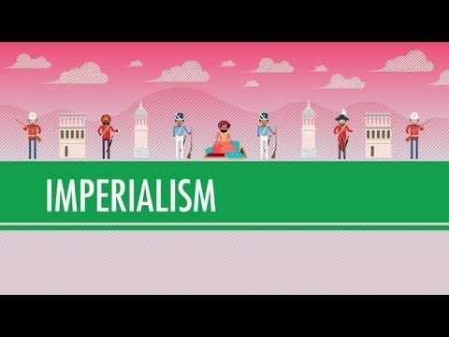
What is Colonialism?

Slide 5
The main character: Okonkwo
What is he known for?
Who is his father?
How does Okonkwo view his father?
Who is Okonkwo thus far?

Slide 6
Read Chp. 3

