Slide 1
Ch 11-3 & 11-4: -Beyond Simple Dominance -Meiosis
Essential Questions:
What are some inheritance patterns different from simple dominance?
What happens during the process of meiosis?
What are the differences between meiosis & mitosis?

Slide 2
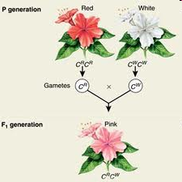
Beyond Dominant and Recessive Alleles
Incomplete Dominance

Slide 3
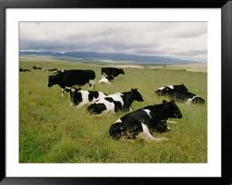
Codominance

Slide 4
Multiple Alleles

Slide 5
Polygenic Traits

Slide 6
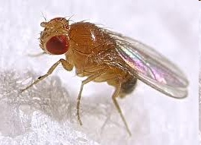
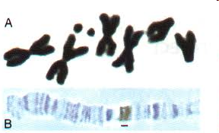
Meiosis
Chromosome number
Homologous: corresponding to other parent’s genes
Ex: fruit fly: 8 chromosomes
4 from Mom, 4 from Dad
Diploid = “2 sets” (2N)
Fruit fly: 2N = 8
Gametes are haploid (“one set”)
Fruit fly: N = 4

Slide 7
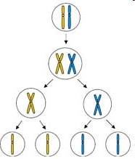
Phases of meiosis
Meiosis I separating homologous chromos.
Crossing over
Meiosis II – sister chromatids
gametes
Dipolid, duplicated chromos.
Meiosis I
Haploid, duplicated chromos.
Meiosis II
Haploid, single copies

Slide 8
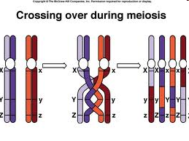

Slide 9
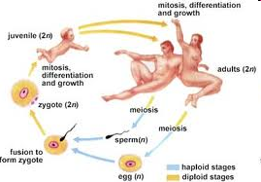
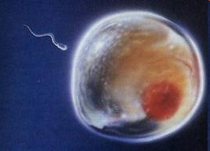
Comparing Mitosis & Meiosis
Mitosis: 2 genetically identical diploid cells
Meiosis: 4 genetically different haploid cells

