Slide 1
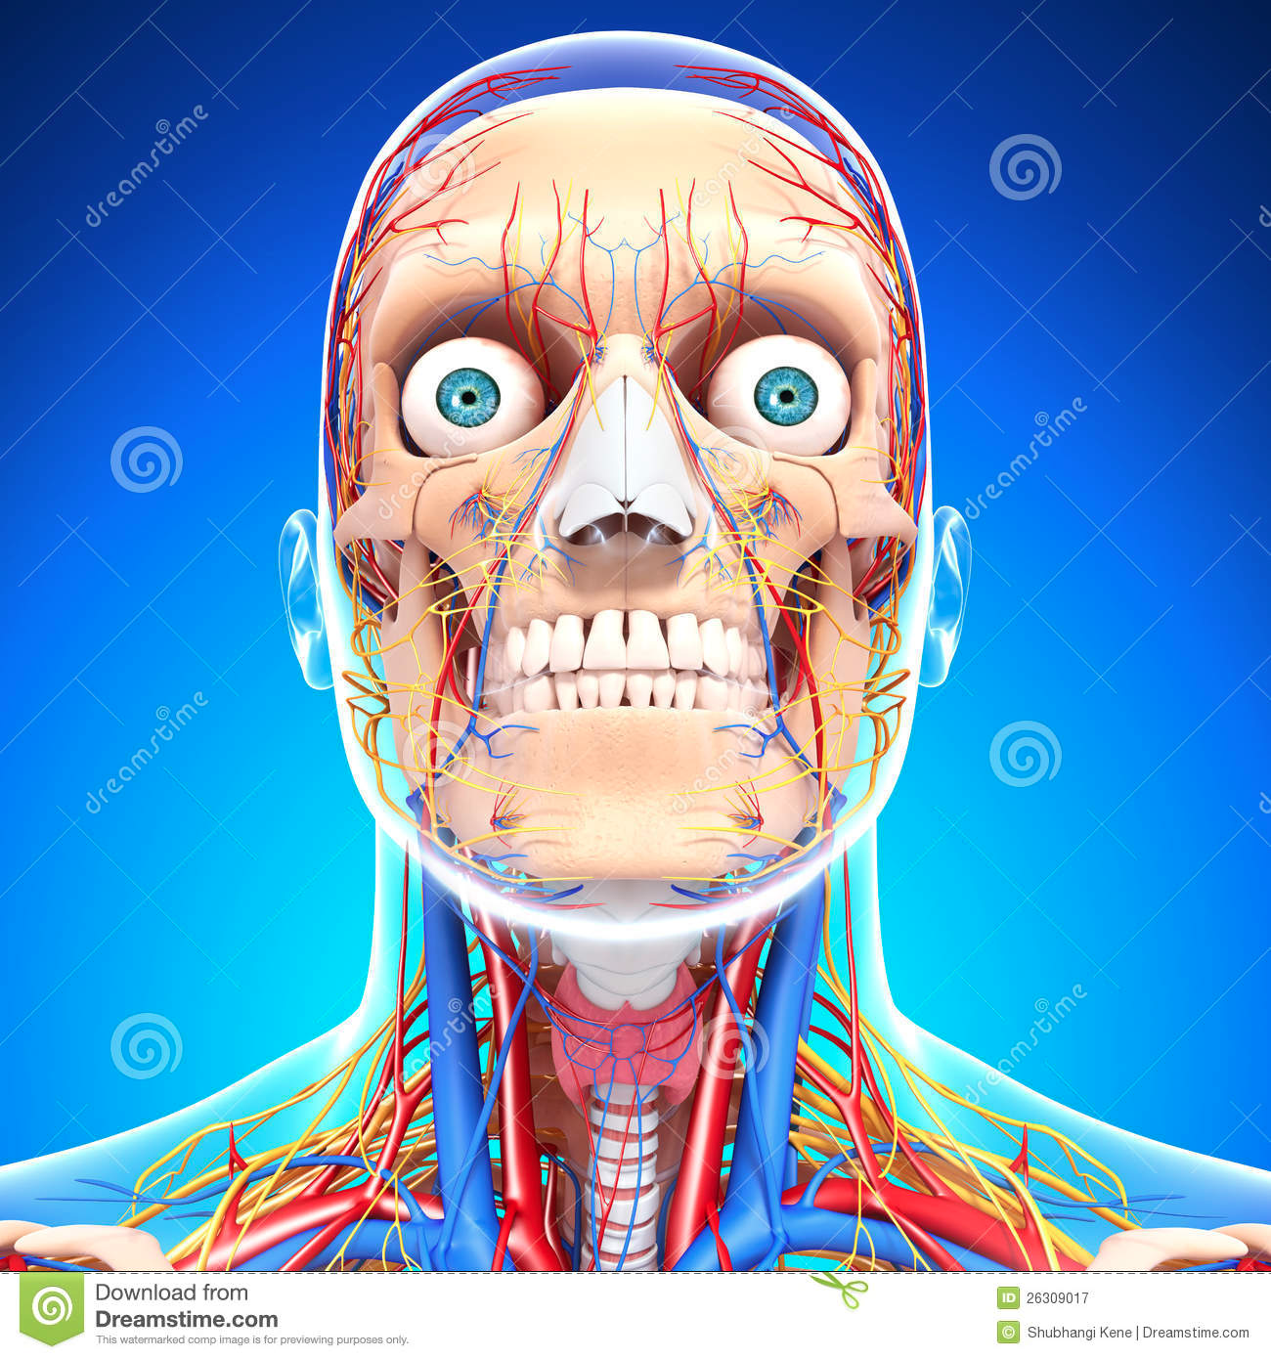
Chapter 35-3: Divisions of the Nervous System
Essential Questions:
What are the functions of the Central Nervous System?
What are the divisions of the Peripheral Nervous System?

Slide 2
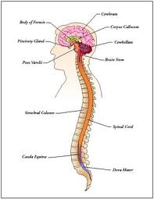
Central Nervous System (CNS)
Function
Brain and spinal cord
Meninges
Cerebrospinal fluid

Slide 3
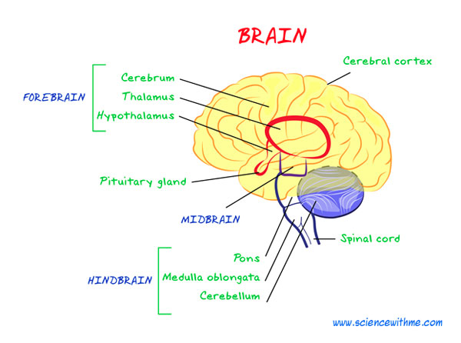
Brain
Cerebrum
Cerebellum
Thalamus
Hypothalamus

Slide 4
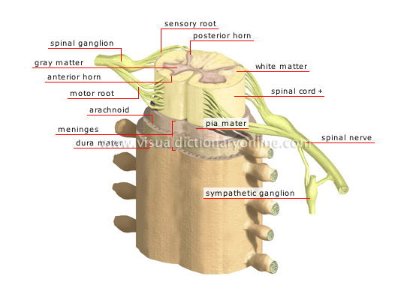
Spinal cord
Link between brain and body
Reflex

Slide 5
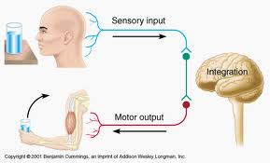
Peripheral nervous system
Sensory division
Motor division
Somatic division
Autonomic division
Sympathetic division
Parasympathetic division

