Slide 1
Scientific Measurement: Precision, Accuracy & Resolution
Essential Questions:
What is a measurement?
How is precision related to accuracy?
What is resolution?

Slide 2
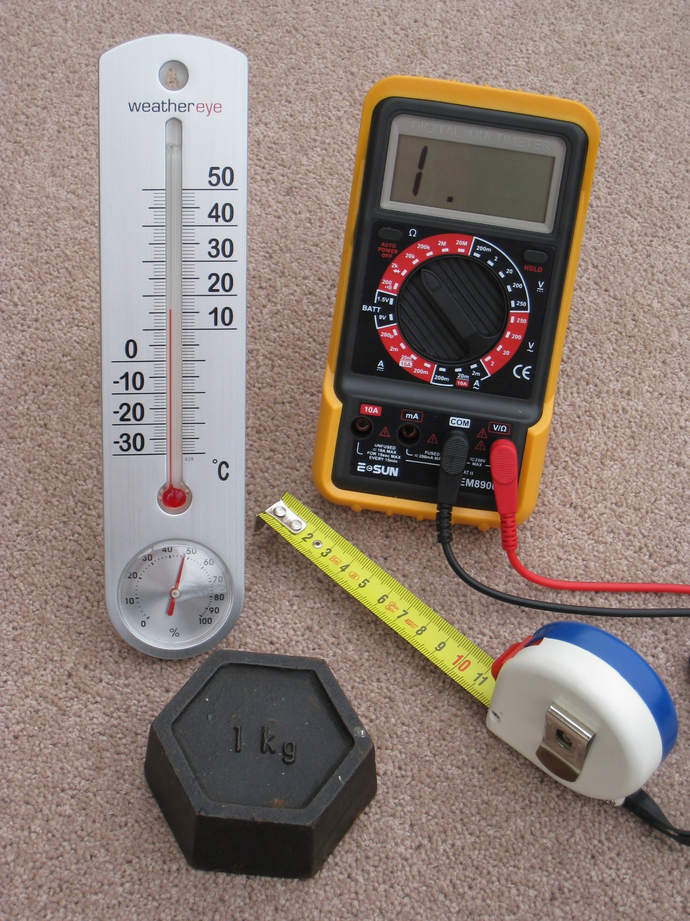
Measurement:
quantity observed
Has number & unit

Slide 3
Precision: how close together repeated measurements are

Slide 4
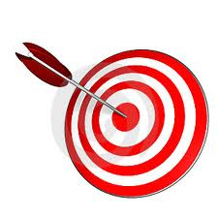
Accuracy: how close a measurement is to an accepted or true value

Slide 5
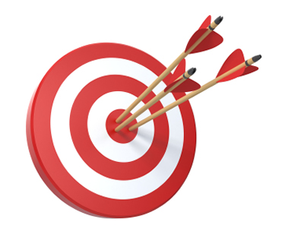
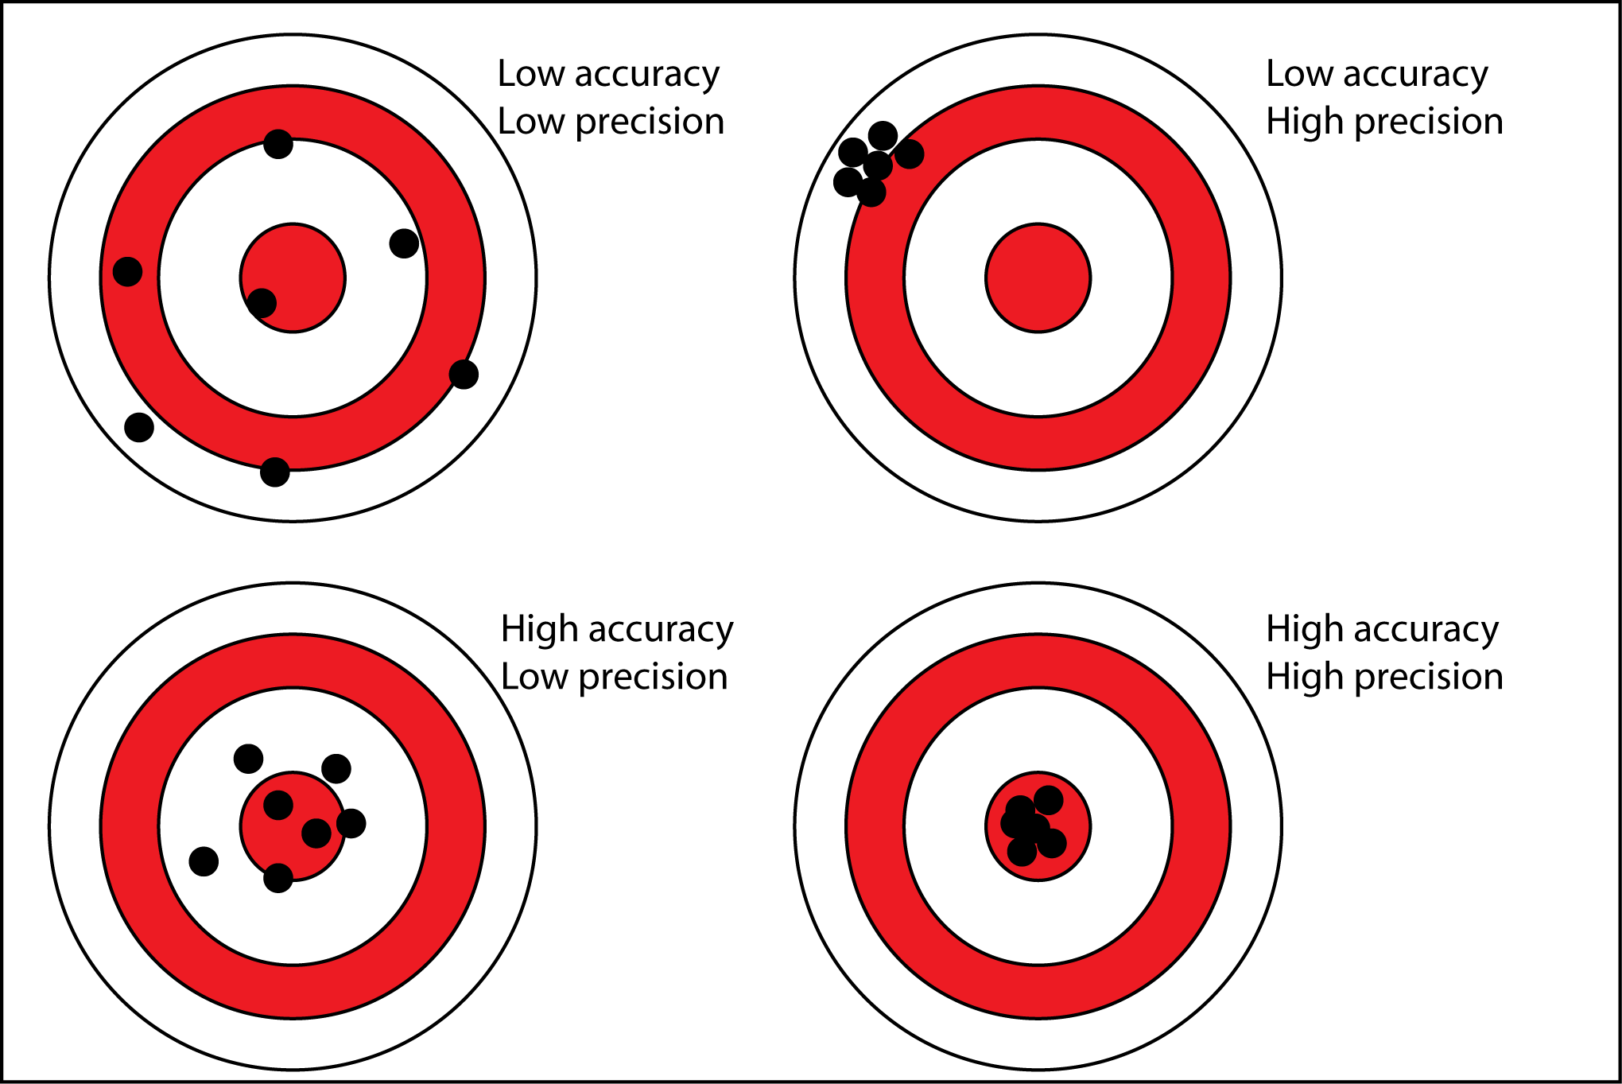
Goal: measurements are both precise and accurate

Slide 6
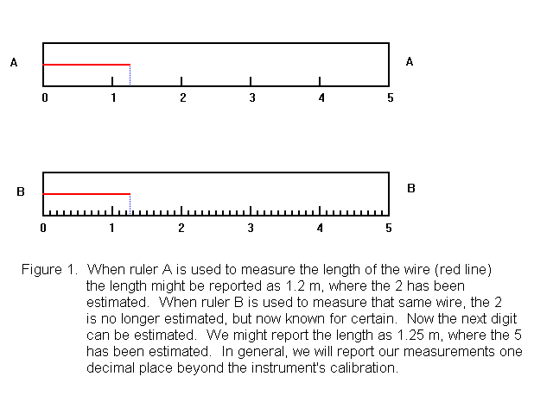
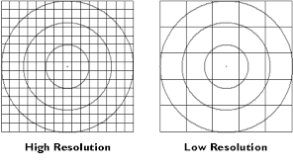
Resolution: smallest interval that can be measured

