Slide 1
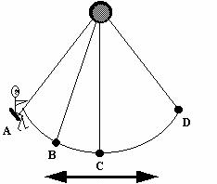
Harmonic Motion and Oscillations
Motion that repeats in cycles.
A cycle is one complete oscillation or one unit of harmonic motion

Slide 2
Wave
Traveling oscillation that transfers energy through matter or space.

Slide 3
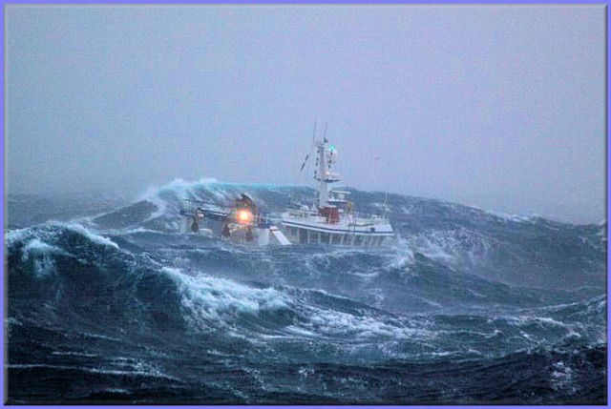
Waves carry energy without transporting matter from place to place.

Slide 4
Two types of waves
1. Transverse wave
Ex. Water, light, x-ray, microwaves
Matter is disturbed perpendicular to the wave direction.
Notes:
Wave demonstration – ask – is wave carrying matter? (No) What is it carrying? (Energy)

Slide 5
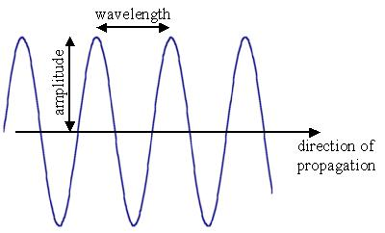
Wave demonstration
Crest
Trough
Notes:
Wave demonstration – ask – is wave carrying matter? (No) What is it carrying? (Energy)

Slide 6
2. Longitudinal wave
Ex. Sound
matter is disturbed parallel to the wave direction
Notes:
Wave demonstration – ask – is wave carrying matter? (No) What is it carrying? (Energy)
Ping pong ball analogy.

Slide 7
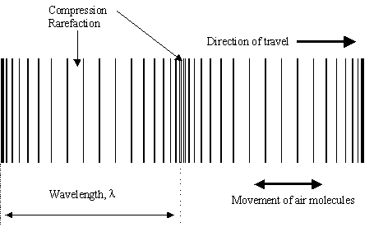
Wave demonstration
compression
Notes:
Wave demonstration – ask – is wave carrying matter? (No) What is it carrying? (Energy)
Ping pong ball analogy.

