Slide 1
Chapter 13-2 & 13-3: Manipulating DNA & Cell Transformation
Essential Questions:
How do scientists make changes to DNA?
What happens during cell transformation?

Slide 2
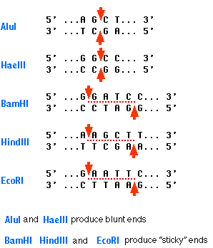
Manipulating DNA
Genetic Engineering: making changes in DNA code of organism
DNA extraction
Open cells, separate DNA
Cutting DNA
Restriction enzymes: cuts DNA
at a specific sequence

Slide 3
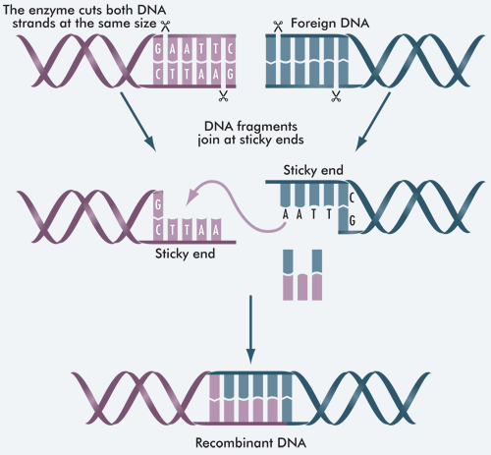

Slide 4
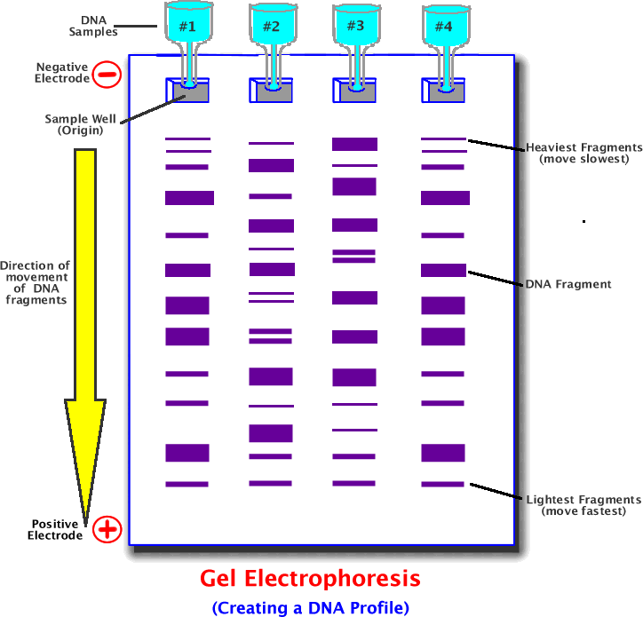
Separating DNA
Gel electrophoresis:
Neg. charged DNA moves toward pos. end of gel
Shorter frags. move faster (farther) than longer frags
Can be used to
compare genomes

Slide 5
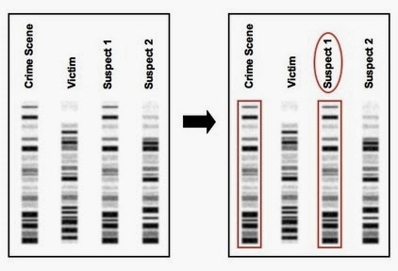

Slide 6
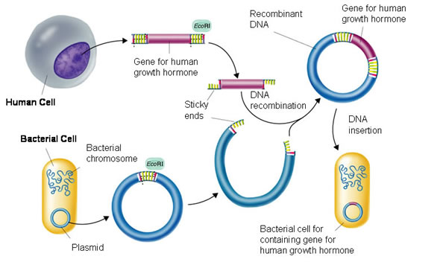
Cell Transformation
Recombinant DNA
Contains DNA from different sources
Transforming bacteria: plasmids

Slide 7
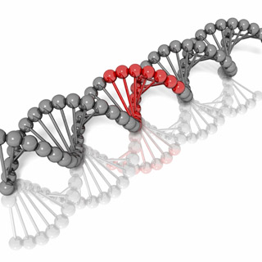
Bacteria w/ recombinant DNA can infect plant and animal cells
This DNA is integrated into one of the chromosomes of the cell
Gene replacement therapy
Replace faulty genes with healthy genes to cure disease

