Slide 1
Ch 13-1, 13-4 & 14-1: Changing the Living World, Genetic Engineering, Human Molecular Genetics
Essential Questions:
What is the purpose of selective breeding?
Why do breeders induce mutations?
How are transgenic organisms useful to humans?
What is gene therapy?

Slide 2
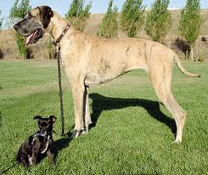
Ch 13-1: Changing the Living World
Selective breeding: allowing only orgs. with desired traits to reproduce

Slide 3
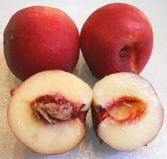
Selective Breeding, cont.
Hybridization: crossing indivs. with different traits to bring both traits together in 1 org.

Slide 4
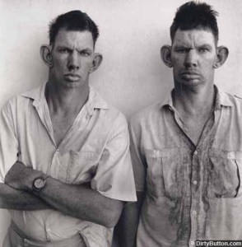
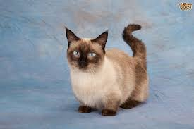
Selective Breeding, cont.
Inbreeding: continued breeding of individuals with similar characteristics

Slide 5
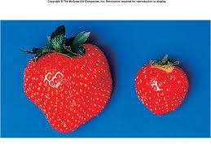
Increasing variation: to add to the natural variation in nature so there are more traits to choose
Inducing mutations with chemicals or radiation

Slide 6
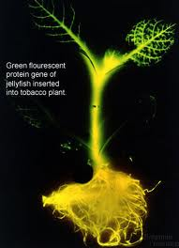
Ch 13-4: Transgenic Organisms
Genetic Engineering: making changes to DNA of living orgs.
Transgenic organisms: contain genes from other orgs.

Slide 7
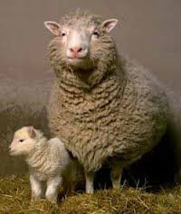
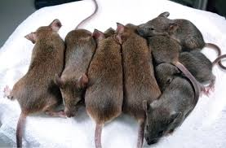
Cloning
Clone: member of a pop. of genetically identical cells produced from a single cell

Slide 8
Ch 14-3: Human molecular genetics
DNA Fingerprinting
Uses sections of DNA that have no known function but vary greatly between indivs.
Human Genome Project: sequenced all human DNA

Slide 9
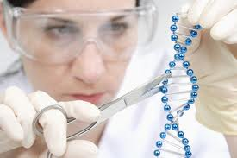
Gene Therapy: absent/faulty gene replaced with normal, working gene

