Slide 1
Chromosomal Inheritance: Introduction
Essential Questions:
What is the Principle of Dominance?
What happens during segregation?
How do geneticists use probability?

Slide 2
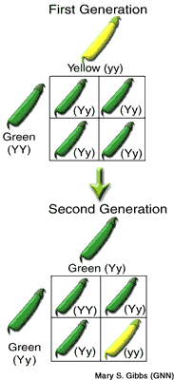
Genes and dominance
Gregor Mendel’s Peas
Trait = specific characteristic
Hybrids = cross between parents w/ different traits
Was result a blend of parent traits?
No!

Slide 3
2 conclusions:
Some “factor” passes traits from 1 generation to next
Now called “genes”
Different forms of a gene are “alleles”
Principle of Dominance: some alleles dominant, some recessive
If dominant allele present, always expressed
Recessive allele only expressed in absence of dom. allele

Slide 4
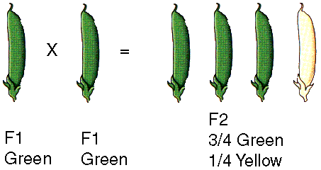
Segregation
Recessive traits disappeared in F₁ offspring – did recessive alleles disappear?
The F₁ cross
Cross 2 green plants
Recessive traits reappear (25%) in F₂ generation

Slide 5
Explaining the F₁ cross
Assume dominant alleles mask recessive alleles
Segregation = separation of alleles
Gametes = sex cells
When gametes formed, each carries only 1 copy of each gene
F₁ plants produce 2 types of gametes

Slide 6
Genetics & probability
Inheritance of alleles is a random event
Probability can be used to predict outcomes of genetic crosses
Probabilities predict averages, NOT actual outcomes

Slide 7
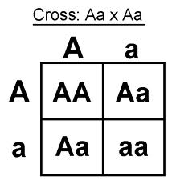
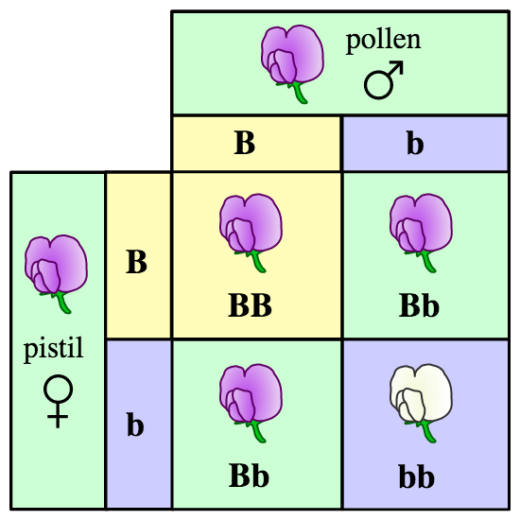
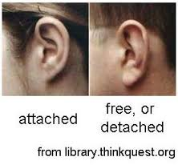
Genotype = what genes are in cells of organism
Phenotype = what traits are expressed in organism

Slide 8
“true breeding” = homozygous (2 identical alleles in genotype)
“hybrid” = heterozygous (2 different alleles in genotype)

