Slide 1
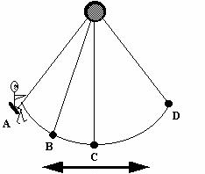
Harmonic Motion and Oscillations
Motion that repeats in cycles.
A cycle is one complete oscillation or one unit of harmonic motion

Slide 2
Wave
Traveling oscillation that transfers energy through matter or space.

Slide 3
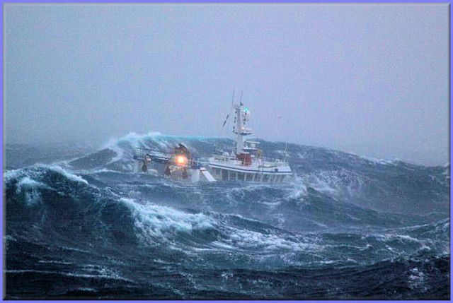
Waves carry energy without transporting matter from place to place.

Slide 4
Two types of waves
1. Transverse wave
Ex. Water, light, x-ray, microwaves
Matter is disturbed perpendicular to the wave direction.
Notes:
Wave demonstration – ask – is wave carrying matter? (No) What is it carrying? (Energy)

Slide 5
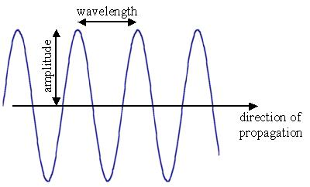
Wave demonstration
Crest
Trough
Notes:
Wave demonstration – ask – is wave carrying matter? (No) What is it carrying? (Energy)

Slide 6
2. Longitudinal wave
Ex. Sound
matter is disturbed parallel to the wave direction
Notes:
Wave demonstration – ask – is wave carrying matter? (No) What is it carrying? (Energy)
Ping pong ball analogy.

Slide 7
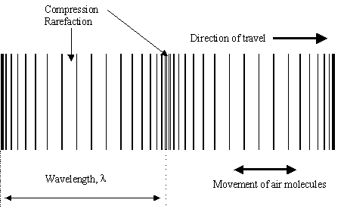
Wave demonstration
compression
Notes:
Wave demonstration – ask – is wave carrying matter? (No) What is it carrying? (Energy)
Ping pong ball analogy.

Slide 8
Frequency:
number of waves passing a given point each second
unit is Hertz (1 Hz = 1 wave/second)
Period:
length of time it takes for 1 complete wave to happen.

Slide 9
Freq: = 10,000 Hz,
Period = 1/10,000 sec.
Period = 2 sec.,
Freq. = ½ Hz.

Slide 10
Frequency = 10 Hz because ten waves pass by each second.
Period = 1/10 second because it takes 1/10th of a second for a complete wave to pass.

Slide 11
What is the frequency?
5 Hz
What is the period?
1/5 second

