Slide 1
Wave Speed, Wavelength & Frequency

Slide 2
What is the formula for wave Speed?
v = f x λ
Frequency?
f = v/ λ
Wavelength?
λ = v/f
__v__
f x λ

Slide 3
If the frequency of a wave is 10 Hz and the wavelength is 0.5 m, what is the wave speed?
v = fλ
v = (10 Hz)(0.5 m) = 5 m/s

Slide 4
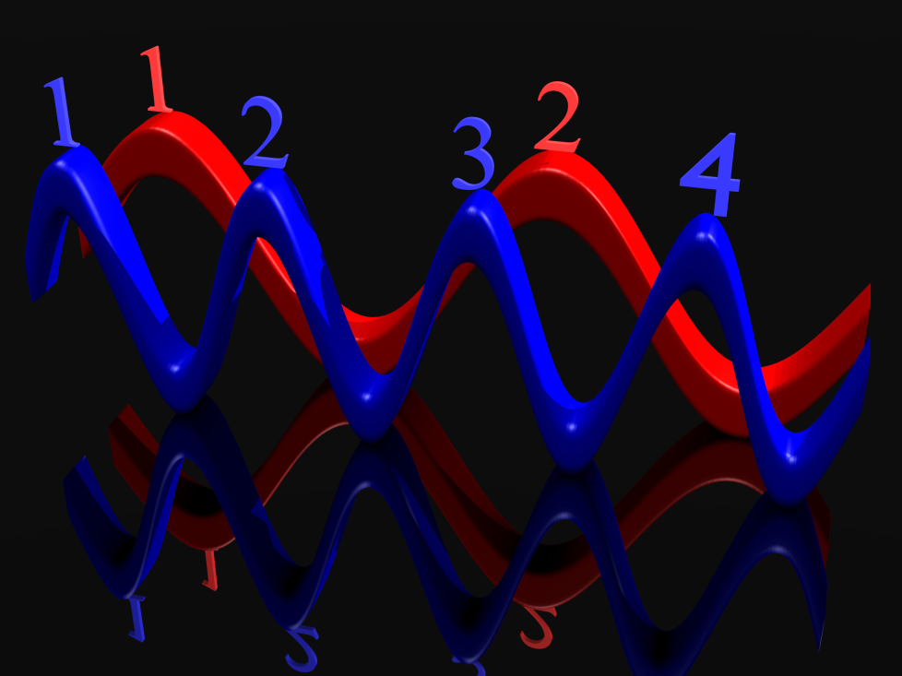
If the speed of a wave is 4 m/s and the wavelength is 2 m. What is the frequency of the wave?
f = v/λ
f = 4m/s / 2m = 2 Hz

Slide 5
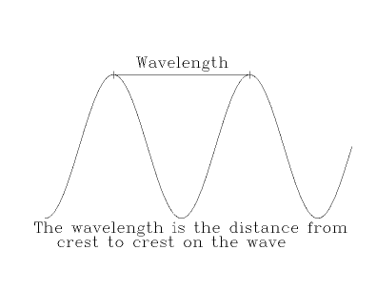
If a wave is going 50 m/s and the frequency is 10 Hz, what is the wavelength?
λ = v/f
λ = 50 m/s / 10 Hz = 5 m

Slide 6
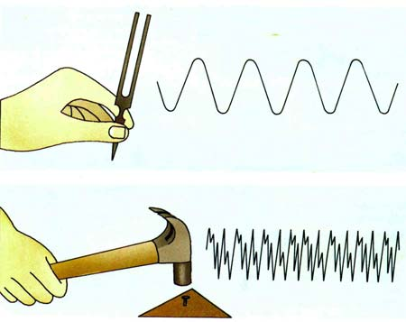
If the frequency is 8 Hz and the wavelength is 2 m how fast is the wave going?
v = fλ
v= (8Hz)(2m) = 16 m/s

Slide 7
A wave has a frequency of 13 Hz.
What is the period of the wave?
1/13 s
How many waves go by each second?
13

Slide 8
A wave generator produces 30. pulses per second. The speed of the wave is 4.0m/s.
What is the period of the wave?
1/30 sec.
What is the frequency of the wave?
30 Hz.
What is the wavelength?
Wavelength = v/f
Wavelength = 4/30
0.13 m/s

