Slide 1
Remember that the Genetics and Pedigree Test is this Thursday. Your Chapter 11 Packet is due Thursday.
Homework
Read section 12.1 and answer questions 1-11 in the Chapter 12 Reading packet for tomorrow

Slide 2
Hemophilia – Sex-linked recessive disease. Pedigree practice
What is the phenotype?
Male with hemophilia
What is the genotype?
X^{n}Y

Slide 3
Hemophilia – Sex-linked recessive disease. Pedigree practice
What is the phenotype?
Normal male
What is the genotype?
X^{N}Y

Slide 4
Hemophilia – Sex-linked recessive disease. Pedigree practice
What is the phenotype?
female with hemophilia
What is the genotype?
X^{n} X^{n}

Slide 5
Hemophilia – Sex-linked recessive disease. Pedigree practice
What is the phenotype?
Normal female
List all the possible genotypes.
X^{N} X^{n}
X^{N} X^{N}
If you aren’t sure, put X^{N} X?

Slide 6
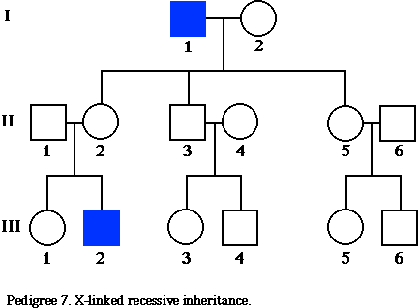
What is the genotype of the circled individuals?

Slide 7
What is the genotype of the circled individuals?
X^{n}Y
X^{n}Y
X^{n}Y

Slide 8
What is the genotype of the circled individuals?

Slide 9
What is the genotype of the circled individuals?
X^{N}Y
X^{n}Y
X^{N}Y
X^{N}Y
X^{N}Y
X^{N}Y
X^{N}Y
X^{n}Y

Slide 10
Which females can you be absolutely sure of their genotypes?
X^{N}X^{n}
X^{n}Y
X^{N}Y
X^{N}Y
X^{N}Y
X^{N}Y
X^{N}Y
X^{n}Y

Slide 11
What do you have to put for the genotype for all the other females?
X^{N}X?
X^{n}Y
X^{N}X?
X^{N}Y
X^{N}Y
X^{N}X?
X^{N}Y
X^{N}X^{n}
X^{N}X^{n}
X^{N}X?
X^{N}X?
X^{N}Y
X^{N}Y
X^{N}X?
X^{n}Y

Slide 12
Hemophilia – Sex-linked recessive disease. Summary
= X^{n}Y
= X^{n}X^{n}
= X^{N}Y
⁼ X^{N}X^{N} Or X^{N}X^{n} Or X^{N}X?
1.
2.
3.
4.

