Slide 1

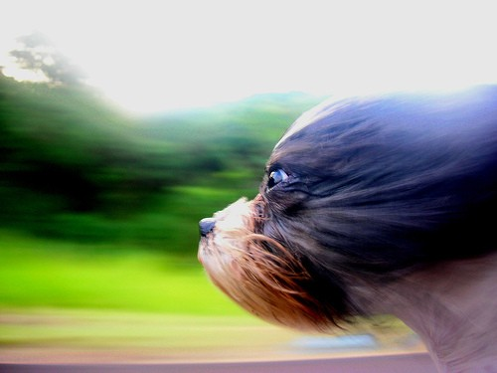
Acceleration Section4.3
Rate of change in velocity
If velocity changes, then acceleration occurs. That means if speed and/or direction change, acceleration occurs.
Positive acceleration = speeding up
Negative acceleration = slowing down

Slide 2
Acceleration = change in velocity / time
A = V _{finish} – V _{start} / T
Calculate the acceleration of a runner who goes from 2.0 m/s to 5.0 m/s in 2.0 seconds.
A = 5.0 m/s – 2.0 m/s ÷ 2.0 s
A = 1.5 m/s²

Slide 3
Graphing acceleration
You don’t get a straight line because speed and/or direction is changing.

Slide 4
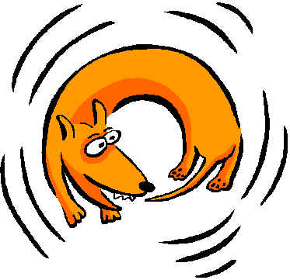
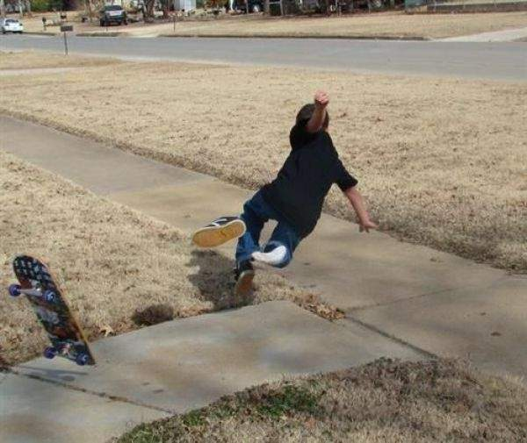
White board
If a dog is going at a constant speed as it chases its tail, is it accelerating?
  Yes (because it is changing direction)
If a skateboarder slows down to avoid running over a little kid, is he accelerating?
  Yes, slowing down is negative acceleration

Slide 5
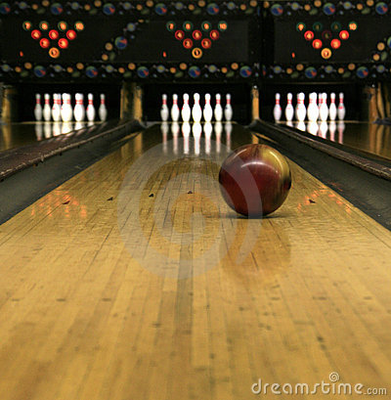
White board
If a bowling ball is rolling at a constant speed in a straight line, is it accelerating?
  No, because it is not changing its speed or direction.

Slide 6
Does this graph show acceleration?
  No, it is a straight line which means the car was going at a constant velocity.

Slide 7
Does this graph show acceleration?
  Yes, because it shows the car changing direction.

Slide 8
Does this graph show acceleration?
  Yes, because it shows the car slowing down (negative acceleration).

Slide 9
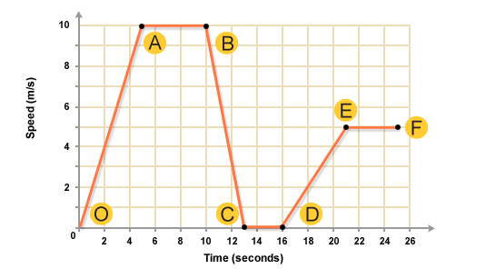
What part of the graph shows the jogger speeding up?
  O-A and D-E

Slide 10
What part of the graph shows the jogger slowing down?
  B-C

Slide 11
What part of the graph shows the jogger going the fastest?
  A-B

Slide 12
What part of the graph shows the jogger stopped?
  C-D

Slide 13
What parts of the graph shows the jogger going at a constant speed?
  A-B and C-D and E-F

Slide 14
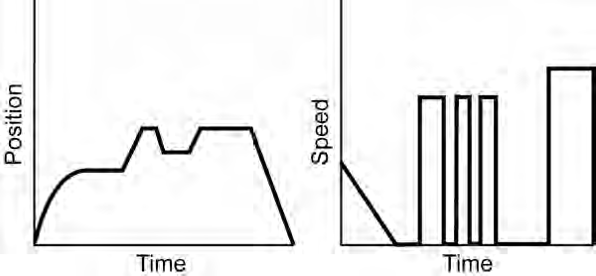
What’s happening?
  A. speeding up
  B. slowing down
  C. stopped

Slide 15
What’s happening?
  A. speeding up
  B. slowing down
  C. stopped

Slide 16
What’s happening?
  A. going forward
  B. going backward
  C. stopped

Slide 17
What’s happening?
  A. going forward
  B. going backward
  C. stopped

Slide 18
What’s happening?
  A. going forward
  B. going backward
  C. stopped

Slide 19
What’s happening?
  A. going forward
  B. going backward
  C. stopped

Slide 20
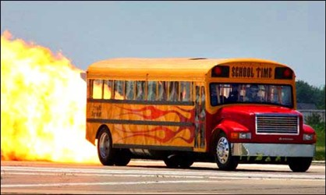
Calculate the acceleration of a bus that goes from 10 m/s to 20 m/s in 5 seconds.
20 m/s – 10 m/s ÷ 5s = 2 m/s²

Slide 21
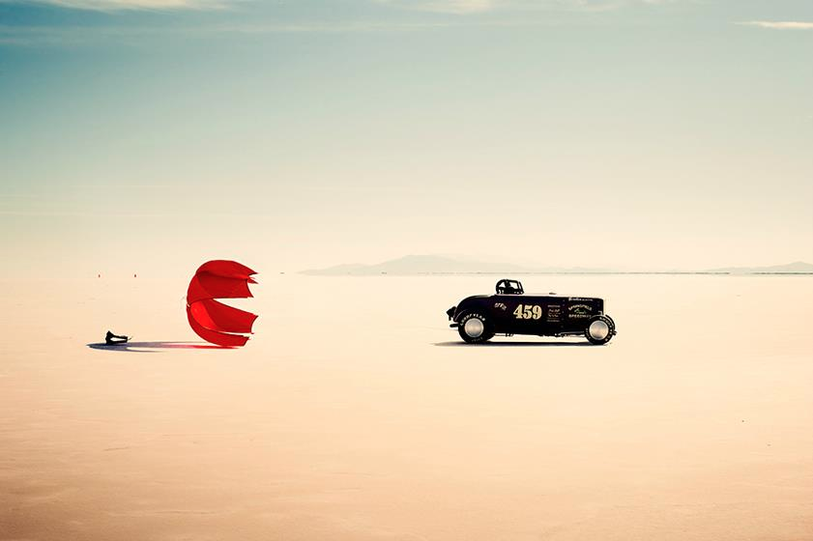
Calculate the acceleration of a car that slows from 50 m/s to 30 m/s in 10 seconds.
30 m/s – 50 m/s ÷ 10s = -2 m/s²

