Slide 1
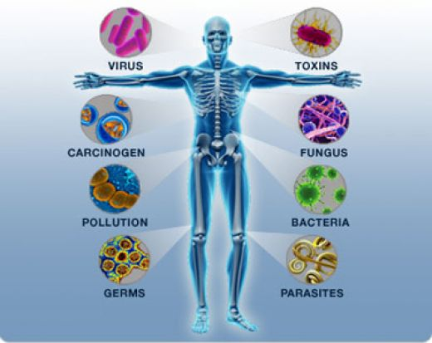
Chapter 40-1: Infectious Disease
Essential Questions:
What are the causes of disease?
How are infectious diseases transmitted?

Slide 2
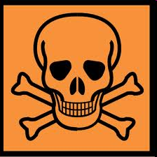
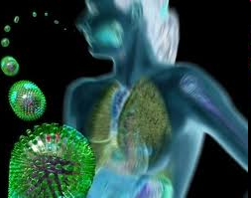
Disease: any change besides injury that disrupts normal body function
Some inherited
Some caused by environmental factors (toxins)
Some caused by agents (bacteria/virus/fungus) – these are pathogens

Slide 3
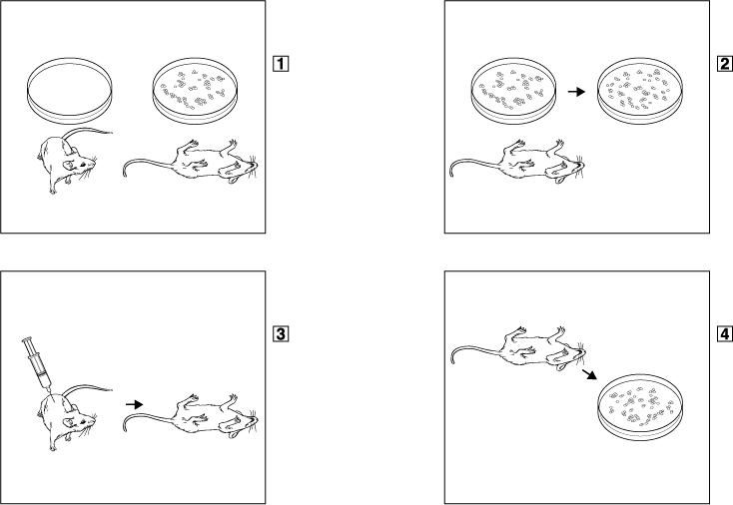
Germ theory of disease
Diseases caused by microorganisms (germs)
Koch’s postulates
No pathogen
Suspected pathogen
Suspected pathogen
The pathogen should always be found in the body of a sick organism and should not be found in a healthy one.
The pathogen must be isolated and grown in the laboratory in a pure culture.
Healthy mouse
Dead mouse
Suspected pathogen grown in pure culture.
Dead mouse
Injection of organisms from pure culture
When purified pathogens are placed in a new host, they should cause the same disease that infected the host.
Pathogen
The very same pathogen should be reisolated from the second host. And it should be the same as the original pathogen.
Dead mouse
Healthy mouse

Slide 4
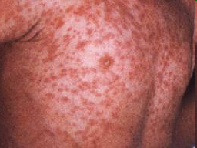
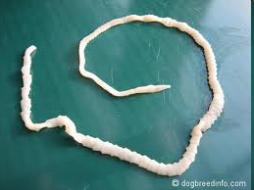
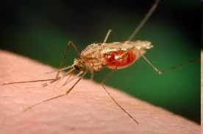
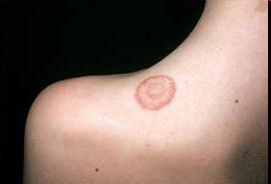
Agents of disease
Viruses: common cold, influenza, measles
Bacteria: tuberculosis, cholera, tetanus
Protists: malaria, amoebic dysentery
Worms: schistosomiasis, beef tapeworm
Fungi: athlete’s foot, ringworm

Slide 5
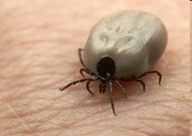
How diseases are spread
Cough or physical contact
Via contaminated food or water
Via infected animals
Vectors: animals that carry disease-causing organisms from person to person (ticks, mosquitos, etc.)

Slide 6
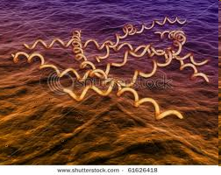
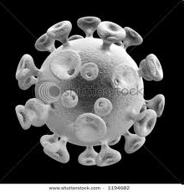
Sexually transmitted diseases
Syphilis & gonorrhea –bacteria
Hepatitus, genital herpes, AIDS - virus

Slide 7
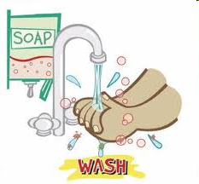
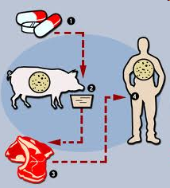
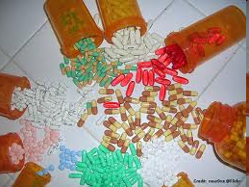
Fighting infectious diseases
Prevention!
Antibiotics – kill bacteria w/out harming cells
Antivirals – inhibit virus’s ability to invade & multiply inside cells

