Slide 1
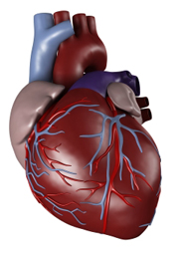
Chapter 37-1: Circulatory System
Essential Questions:
What are the structures of the circulatory system?
What are 3 types of blood vessels in the circulatory system?

Slide 2
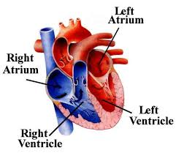
Consists of heart, blood vessels & blood
Heart
Myocardium: thick muscle, contracts to pump blood
Atrium: upper chamber, receives blood
Ventricle: lower chamber, pumps blood out

Slide 3
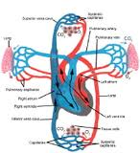
Circulation through body
Pulmonary circ. : right side of heart pumps blood to lungs
CO₂ leaves blood, O₂ absorbed
Systemic circ. : O₂ –rich blood flows to left side of heart, pumped to rest of body
Blood returning to right side of heart is O₂ –poor and loaded with CO₂

Slide 4
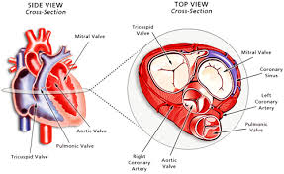
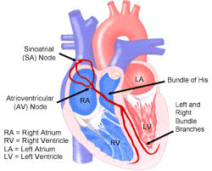
Blood flow through heart
Valves: keep blood from flowing backwards
Heartbeat
Sinoatrial node: sm. group of cardiac muscle cells where contraction begins
“Pacemaker”

Slide 5
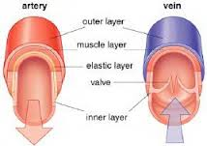
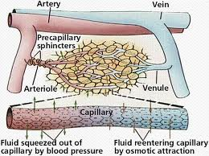
Blood vessels
Arteries: carry blood away from heart
Capillaries:
Very narrow
Allows exchange of gases and nutrients with body cells
Veins: return blood to heart

Slide 6
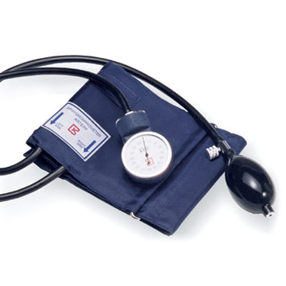
Blood pressure
Ex: normal = 120/80 (unit: mmHg)
1st number: systolic pressure: when ventricles contract
2nd number: diastolic pressure: when ventricles relax
How b.p. is regulated:
Neurotransmitters in sympathetic & parasympathetic nervous system
Kidneys remove water from blood when pressure too high

Slide 7
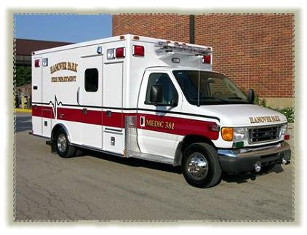
Disorders of circulatory system
Atherosclerosis: fatty deposits (plaque) builds up on artery walls
Increases blood pressure, creates blood clots
High blood pressure = hypertension
Can damage heart
Increases risk of heart attack & stroke
Heart attack: atherosclerosis in coronary arteries (supplies blood to heart muscle)
Can cause parts of heart muscle to begin to die

Slide 8
Stroke: blood clot gets stuck in brain, or weakened artery bursts
Can lead to paralysis, loss of speech, death
Preventing Circ. System Disorders:
Exercise
Weight control
Sensible diet
Don’t smoke

