Slide 1
Chapter 37-2: Blood and the Lymphatic System
Essential Questions:
What is the function of each type of blood cell?
What is the role of the lymphatic system?

Slide 2
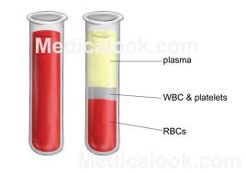
Blood plasma
45% blood volume is cells
Other 55% is plasma – mostly water, plus misc. items

Slide 3
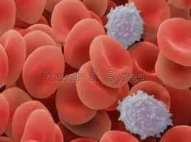
Blood cells
Red blood cells (RBC)
Transport O₂
Hemoglobin: iron-containing protein, binds to O₂ in lungs
White Blood Cells (WBC)
Attack foreign substances
or organisms
Phagocytes: “eating” cells
Platelets & blood clotting
Platelets are cell fragments
Plasma proteins & platelets allow clotting

Slide 4
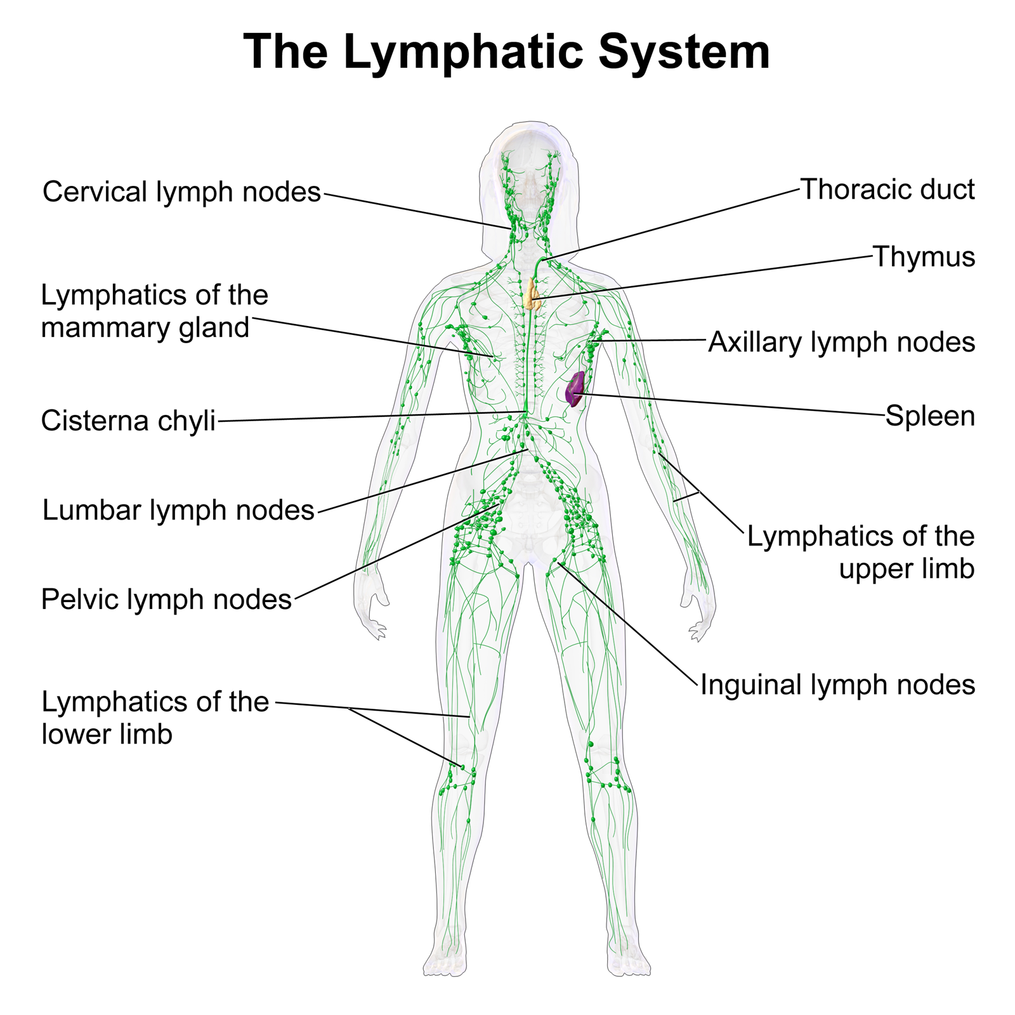
Lymphatic system
Collects fluid lost by blood & returns to circ. system
Lymph nodes: act like filters, trap microorganisms
Lyphocytes: WBC that fight infection
Lymph vessels play a part in nutrient absorption

