Slide 1
Chapter 4: Ecosystems and Communities
Essential Questions:
How does the greenhouse effect maintain the biosphere’s temp. range?
What are Earth’s 3 main climate zones?
How do biotic and abiotic factors influence an ecosystem?
What interactions occur within communities?
What is ecological succession?
What are characteristics of the major land biomes?

Slide 2
4–1 The Role of Climate
What Is Climate?
Weather vs. Climate
The Greenhouse Effect
sun’s heat energy trapped by CO₂, CH₄, H₂O vapor, etc. in atmosphere
B. Effect of Latitude on Climate
Angle of incoming sun energy determined by latitude
3 main climate zones based on latitude
Polar – between 66.5° & 90° north & south – cold
Temperate – between 23.5° & 66.5° north & south – fluctuates warm/cold
Tropical – between 23.5° north and 23.5° south - warm
Heat Transport in the Biosphere
Unequal heating of earth surface drives wind and ocean currents, moves heat
Land masses can interfere with movement of air masses, affecti climate
Go to Section:

Slide 3
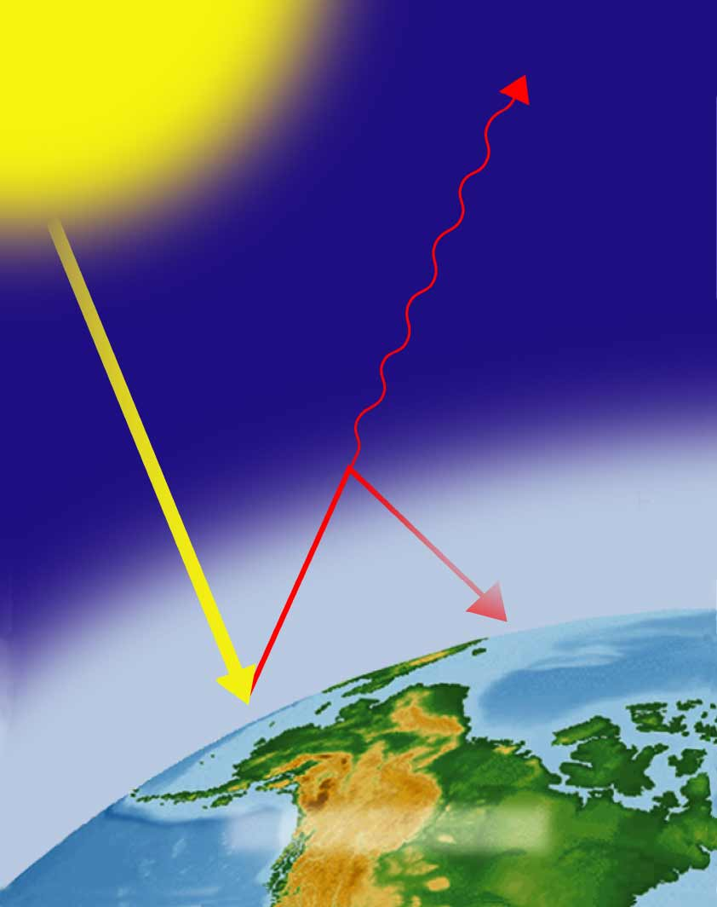
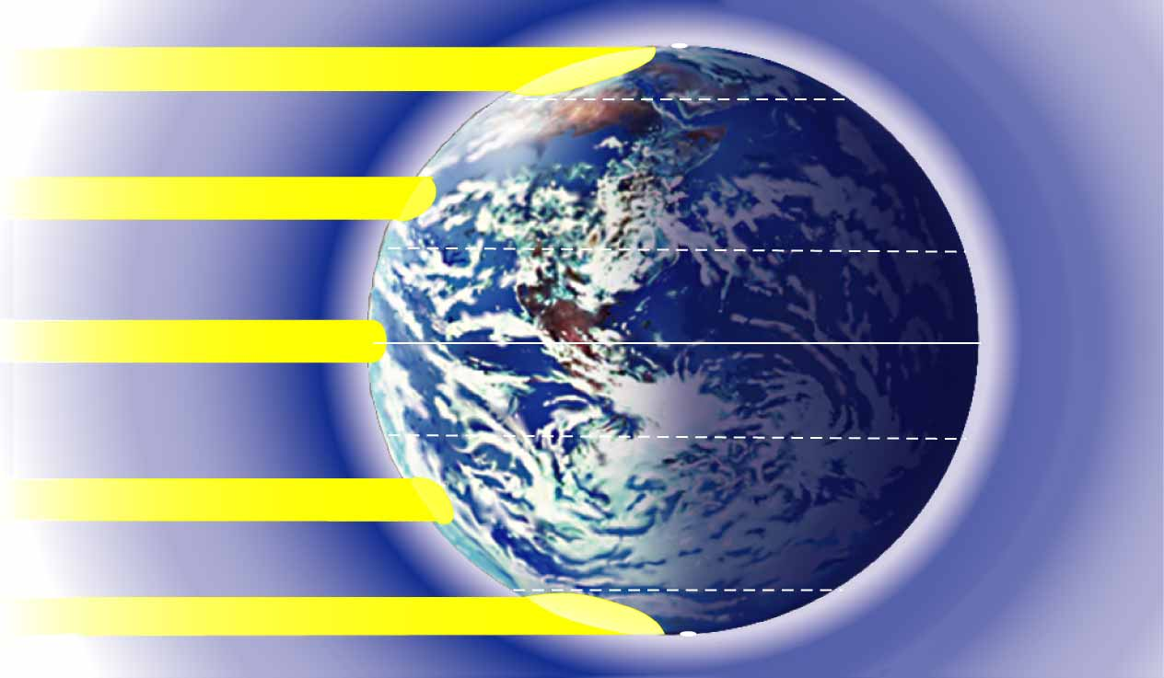
Greenhouse Effect
Different Latitudes
Sunlight
90°N North Pole
Sunlight
66.5°N
Arctic circle
Some heat
escapes
into space
Sunlight
Tropic of Cancer
23.5°N
Most direct sunlight
Equator
0°
Greenhouse
gases trap
some heat
Tropic of Capricorn
23.5°S
Sunlight
Atmosphere
Arctic circle
Sunlight
66.5°S
Earth’s surface
90°S South Pole

Slide 4
4–2 What Shapes an Ecosystem?
Biotic & Abiotic Factors
Biotic = living
Abiotic = non-living
The Niche
1. Habitat = address, niche = occupation
C. Community Interactions
Competition – for resources
a. Competition exclusion principle: no 2 species can occupy same niche @ same time
2. Predation – 1 organism captures & feeds on another
Symbiosis –”living together”
Mutualism – both benefit
Commensalism -1 benefits, other neither helped nor harmed
Parasitism – 1 benefits, other is harmed
Go to Section:

Slide 5
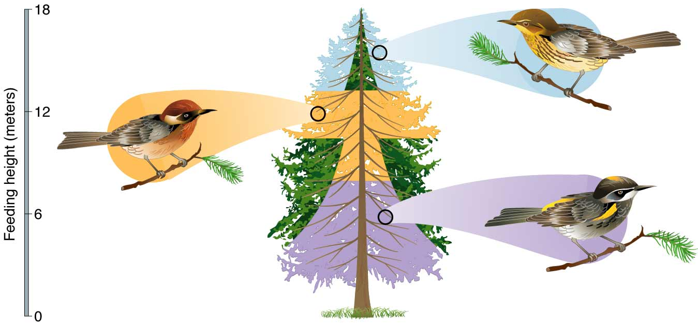
Figure 4-5 Three Species of Warblers and Their Niches
Cape May Warbler
Feeds at the tips of branches
near the top of the tree
Bay-Breasted Warbler
Feeds in the middle
part of the tree
Spruce tree
Yellow-Rumped Warbler
Feeds in the lower part of the tree and
at the bases of the middle branches

Slide 6
D. Ecological Succession – ecosystems change in response to disturbances
Primary succession – on surfaces where no soil exists
Secondary succession – disturbance changes existing community without removing soil

Slide 7
4–3 Land Biomes
A. Biome – particular physical environment containing characteristic assemblage of plants & animals
Climate and Microclimate
Climate diagram – shows 2 main factors determining climate – temp & precip
Microclimate – climate in small area different from surrounding climate
The Major Biomes – see map
D. Other Land Areas – don’t fall neatly into major biome categories
1. Mountain Ranges – biotic & abiotic conditions vary with elevation
2. Polar Ice Caps – cold year-round, plants few

Slide 8
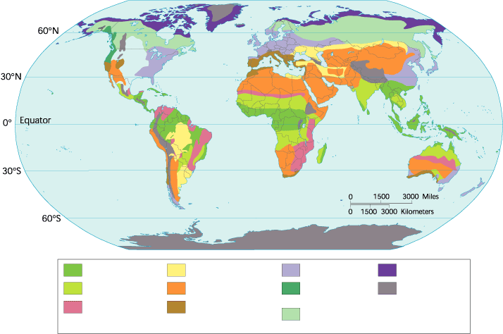
Figure 4-17 The World’s Major Land Biomes
Section 4-3
Tropical rain forest
Temperate grassland
Temperate forest
Tundra
Tropical dry forest
Desert
Northwestern
coniferous forest
Mountains and
ice caps
Tropical savanna
Temperate woodland
and shrubland
Boreal forest
(Taiga)
Go to Section:

