Slide 1
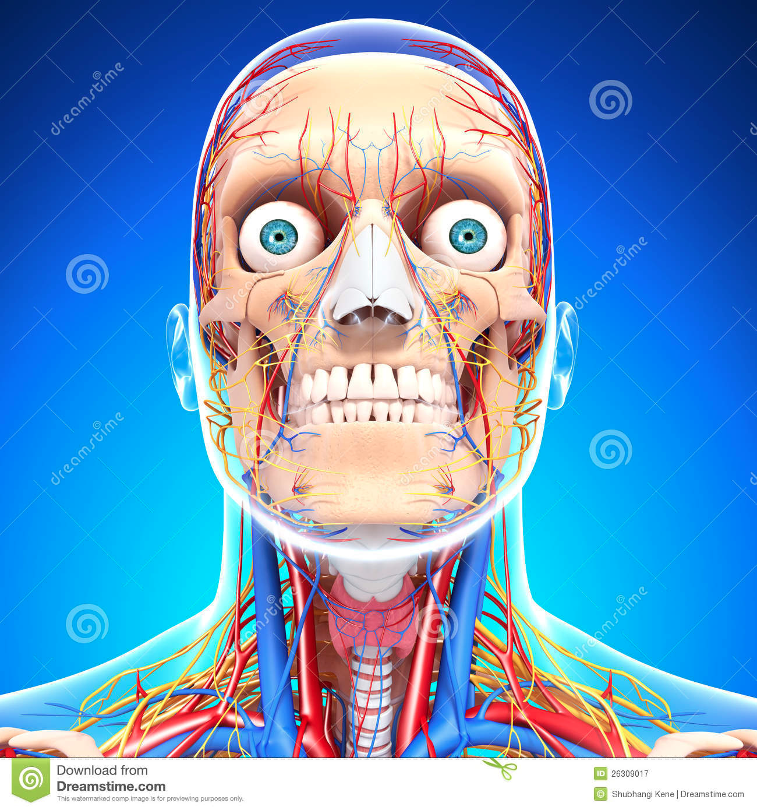
Chapter 35-3: Divisions of the Nervous System
Essential Questions:
What are the functions of the Central Nervous System?
What are the divisions of the Peripheral Nervous System?

Slide 2
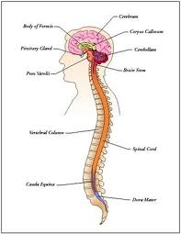
Central Nervous System (CNS)
Function: relays messages, processes information, analyzes information
Consists of brain and spinal cord
Meninges: connective tissue wrapping them
Cerebrospinal fluid: acts as shock absorber

Slide 3
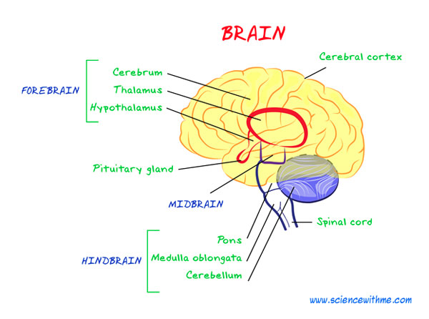
Brain
Cerebrum
Largest part
Voluntary, conscious activities
Cerebellum
2nd largest part, back of skull
Coordinates muscle action
Thalmus
Gets messages from sense organs
Hypothalmus
Control center for info on hunger, thirst, fatigue, anger, body temp

Slide 4
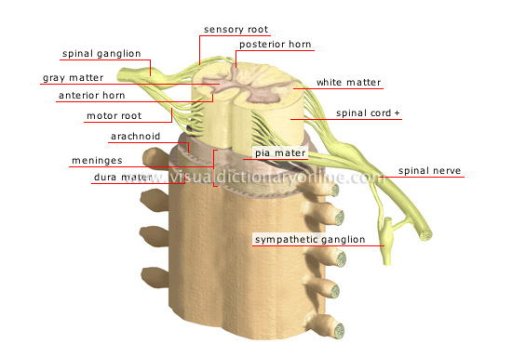
Spinal cord
Link between brain and body
Reflex
Quick, auto-response
Processed directly in spinal cord

Slide 5
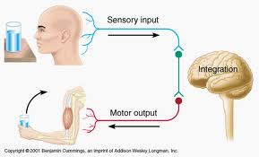
Peripheral nervous system
Sensory division
Transmits impulses from sense organs to CNS
Motor division
Transmits impulses from CNS to muscles & glands
Somatic division
Conscious control
Reflexes
Autonomic division
Involuntary
Sympathetic division
Increases function
Parasympathetic division
Decreases function

