Slide 1
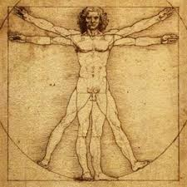
Chapter 35-1: Human Body Systems
Essential Question:
How does the human body maintain homeostasis?

Slide 2
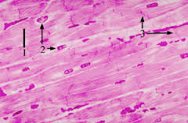
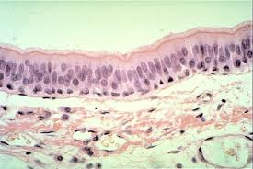
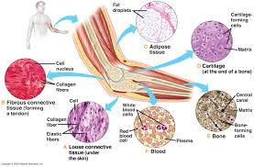
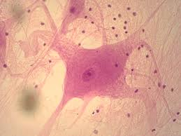
Homeostasis
Process where organisms maintain relatively stable internal environment
Organization of the body
11 organ systems maintain homeostasis
Tissue types
Muscle
Epithelial
Connective
Nervous

Slide 3
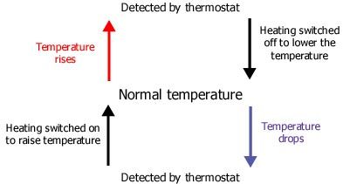
Feedback inhibition
To maintain homeostasis
Process: product of a system shuts down or limits operation

Slide 4
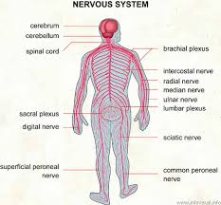
Chapter 35-2: The Nervous System
Essential questions:
What is the function of the nervous system?
How is a nerve impulse transmitted?

Slide 5
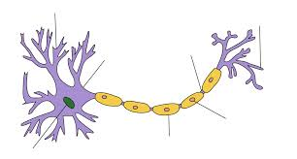
Function of Nervous System:
control and coordinate functions of body & respond to external & internal stimuli
Neurons
Cells that transmit electrical signals (impulses)
Anatomy:
Cell body
Dendrites
Axon
Myelin sheath

Slide 6
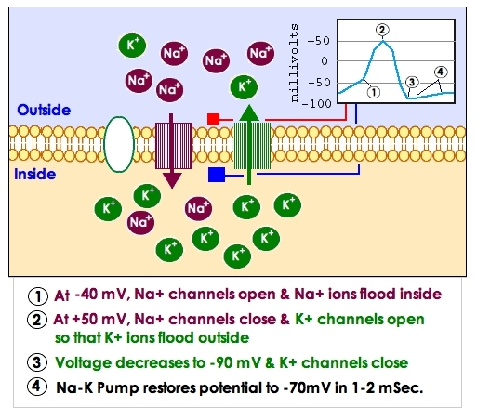
The Nerve Impulse
Resting potential
Distribution of Na⁺ and K⁺ ions inside & outside neuron
More Na⁺ outside cell, more K⁺ inside cell
K⁺ diffuses out more easily than Na⁺ diffuses in
So, negative charge builds inside cell, positive outside
This difference across membrane is resting potential

Slide 7
Action potential
Nerve impulse: neuron is stimulated by another neuron or environment
Moves through nerve cells like ripple caused by a rock thrown in a pond
@ leading edge of nerve impulse, “sodium gates” (channel proteins) open in cell membrane, Na⁺ flows in
This reverses electrical charge across membrane – this is the action potential
As impulse passes, “potassium gates” open, allow K⁺ to flow out, re-establishes resting potential

Slide 8
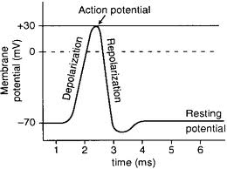
Threshold: minimun level of stimulus needed to activate a neuron
Strength of impulse always the same
“all or nothing” principle

Slide 9
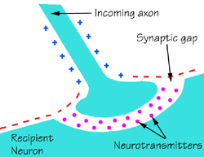
Synapse
Location where a neuron can transfer an impulse to another cell
Between axon terminal of 1 cell and dendrites of another cell
Neurotransmitters
Chemicals used to transmit impulse across a synapse

