Slide 1
Ch 11-3 & 11-4: -Beyond Simple Dominance -Meiosis
Essential Questions:
What are some inheritance patterns different from simple dominance?
What happens during the process of meiosis?
What are the differences between meiosis & mitosis?

Slide 2
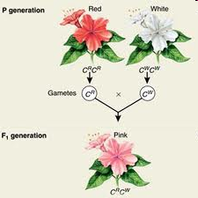
Beyond Dominant and Recessive Alleles
Incomplete Dominance
neither allele is dominant
ex: white x red flowers = pink flowers

Slide 3
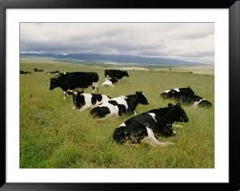
Codominance
both alleles contribute
ex: white bull x black cow = black & white spotted cow

Slide 4
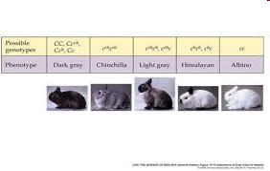
Multiple Alleles
more than 2 alleles possible for a trait’s gene
ex: coat color in rabbits

Slide 5
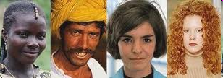
Polygenic Traits
many genes control trait
ex: skin color in humans – 4 + genes likely control it

Slide 6
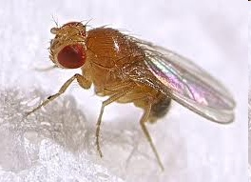
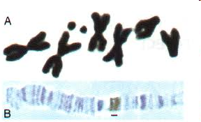
Meiosis
Chromosome number
Homologous means corresponding to other parent’s genes
Ex: fruit fly: 8 chromosomes
4 from Mom, 4 from Dad
Diploid = “2 sets” (2N)
Fruit fly: 2N = 8
Gametes are haploid (“one set”)
Fruit fly: N = 4

Slide 7
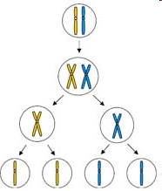
Phases of meiosis
Meiosis I - # of chromosomes per cell is cut in half by separating homologous chromos.
Crossing over happens, so cells NOT genetically identical
Meiosis II – 2N cells divide again to form 4 cells that are N
2N
4N
Meiosis I
2N
Meiosis II
N

Slide 8
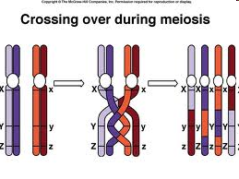

Slide 9
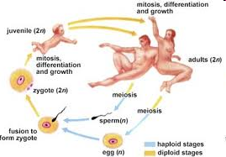
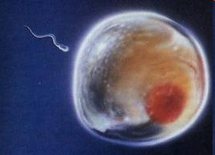
Gamete formation: meiosis is the process that produces them
Comparing Mitosis & Meiosis
Mitosis produces 2 genetically identical diploid cells
Meiosis produces 4 genetically different haploid cells

