Slide 1
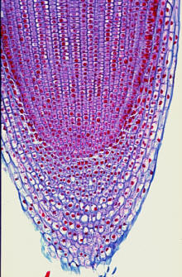
Root Tip

Slide 2
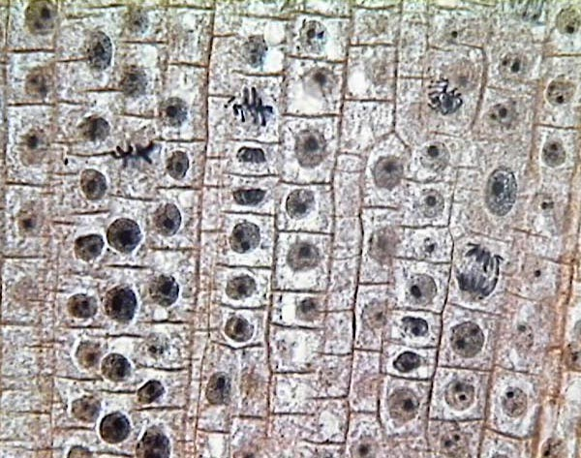
Metaphase

Slide 3
Prophase

Slide 4
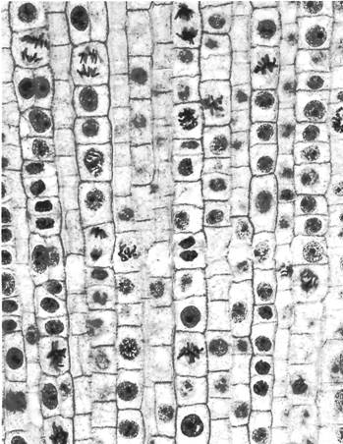
Telophase

Slide 5
Interphase

Slide 6
Anaphase

Slide 7
Good? Bad? So-so?

Slide 8
Good? Bad? So-so?

Slide 9
Good? Bad? So-so?

