Slide 1
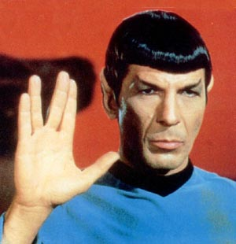
‘The madman is not the man who has lost his reason. The madman is the man who has lost everything but his reason.’

Slide 2
The curious incident
An expensive racehorse has been stolen. A policeman talks to Sherlock Holmes.
I’ve been stolen, that’s why I’ve got such a long face!

Slide 3
The curious incident
Does any aspect of the crime strike you as significent Mr Holmes?

Slide 4
The curious incident
Does any aspect of the crime strike you as significent Mr Holmes?
Yes constable, the curious incident of the dog in the night.

Slide 5
The curious incident
The dog did nothing in the night Sir.

Slide 6
The curious incident
The dog did nothing in the night Sir.
That is the curious incident!

Slide 7
Who stole the horse?
Notes:
Can they figure it out?

Slide 8
Holme’s reasoning
The solution to the crime hinges on the fact that the guard dog did not bark in the night, and from this Holmes deduces that the thief must have been known to the dog.
I know him!

Slide 9
Holmes’ reasoning
Holmes’ reasoning can be laid out as follows
All guard dogs bark at strangers
The guard dog did not bark at the thief
Therefore the thief was not a stranger

Slide 10
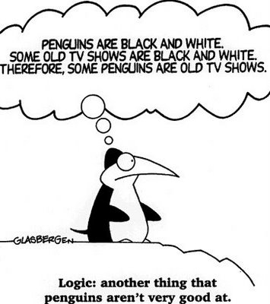
Deductive and induction reasoning

Slide 11
Seven Witches
Seven Witches
Once upon a time, on top of a magical peak
Seven witches wished wishes one week.
Sunday the first witch sought beauty.
On Wednesday one asked for wealth.
(Broomhilda just wanted her health.)
The day after Broomhilda had finished,
Morgana wished to be queen.
One witch was named Jolene.
On Friday one witch said,
“I wish most of all for fame.”
Drusella was not this one’s name.
Saturday’s witch asked for diamonds
To hang from her door like a wreath.
(Poor Greta just wanted some teeth.)
Samantha wished before Hannah,
Who didn’t want diamonds or fame.
And now you can play the game.
If each day a witch wished a wish
In this magical land far away,
Which witch wished which wish which day?

Slide 12
Which witch wished which wish which day?

Slide 13
Deductive reasoning

Slide 14
Syllogisms
Holmes reasoning is an example of a syllogism.

Slide 15
The Socrates Syllogism
All human beings are mortal
Socrates is a human being
Therefore Socrates is mortal
premises
conclusion

Slide 16
Syllogisms contain:
Two premises and a conclusion
Three terms, each must occur twice (“Socrates”, “human”, “mortal”.)
Quantifiers, such as “all”, or “some” or “no” which tell us of the quantity being referred to
“TOK for the IB Diploma”, Richard van de Lagemaat, Cambridge

Slide 17
Truth and validity
An argument is valid if the conclusion follows logically from the premises.
All hippopotamuses eat cockroaches
Mr Porter is a hippopotamus
Therefore Mr Porter eats cockroaches
Both premises and conclusion are false, but the argument is valid.
Imagine that some strange planet exists where the premises are true

Slide 18
Truth and validity
All rats are teachers
Mr Hulings is a rat
Therefore Mr Hulings is a teacher
Both premises are false and conclusion is true! (but the argument is still valid).
=

Slide 19
Deductive reasoning and truth
Just because an argument is valid does not mean that the conclusion is true.
 | Premises are true | Premises are false
Valid Argument | Conclusion must be true | Conclusion could be either true or false
Invalid Argument | Conclusion could be either true or false | Conclusion could be either true or false

Slide 20
Socrates
Socrates is a man
All men are mortal
Therefore Socrates is mortal
The conclusion is only true if the premises are true.

Slide 21
Make up your own VALID syllogisms to illustrate each of the following;
2 true premises and a true conclusion
1 true premise, 1 false premise and a true conclusion
1 true premise, 1 false premise and a false conclusion
2 false premises and a true conclusion
2 false premises and a false conclusion

Slide 22
Belief Bias
The tendency to think an argument is valid simply because you agree with the conclusion.

Slide 23
Deciding whether a syllogism is valid
Trying to decide if a syllogism is valid is not easy.
Venn diagrams can help (at last a good use for Venn diagrams!)

Slide 24
An example
All As are Bs
All Bs are Cs
Therefore all Cs are As

Slide 25
Another example
All As are Bs
A
B

Slide 26
Another example
All Bs are Cs
A
B
C

Slide 27
Another example
Therefore all Cs are As
These Cs are not As
A
B
C
The syllogism is not valid

Slide 28
Another example!
All As are Bs
Some As are Cs
Therefore some Bs are Cs

Slide 29
Another example!
All As are Bs
A
B

Slide 30
Another example!
Some As are Cs
A
C
B

Slide 31
Another example!
Therefore some Bs are Cs
A
C
B
The syllogism is valid

Slide 32
Now your turn
Using Venn diagrams in your notebooks, decide whether each of the following arguments is valid or invalid.

Slide 33
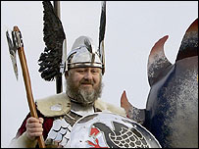
Valid or invalid
All Norwegians eat hotdogs
Ethan eats hotdogs
Therefore Ethan is Norwegian

Slide 34
Valid or invalid
All Seniors are brave
Some brave people are compassionate
Some seniors are compassionate

Slide 35
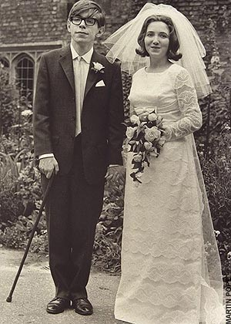
Valid or invalid
Some physicists are frauds
Some frauds are not wealthy
Therefore some physicists are not wealthy

Slide 36
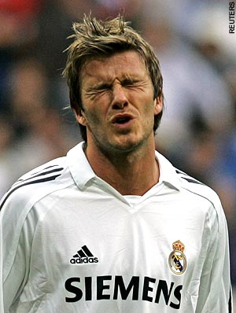
Valid or invalid
All Norwegians have dogs
No good football players have dogs
Therefore no Norwegians are good football players

Slide 37
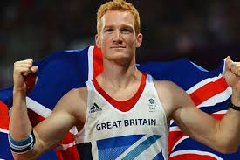
Valid or invalid
All rookies have red hair
All people with red hair are runners
Therefore all rookies are runners.

Slide 38
Inductive reasoning
All human beings are mortal
This statement cannot be proved by logic and reasoning, but is based on experience.
This brings us to inductive reasoning

Slide 39
Inductive reasoning
While deductive reasoning goes from the general to the particular, inductive reasoning goes from the particular to the general
Going from “all observed human beings have died” to “all human beings are mortal” is an example of inductive reasoning

Slide 40
Inductive reasoning and generalizations
Since inductive reasoning goes from the observed to the unobserved, it enables us to make generalizations about the world
All metals expand when heated
All human beings are mortal

Slide 41
Generalizations
Is there a danger to generalizations?
YEP
Notes:
Print out the next 3 slides

Slide 42
Generalizations
Americans are rude
Water boils at 100 °C.
Most graffiti artists are under 25 years old.
All generalizations are dangerous.
When spelling in English “i before e except after c”.

Slide 43
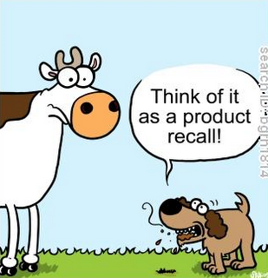
Generalizations
In Spanish, if a word ends in “o” it is masculine.
Dogs eat their own poo.
Norwegians are good at skiing.
Teenagers are lazy.
Metals expand when heated.

Slide 44
Good generalizations
Number
You should look at a good number of examples. If you see one dog swimming, this is not enough to decide that “all dogs can swim”

Slide 45
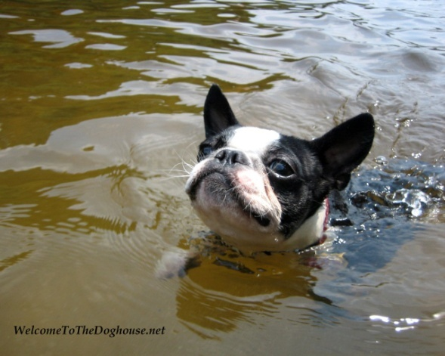
Good generalizations
Variety
You should look at a variety of circumstances. In the example of dogs swimming, looking at different breeds of dog.

Slide 46
Good generalizations
Exceptions
You should actively look for counter examples. Look for dogs that can’t swim!

Slide 47
Good generalizations
Coherence
You should look for more evidence to support surprising claims! If somebody suggests that all dogs have superpowers you may demand greater proof!

Slide 48
Good generalizations
Subject area
Generalizations may be more reliable in some subject areas (e.g. science) than in others (e.g. economics or other social sciences).

Slide 49
Inductive turkeys
Some ‘inductive turkeys’ arrive on a farm one January. They are well looked after, and every morning after breakfast the farmer comes and feeds them. After a few weeks, some of the more philosophical turkeys begin to notice that ‘whenever the farmer appears they get fed’. As good inductive turkeys they continue to observe patiently, and as January turns to February the become increasingly confident of the truth of the generalisation that ‘whenever the farmer comes, we get fed’. The months pass, and as the spring turns to summer and as summer turns to autumn, this generalisation acquires the status of a law of nature. The connection between the farmer’s appearance and the arrival of food, is the turkeys decide, a brute fact of reality, and to question it would be a clear sign of insanity. Things continue in much the same way until one cold December morning – 24th December to be precise – The farmer breaks the neck of the first Turkey that comes up to him to be fed.

Slide 50
Activity
To what extent do human beings sometimes act like the turkeys in the story?
The turkeys turned out to be wrong, but do you think that their belief was reasonable? What does this suggest to you about the relationship between reason and truth?
When your dog gets excited when he sees you getting his lead out, do you think he is using inductive reasoning to predict you are going to take him for a walk?

Slide 51
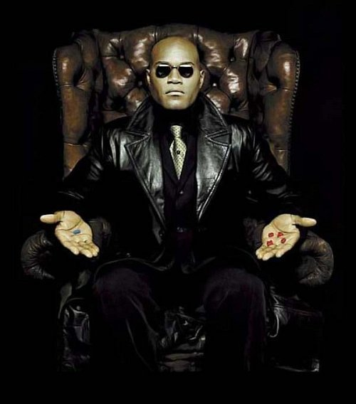
The point
The story of the turkeys alerts us to the fact that even well confirmed generalisations can fail us. Newton’s laws of motion were confirmed by observational evidence on countless occasions and were believed to be true for more than 200 years. Nevertheless they eventually turned out to be false.
Despite the obvious survival value of inductive reasoning we might ask how we can know that the future will be similar to the past in any respect. How can we be sure that the laws of physics, together with the countless regularities that we take for granted, wont suddenly break down tomorrow.
Think about the film The Matrix

Slide 52
Language and reasoning
Day and night? Where does night end and day begin?
Young or old? Am I young or old?
Grass is green? (Is it? Can you have non-green grass?
Man or woman?
Pluto. Planet?
Notes:
Most reasoning uses words – words are not always as precise as we think they are.

Slide 53
Deduction and Induction compared
Deduction
Reasoning from general to particular
Example; All metals expand when heated, A is a metal, therefore A expands when heated
Value; More certain, but less informative than induction
Induction
Reasoning from particular to general
Example; Metal A expands when heated, so does metal B and C etc. therefore all metals expand when heated
Value; More informative, but less certain than deduction

Slide 54
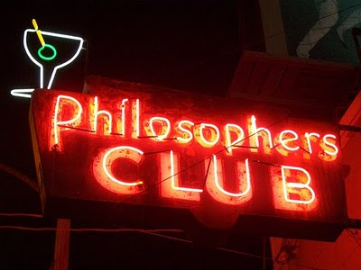
Informal reasoning

Slide 55
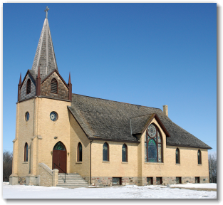
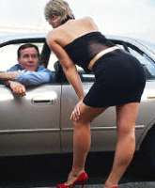
The more churches there are in a city, the more prostitutes there are.
Notes:
Discuss! (This is a TRUE statement). Bigger cities have more of everything – elementary schools, McDonalds, churches etc.

Slide 56
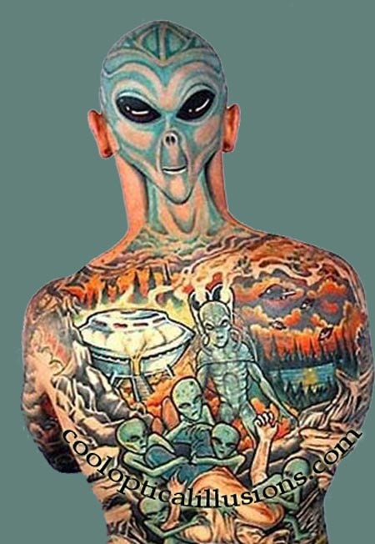
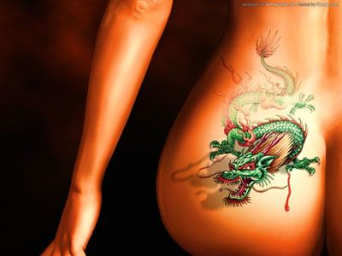
People who have a tattoo are more likely to develop lung cancer. This is true.
Notes:
Discuss

Slide 57
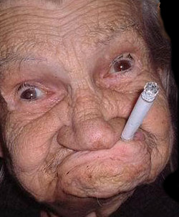
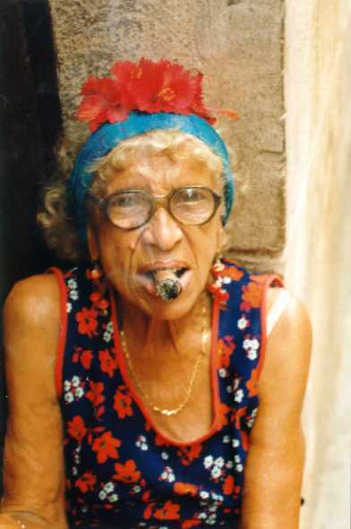
Chris says that he knows someone who is 90 and who has smoked 40 cigarettes a day for 75 years and he’s OK, so smoking can’t be harmful.
Notes:
Discuss

Slide 58
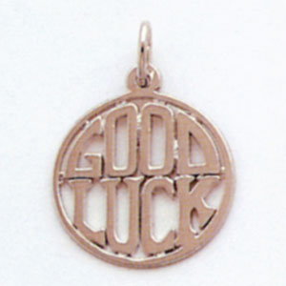
Kate bought a good luck charm and he seems to be doing better at school.
Notes:
Discuss

Slide 59
Post hoc ergo propter hoc
Assuming one thing causes another just because one follows another.
“Theory of Knowledge for the IB Diploma”, Richard van de Lagemaat, Cambridge University Press

Slide 60
A summary of common fallacies

Slide 61
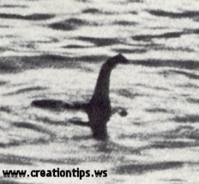
Ad ignorantiam
Claiming that something is true because it cannot be proved to be false.
“Theory of Knowledge for the IB Diploma”, Richard van de Lagemaat, Cambridge University Press
Notes:
“Nobody has proved the Loch Ness Monster doesn’t exist”

Slide 62
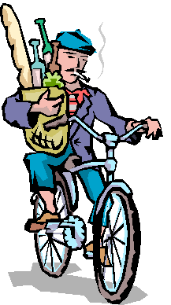
Hasty generalization
Generalizing from insufficient evidence.
“Theory of Knowledge for the IB Diploma”, Richard van de Lagemaat, Cambridge University Press
Notes:
“All French people are rude”

Slide 63
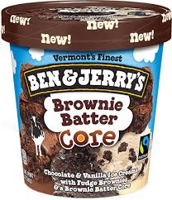
Ad hominem
Attacking /supporting the person rather than the argument.
“Theory of Knowledge for the IB Diploma”, Richard van de Lagemaat, Cambridge University Press
Notes:
My opponent suggests that lowering taxes will be a good idea -- this is coming from a woman who eats a pint of Ben and Jerry’s each night!

Slide 64
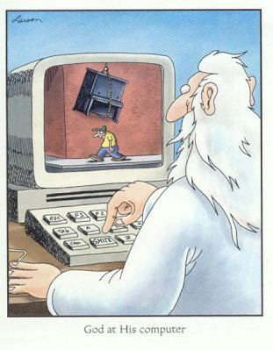
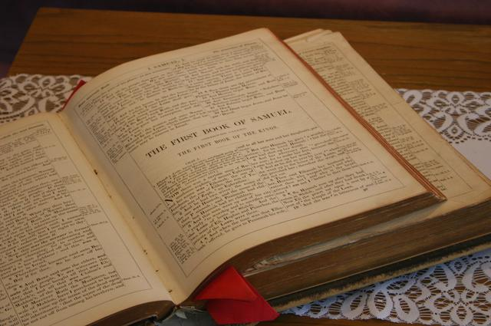
Circular reasoning
Assuming the truth of what you are supposed to be proving.
“Theory of Knowledge for the IB Diploma”, Richard van de Lagemaat, Cambridge University Press
Notes:
The bible says god exists, and the bible is the word of god, so it must be true”

Slide 65
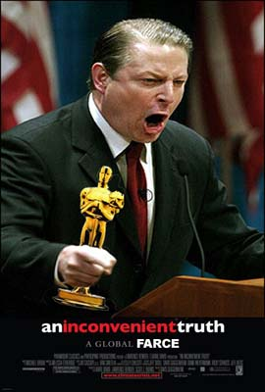
Special pleading
Using double standards to excuse an individual or group.
“Theory of Knowledge for the IB Diploma”, Richard van de Lagemaat, Cambridge University Press
Notes:
“It’s OK that my house produces 14x more CO2 than an average house – I’m an important person”

Slide 66
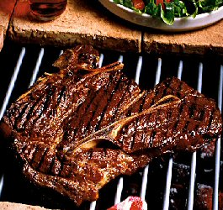
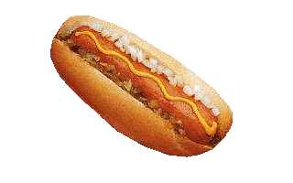
Equivocation
Using language ambiguously.
“Theory of Knowledge for the IB Diploma”, Richard van de Lagemaat, Cambridge University Press
Notes:
“A hotdog is better than nothing, and nothing is better than steak, so a hotdog is better than steak”

Slide 67
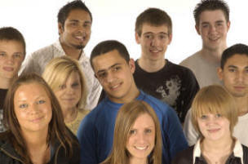
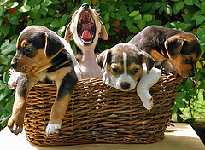
False analogy
Assuming that because two things are alike in one way that they are alike in other respects.
“Theory of Knowledge for the IB Diploma”, Richard van de Lagemaat, Cambridge University Press
Notes:
“Year 12 are like cuddly puppies”

Slide 68
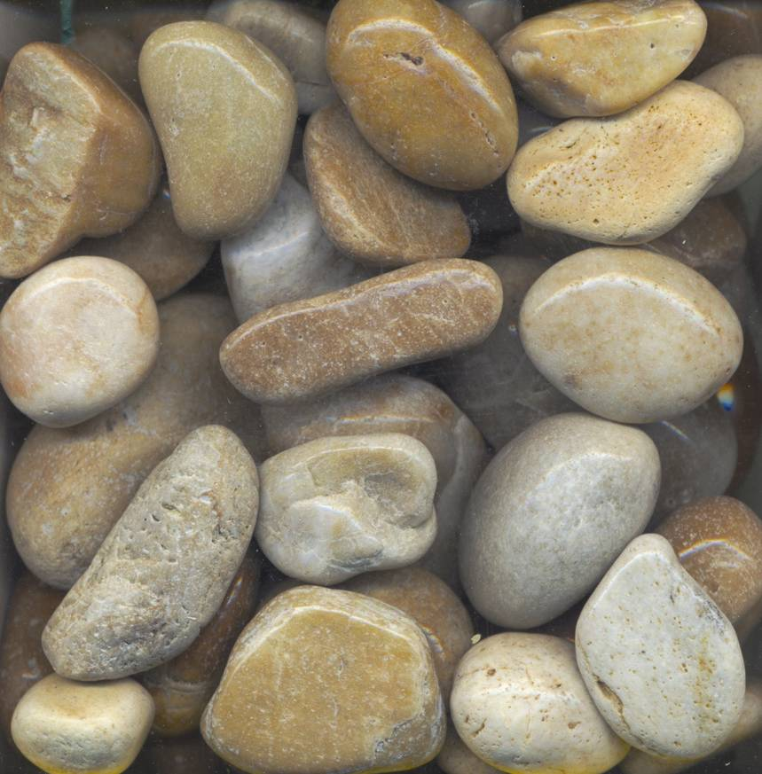
False dilemma
Assuming that only a limited number of alternatives exist.
“Theory of Knowledge for the IB Diploma”, Richard van de Lagemaat, Cambridge University Press
Notes:
Are these stones dead or alive?

Slide 69
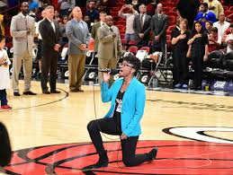
Loaded question
A question that is biased because it contains a built-in assumption.
“Theory of Knowledge for the IB Diploma”, Richard van de Lagemaat, Cambridge University Press
Notes:
Do you know that your political views are destructive to our country?

Slide 70
In each of the following cases, decide which best applies to the argument.
Hasty generalisation, post hoc ergo propter hoc, circular reasoning, ad hominem, special pleading, ad ignorantium, false dilemma, false analogy, equivocation, loaded question.

Slide 71
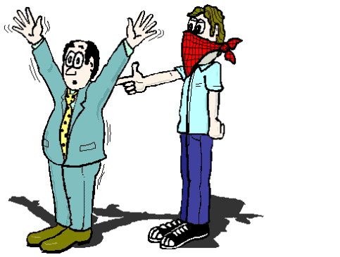
1.
Hasty generalisation, post hoc ergo propter hoc, circular reasoning, ad hominem, special pleading, ad ignorantium, false dilemma, false analogy, equivocation, loaded question.
Since strict gun control laws were introduced in Dodge City, the crime rate has risen. This shows that gun control does nothing to reduce crime.
“Theory of Knowledge for the IB Diploma”, Richard van de Lagemaat, Cambridge University Press

Slide 72
post hoc ergo propter hoc
Since strict gun control laws were introduced in Dodge City, the crime rate has risen. This shows that gun control does nothing to reduce crime.

Slide 73
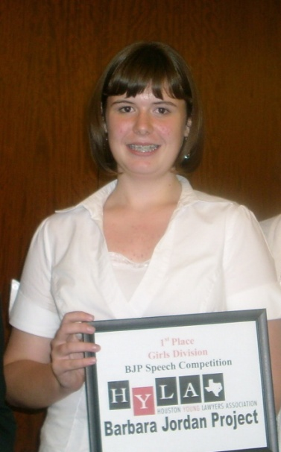
2.
Hasty generalisation, post hoc ergo propter hoc, circular reasoning, ad hominem, special pleading, ad ignorantium, false dilemma, false analogy, equivocation, loaded question.
Emmeline said she trusted me, and she must be telling the truth because she wouldn’t lie to someone that she trusted.
“Theory of Knowledge for the IB Diploma”, Richard van de Lagemaat, Cambridge University Press

Slide 74
circular reasoning
Emmeline said she trusted me, and she must be telling the truth because she wouldn’t lie to someone that she trusted.
“Theory of Knowledge for the IB Diploma”, Richard van de Lagemaat, Cambridge University Press

Slide 75
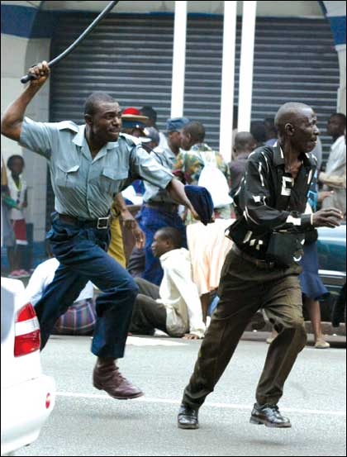
3.
Hasty generalisation, post hoc ergo propter hoc, circular reasoning, ad hominem, special pleading, ad ignorantium, false dilemma, false analogy, equivocation, loaded question.
The ends justifies the means. After all, if you want to make omelettes, you have to break eggs.
“Theory of Knowledge for the IB Diploma”, Richard van de Lagemaat, Cambridge University Press
Notes:
We should beat year 12 students to make them work harder

Slide 76
false analogy
The ends justifies the means. After all, if you want to make omelettes, you have to break eggs.

Slide 77
4.
Hasty generalisation, post hoc ergo propter hoc, circular reasoning, ad hominem, special pleading, ad ignorantium, false dilemma, false analogy, equivocation, loaded question.
That can’t be right, none of my friends would believe it.
“Theory of Knowledge for the IB Diploma”, Richard van de Lagemaat, Cambridge University Press

Slide 78
ad hominem
That can’t be right, non of my friends would believe it.

Slide 79
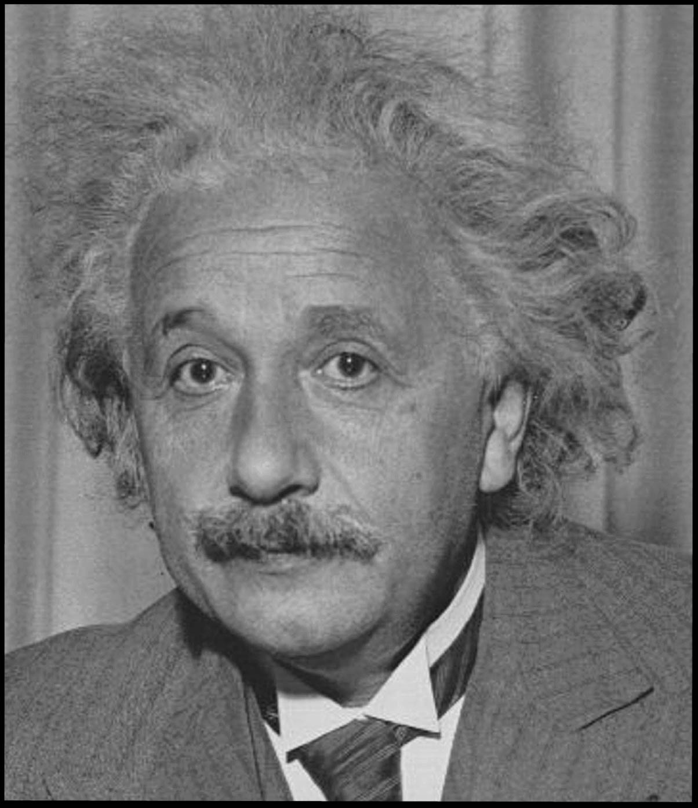
5.
Hasty generalisation, post hoc ergo propter hoc, circular reasoning, ad hominem, special pleading, ad ignorantium, false dilemma, false analogy, equivocation, loaded question.
Since many great scientists have believed in God, there must be some truth in religion.
“Theory of Knowledge for the IB Diploma”, Richard van de Lagemaat, Cambridge University Press

Slide 80
ad hominem
Since many great scientists have believed in God, there must be some truth in religion.

Slide 81
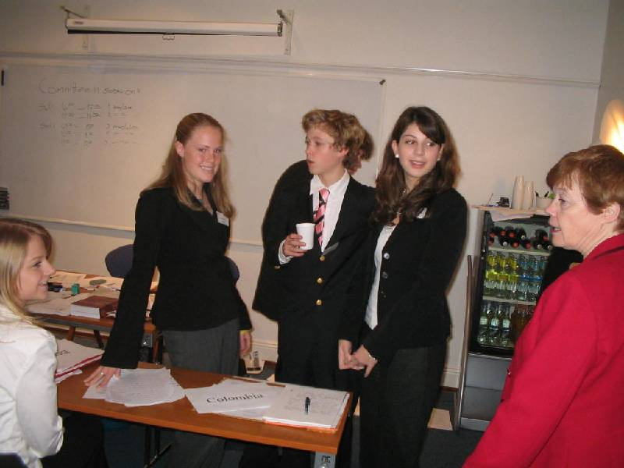
6.
Hasty generalisation, post hoc ergo propter hoc, circular reasoning, ad hominem, special pleading, ad ignorantium, false dilemma, false analogy, equivocation, loaded question.
Teddy and Seanne got on very well on their two dates together. They are clearly well suited and should get married.
“Theory of Knowledge for the IB Diploma”, Richard van de Lagemaat, Cambridge University Press

Slide 82
hasty generalisation
Teddy and Seanne got on very well on their two dates together. They are clearly well suited and should get married.

Slide 83
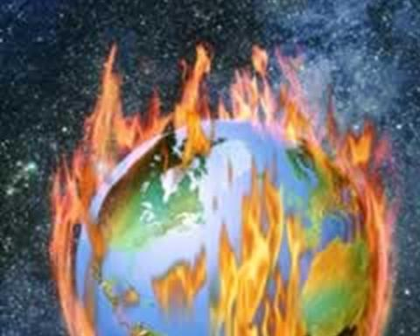
7.
Hasty generalisation, post hoc ergo propter hoc, circular reasoning, ad hominem, special pleading, ad ignorantium, false dilemma, false analogy, equivocation, loaded question.
Do you want to be part of the solution, or part of the problem?
“Theory of Knowledge for the IB Diploma”, Richard van de Lagemaat, Cambridge University Press

Slide 84
false dilemma
Do you want to be part of the solution, or part of the problem?

Slide 85
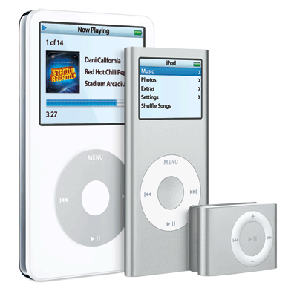
8.
Hasty generalisation, post hoc ergo propter hoc, circular reasoning, ad hominem, special pleading, ad ignorantium, false dilemma, false analogy, equivocation, loaded question.
“I agree that you shouldn’t copy mp3s illegally, but I’ve only copied a few and I do buy tracks sometimes.”
“Theory of Knowledge for the IB Diploma”, Richard van de Lagemaat, Cambridge University Press

Slide 86
special pleading
“I agree that you shouldn’t copy mp3s illegally, but I’ve only copied a few and I do buy tracks sometimes.”

Slide 87
9.
Hasty generalisation, post hoc ergo propter hoc, circular reasoning, ad hominem, special pleading, ad ignorantium, false dilemma, false analogy, equivocation, loaded question.
The average UK family has 2.5 children. The Smiths are average people, they must have 2.5 kids.
“Theory of Knowledge for the IB Diploma”, Richard van de Lagemaat, Cambridge University Press

Slide 88
equivocation
The average UK family has 2.5 children. The Smiths are average people, they must have 2.5 kids.

Slide 89
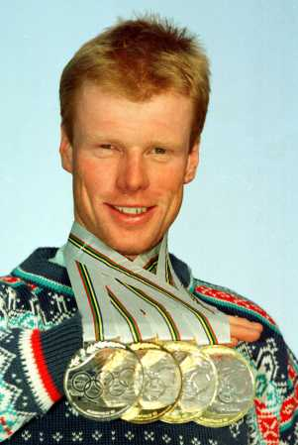
10.
Hasty generalisation, post hoc ergo propter hoc, circular reasoning, ad hominem, special pleading, ad ignorantium, false dilemma, false analogy, equivocation, loaded question.
Since no-one has been able to prove that God didn’t create the universe, we must conclude that God did make everything.
“Theory of Knowledge for the IB Diploma”, Richard van de Lagemaat, Cambridge University Press

Slide 90
ad ignorantium
Since no-one has been able to prove that God didn’t create the universe, we must conclude that God did make everything.

Slide 91
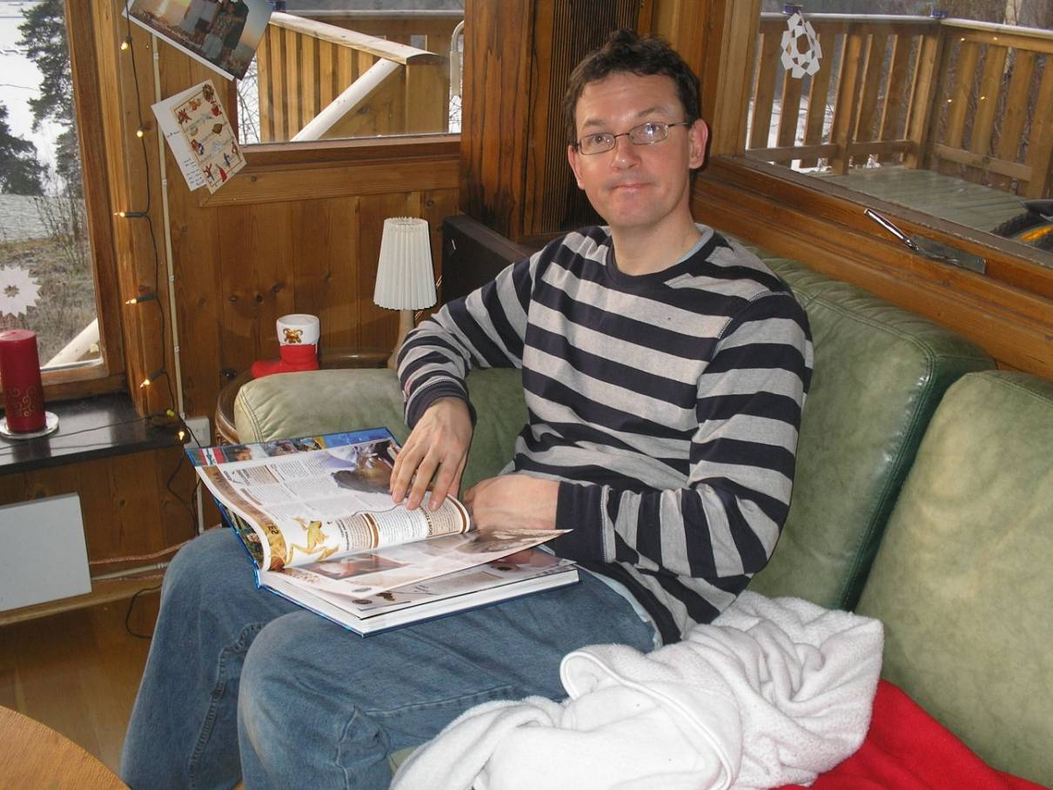
11.
Hasty generalisation, post hoc ergo propter hoc, circular reasoning, ad hominem, special pleading, ad ignorantium, false dilemma, false analogy, equivocation, loaded question.
Are all your family stupid, or is it just you?
“Theory of Knowledge for the IB Diploma”, Richard van de Lagemaat, Cambridge University Press

Slide 92
loaded question
Are all your family stupid, or is it just you?

Slide 93
12.
Hasty generalisation, post hoc ergo propter hoc, circular reasoning, ad hominem, special pleading, ad ignorantium, false dilemma, false analogy, equivocation, loaded question.
No scandal has ever touched Mr Porter. He must be a clean living and honest man.
“Theory of Knowledge for the IB Diploma”, Richard van de Lagemaat, Cambridge University Press

Slide 94
ad ignorantium
No scandal has ever touched Mr Porter. He must be a clean living and honest man.

Slide 95
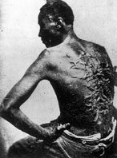
13.
Hasty generalisation, post hoc ergo propter hoc, circular reasoning, ad hominem, special pleading, ad ignorantium, false dilemma, false analogy, equivocation, loaded question.
Just as you are more likely to take care of a car that you own rather than a car that you rent, a slave owner would look after a slave better than an employer would look after their worker.
“Theory of Knowledge for the IB Diploma”, Richard van de Lagemaat, Cambridge University Press

Slide 96
false analogy
Just as you are more likely to take care of a car that you own rather than a car that you rent, a slave owner would look after a slave better than an employer would look after their worker.

Slide 97
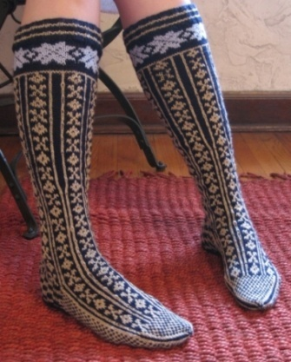
14.
Hasty generalisation, post hoc ergo propter hoc, circular reasoning, ad hominem, special pleading, ad ignorantium, false dilemma, false analogy, equivocation, loaded question.
To ignore the possibility that Norway landed the first person on the moon just because nobody has heard of a Norwegian space program is arrogant. If we are unaware of something does not mean that it never happened.
“Theory of Knowledge for the IB Diploma”, Richard van de Lagemaat, Cambridge University Press

Slide 98
ad ignorantium
To ignore the possibility that Norway landed the first person on the moon just because nobody has heard of a Norwegian space program is arrogant. If we are unaware of something does not mean that it never happened.

Slide 99
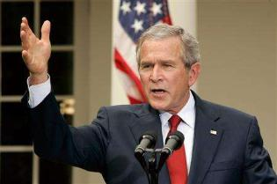
15.
Hasty generalisation, post hoc ergo propter hoc, circular reasoning, ad hominem, special pleading, ad ignorantium, false dilemma, false analogy, equivocation, loaded question.
In the fight against terrorism, you are either with the USA or against.
“Theory of Knowledge for the IB Diploma”, Richard van de Lagemaat, Cambridge University Press

Slide 100
false dilemma
In the fight against terrorism, you are either with the USA or against.

Slide 101
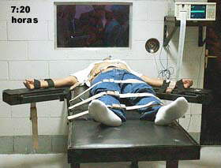
What do you think?
In most legal systems, someone who is accused of a crime is considered innocent until proven guilty. Is this an example of argument ad ignorantiam? Should we abandon this assumption?

Slide 102
Causes of bad reasoning
Rationalisation – Manufacturing arguments to justify our ignorance, pride, laziness and prejudices
Take any editorial or opinion article from a newspaper and see how many logical fallacies you can find in it.
Have you ever rationalized?

Slide 103
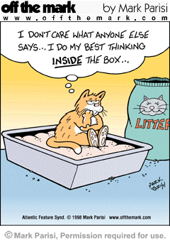
Lateral Thinking
“Thinking out the box”

Slide 104
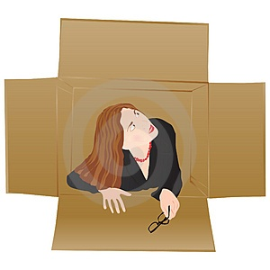
Lateral Thinking
Both inductive and deductive reasoning have their flaws and often confine the knower to a systematic approach to thinking. So perhaps it is better if we all had a little more intellectual flexibility. According to Eduardo de Bono (1993-) if we are to escape from the ‘prison of consistency’ then we must learn to ‘think outside of the box’ and come up with more creative ways to looking at problems. He argues we cannot rely on traditional logic to give us new ideas, we need to adopt a more creative way of thinking that encourages us to search actively for better solutions to problems.

Slide 105
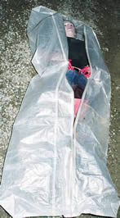
Body in the Park
A body is discovered in a park in Chicago in the middle of summer. It has a fractured skull and many other broken bones, but the cause of death was hypothermia. Can you explain?

Slide 106
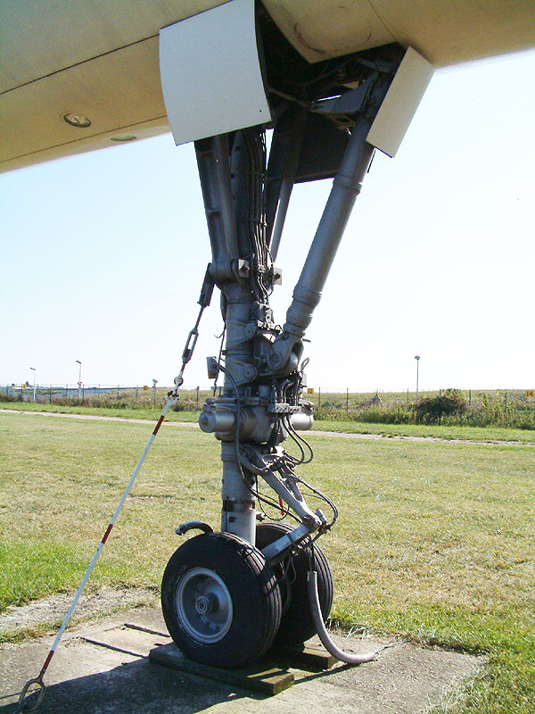
Body in the Park
A body is discovered in a park in Chicago in the middle of summer. It has a fractured skull and many other broken bones, but the cause of death was hypothermia. Can you explain?
He was a stowaway hiding in the landing gear of an aircraft. He fell out when the wheels opened for landing at Chicago airport.

Slide 107
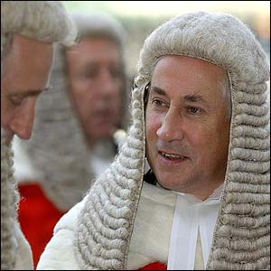
Guilty Sister
A woman has incontrovertible proof in court that her husband was murdered by her sister. The judge declares, "This is the strangest case I've ever seen. Though it's a cut-and-dried case, this woman cannot be punished." Why?

Slide 108
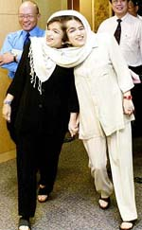
Guilty Sister
A woman has incontrovertible proof in court that her husband was murdered by her sister. The judge declares, "This is the strangest case I've ever seen. Though it's a cut-and-dried case, this woman cannot be punished." Why?
Her sister is her conjoined twin.

Slide 109
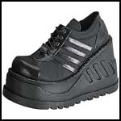
Deadly Shoes
A woman buys a new pair of shoes, goes to work, and dies.

Slide 110
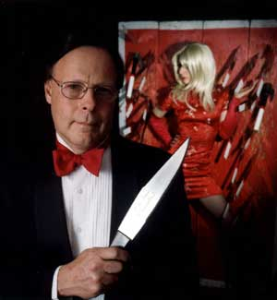
Deadly Shoes
A woman buys a new pair of shoes, goes to work, and dies.
She works as an assistant to a knife-thrower at the circus. The shoes have high heels. The knife thrower blindfolds himself and throws as normal, hitting the woman.

Slide 111
Pete and John
Two men enter a bar. They are served identical drinks. One lives; the other dies.

Slide 112
Pete and John
Two men enter a bar. They are served identical drinks. One lives; the other dies.
The drinks contain poisoned ice cubes. One mans drinks his drink quickly before the ice melts.

Slide 113
Top Floor
A man lives in the penthouse of an apartment building. Every morning he takes the elevator down to the lobby and leaves the building. Upon his return, however, if he is alone he can only travel halfway up in the lift and has to walk the rest of the way - unless it's raining. What is the explanation for this?

Slide 114
Top Floor
A man lives in the penthouse of an apartment building. Every morning he takes the elevator down to the lobby and leaves the building. Upon his return, however, if he is alone he can only travel halfway up in the lift and has to walk the rest of the way - unless it's raining. What is the explanation for this?
He’s a dwarf and cannot press the top buttons in the elevator (unless he uses an umbrella).

Slide 115
Falling Baby
How could a baby fall out of a twenty-story building onto the ground and live?

Slide 116
Falling Baby
How could a baby fall out of a twenty-story building onto the ground and live?
The baby fell out of a ground floor window.

Slide 117
Hands up!
Assume there are approximately 6 billion people on Earth. What would you estimate to be the result, if you multiply together the number of fingers on every person's left-hands?

Slide 118
Hands up!
Assume there are approximately 6 billion people on Earth. What would you estimate to be the result, if you multiply together the number of fingers on every person's left-hands?
Zero. It only takes one person to have no fingers on their left hand for the product to be zero, because anything multiplied by zero equals zero.

Slide 119
Baby puzzle
A woman gave natural birth to two sons who were born on the same hour of the same day of the same month of the same year. But they were not twins and she had no access to a time machine. How could this be?

Slide 120
Baby puzzle
A woman gave natural birth to two sons who were born on the same hour of the same day of the same month of the same year. But they were not twins and she had no access to a time machine. How could this be?
They were two babies from a set of triplets

Slide 121
Who do you help?
You are driving down the road in your car on a wild, stormy night, when you pass by a bus stop and you see three people waiting for the bus:
1. An old lady who looks as if she is about to die. 2. An old friend who once saved your life. 3. The perfect partner you have been dreaming about.
Knowing that there can only be one passenger in your car, whom would you choose?

Slide 122
HINT
You can make everyone happy. Your car can only contain one passenger, so whom should it be?

Slide 123
Solution
The old lady of course! After helping the old lady into the car, you can give your keys to your friend, and wait with your perfect partner for the bus.

Slide 124
Double Jeopardy Doors
You are trapped in a room with two doors. One leads to certain death and the other leads to freedom. You don't know which is which.
There are two robots guarding the doors. They will let you choose one door but upon doing so you must go through it.
You can, however, ask one robot one question. The problem is one robot always tells the truth ,the other always lies and you don't know which is which.
What is the question you ask?

Slide 125
Hint
The two robots know each others personality. That they talk when they're bored, lonely, etc. Try to get the two robots to cancel their evil & good ways out.

Slide 126
Solution
Ask one robot what the other robot would say, if it was asked which door was safe. Then go through the other door.

Slide 127
There’s Something about Mary
Mary's mum has four children. The first child is called April. The second May. The third June. What is the name of the fourth child?

Slide 128
Solution
Mary

Slide 129
A Dark and Stormy Night
It was a dark stormy night and a couple were in a car racing madly through a foreign city. The car broke down and the husband had to go get help from someone who spoke his language. He was afraid to leave his wife alone in the car so he pulled up the windows and locked the car before leaving. When he came back, the car was in the same state as he had left it but his wife was dead, there was blood on the floor and there was a stranger in the car. What happened?

Slide 130
Hint
He must have been gone for more than a few minutes.

Slide 131
Solution
The wife was about to have a baby. They were driving to the hospital. The baby was born, and the wife didn't survive the birth.

Slide 132
Conclusion
Rationalist philosophers like Rene Descartes believed that reason was a way of knowing that can give us certainty. But as we have seen this belief is open to serious doubt. For reason is only as certain as the premises on which it is based, and it is always possible that we have reasoned badly in arguing from premises to conclusions. We also raised various philosophical doubts about induction and deduction but in practice it is difficult to see how we can do without these two ways of reasoning.
It seems that reason like other ways of knowing is a double edged tool. We need to reason to develop consistent beliefs about the world but we can become trapped in the ‘prison of logic’ and this can stifle our creativity. Furthermore, reason is not appropriate in every situation, and if someone is too rational they may simply come across as a cold and unfeeling robot. Reason needs to be balanced by emotion.

Slide 133
Let’s read (p141-142)
YouTube - Argument Clinic

Slide 134
Let’s write another essay!
Is adversarial argument the best way to decide someone’s innocence. Discuss.

