Slide 1
Knowledge Questions
What are they and why do we ask them?

Slide 2
A Definition:
Knowledge questions are questions about knowledge!
What does ‘about knowledge’ mean?

Slide 3
We ask Knowledge Questions when we are not satisfied with accepting everything that everyone tells us
If you find yourself asking ‘How do you know?’ then you are asking Knowledge Questions.

Slide 4
Why do we ask KQ’s?
To get a deeper understanding of what we know and how we know it!

Slide 5
Example:
A: Aliens live in the middle of the Earth.
B: How do you know this?
A: I have faith that they do.
B: But isn’t the content of the middle of the earth a question that can be answered by Natural Science?
A: Maybe, but the sciences also rely on Faith as a way of knowing. Don’t scientists rely on Faith when they tell us what is inside black holes? They can’t exactly see inside black holes or use their sense perception. So isn’t this just Faith?
B: Hmm, I think we may be talking about Faith in a different way. What should the role of Faith be in making claims in Natural Science? KNOWLEDGE QUESTION!!!

Slide 6
Basic
Should Hong Kong adopt a minimum wage?
Deeper
How do we know whether or not wage increases will improve quality of life?
ToK
How reliable are statistics for knowledge in Human Science?
Claim
Hong Kong should adopt a minimum wage.

Slide 7
Basic
Is it morally wrong to have sex before you are married?
Deeper
How do we know whether an action is ethical or not?
ToK
To what extent do ethical claims apply across cultures?
Claim
It is wrong to have sex before you are married.

Slide 8
Open-ended questions that admit more than one possible answer
Explicitly about knowledge in itself and not subject-specific claims
Couched in terms of TOK vocabulary and concepts: the areas of knowledge, the ways of
knowing and the concepts in the linking questions—belief, certainty, culture, evidence,
experience, explanation, interpretation, intuition, justification, truth, values
precise in terms of the relationships between these concepts

Slide 9
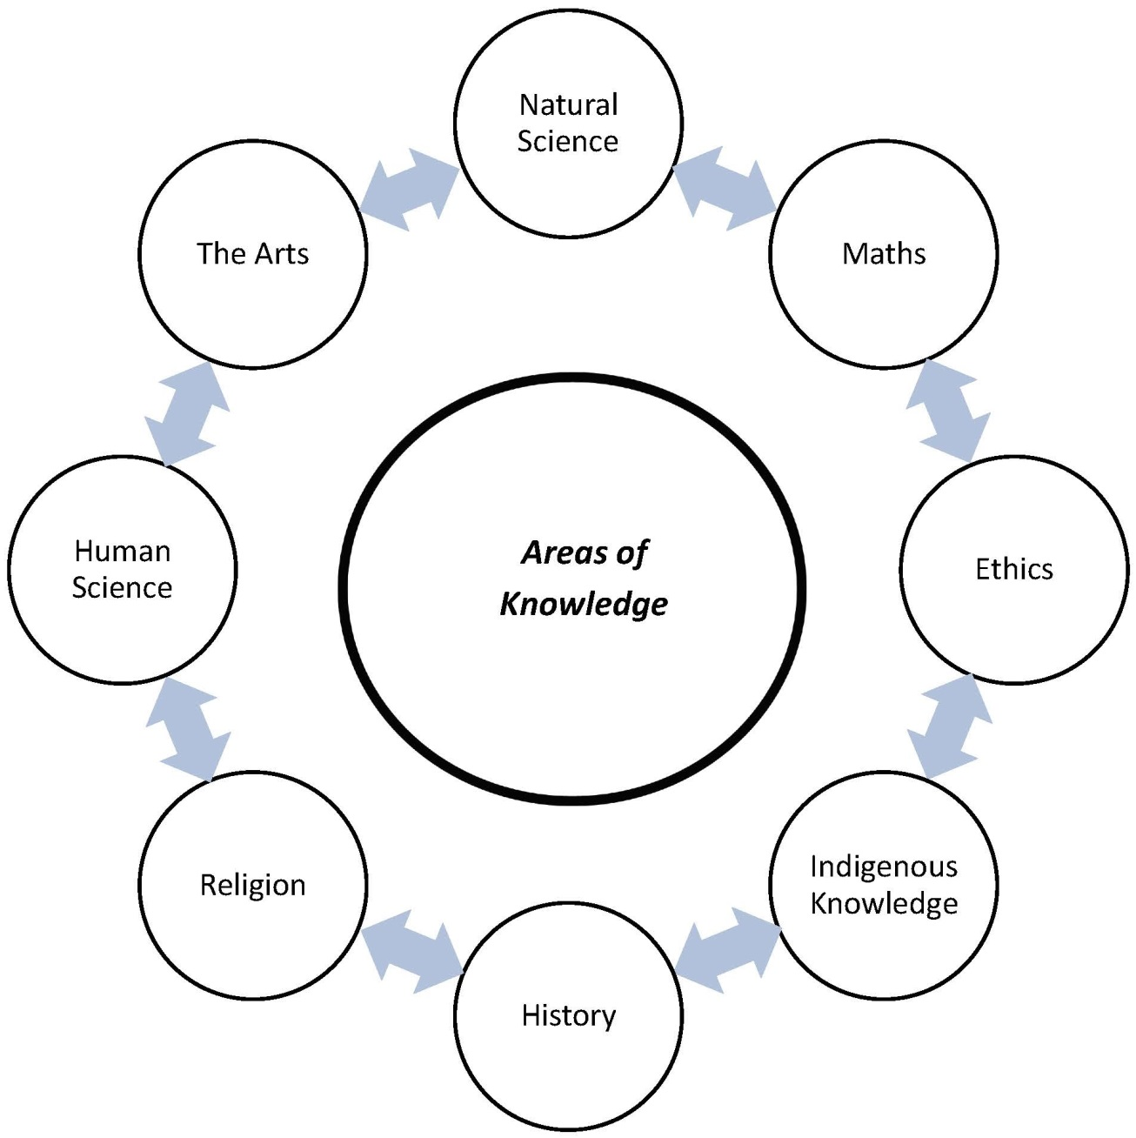

Slide 10
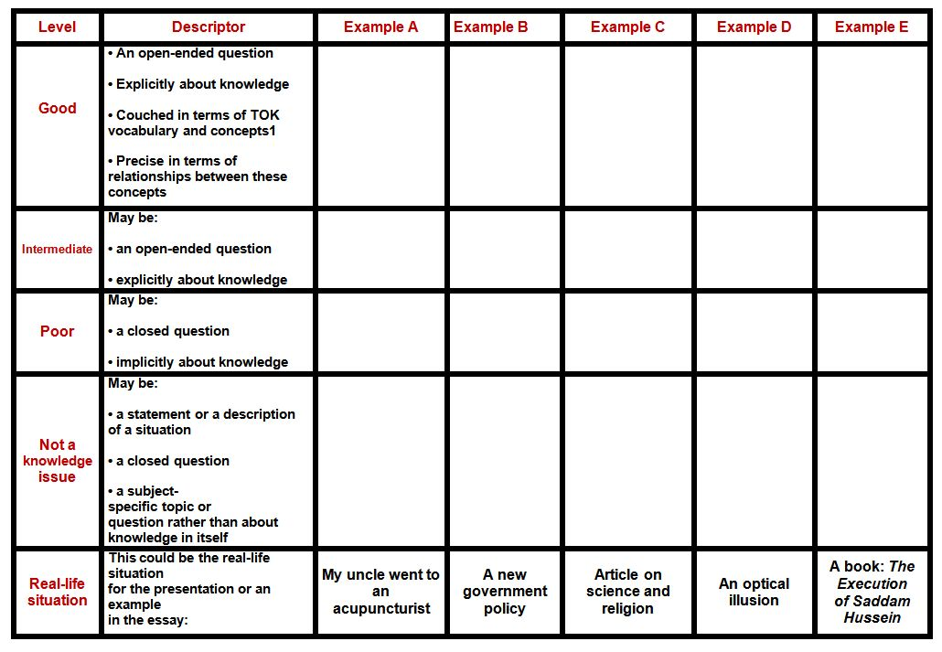
Your Turn:
Exercise with the Knowledge Question table

Slide 11
Summary:
The main questions in TOK are not just ‘How do I know’….
They are more like:
How do we know in Maths?
How do we know in Science?
KQ’s link concepts like WOKs, justification, evidence, culture, perspectives, truth, belief, experience, bias…

Slide 12
If knowledge is like a map, KQs are the questions we make to investigate the ways these maps are made, their strengths, limitations, boundaries, and similarities..

Slide 13
Reflection and homework:
Create your own Knowledge Question using the blank template

