Slide 1
Language as a Way of Knowing

Slide 2
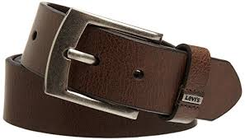
What is Language?
1. Language is rule governed
The rules are arbitrary, but everyone agrees on them.
This applies to the rules of grammar and syntax in any language, and also to the meaning of words.
Example: Take any familiar word of your choice, such as belt or chair, and repeat it 20 times. Do it. What happens?

Slide 3
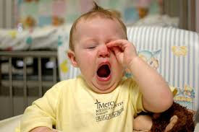
What is Language?
2. Language is Intended
Language is a form of communication, but not all communication is language.
Example: You may yawn during this powerpoint. That communicates something to me. You did not intend to communicate anything with me, so it is not language. However, if you look across the room to your friend and make a yawning gesture, you intended to communicate something, so this is a form of language

Slide 4
What is Language?
3. Language is creative and open-ended
The rules of language and grammar allow us to make an almost infinite number of grammatically correct sentences.
“The wise cow seeks shelter when it snows at dusk.”
Write one sentence of about twenty words that you think has never been written before in history.
You could say a sentence like this every 5 seconds for
Languages change and develop over time.
We borrow words from other languages
Technology evolves and gives rise to the need for more language.
Binge-watch and net neutrality were added to the Mirriam Webster Dictionary this year. As was weak-sauce.

Slide 5
The Problem of Meaning
“The Montillation of Traxoline”
It is very important that you learn about traxoline. Traxoline is a new form of zionter. It is montilled in Ceristanna. The Ceristannians gristeriate large amounts of fevon and then bracter it into quasel traxoline. Traxoline may well be one of our most lukized snezlaus in the future because of our zionter lescelidge.”
1. What is traxoline?
2. Where is traxoline montilled?
3. How is traxoline quaselled?
4. Why is it important to know about traxoline?

Slide 6
The Problem of Meaning
If you don’t know what the words mean, you learn nothing.
But, from where is meaning derived? We will consider 3 theories.
Definition Theory
Denotation Theory
Image Theory

Slide 7
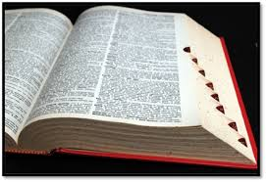
Definition Theory
Resolve conflicts over a words meaning by consulting a dictionary or authority
Define triangle. Table. Love
Problems
It is impossible to define the word red to a blind person.
Definitions are imprecise. (table and love, from above)
They only explain the meaning of words using other words. Shouldn’t language connect to the world.

Slide 8
Denotation Theory
What distinguishes a meaningful word from a meaningless word is that a meaningful one stands for something in the real world
France
Spaghetti
Criticism
Good for naming things, but falls down when you look for the meaning of words like wisdom or freedom. You can point to examples of these, but not to the thing itself.
Doesn’t allow you to talk about people once they are dead

Slide 9
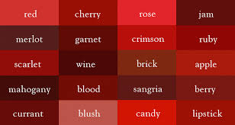
Image Theory
The meaning of a word is the mental image it stands for, and you know the meaning of the word when you have the appropriate mental image.
When a parrot “talks” they do not have the appropriate mental image. They are just making noises that sound like talking.
Criticism
Can’t be sure that others share the same mental image
What is red?

Slide 10
Problematic Meaning
Vagueness
John lives close to his school? How near does he live?
Can be helpful pointing us in the right direction.
Baldness
Ambiguity
Visiting relatives can be boring.
Bob tickled the man with a feather duster.
Can be used to purposely mislead.
Secondary meaning
We often use euphemisms for harsh words
“passed away” instead of “died”

Slide 11
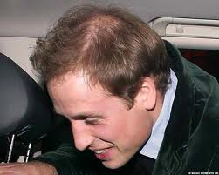
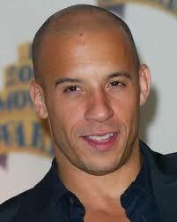
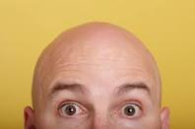
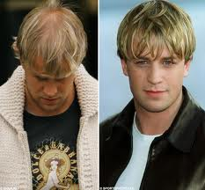
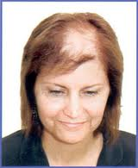
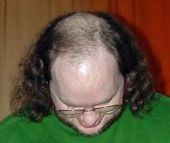
Sometimes words need to be vague e.g. ‘bald’

Slide 12
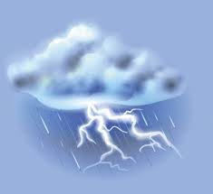
Problematic Meaning
Metaphor
Can be difficult, without context, to determine whether something is meant literally or metaphorically.
No man is an island.
No man is a banana.
Irony
Nice weather!

Slide 13
Other Mistranslations
Rome doctor's office: Specialist in women and other diseases.
Mexican Hotel: The manager has personally passed all the water served here
Danish airline ticket office: We take your bags and send them in all directions
Rome laundry: Leave your clothes here and spend the afternoon having a good time.
On a Polish menu: Salad a firm's own make; limpid red beet soup with cheesy dumplings in the form of a finger.

Slide 14
Untranslatable words
Some words have no direct equivalent in other languages
Schlimmbessrung (German): an ‘improvement’ that actually makes things worse
Any new iphone
Jayus (Indonesian): a joke so unfunny that it becomes funny
Think 6th grade
Mamihlapinatapai (Tierra del Fuegan): to look at each other, each hoping the other will offer to do something which both parties very much desire done but which neither is willing to do.
“Tell you what, I’ll go scoop up the dog poop in the backyard before our friends get here.”

Slide 15
Idioms
A colloquial (regional/local/national) expression whose meaning cannot be worked out from the meanings of the words it contains.
A Chip On Your Shoulder: Being upset for something that happened in the past
A Leopard Can't Change His Spots: You cannot change who you are.
Add Fuel To The Fire: Whenever something is done to make a bad situation even worse than it is.
All In The Same Boat: When everyone is facing the same challenges.
An Arm And A Leg: Very expensive. A large amount of money.
An ax To Grind: To have a dispute with someone.
Back Seat Driver:
People who criticize from the sidelines, much like someone giving unwanted advice from the back seat of a vehicle to the driver

Slide 16
???????
In Polish is kopnąć w kalendarz ("to kick the calendar"),
In Bulgarian the closest analogous phrase is da ritnesh kambanata ("да ритнеш камбаната", "to kick the bell");
In Dutch, het loodje leggen ("to lay the piece of lead");
In Finnish, potkaista tyhjää ("to kick the void");
In French, manger des pissenlits par la racine ("to eat dandelions by the root");
In Spanish, estirar la pata (to stretch the foot);
In German, den Löffel abgeben ("to give the spoon away") or ins Gras beißen ("to bite into the grass");
In Latvian, nolikt karoti ("to put the spoon down");
In Portuguese, bater as botas ("to beat the boots");
In Danish, at stille træskoene ("to take off the clogs");
In Swedish, trilla av pinnen ("to fall off the stick");
In Norwegian, å parkere tøflene ("to park the slippers");
In Greek, τινάζω τα πέταλα ("to shake the horse-shoes").

Slide 17
Labels and Stereotypes
Labels
Useful
Efficient and economical
Can help you predict how an object will behave
Problematic
Danger of mislabeling things
Notes:
You would probably label the contents of the red glass as different. But, imagine that 1 is water, 1 is red Kool Aid and one is hydrochloric acid.

Slide 18
Labels and Stereotypes
Stereotypes
Typically a stereotype is a caricature which exaggerates the negative features of a group and assumes they are possessed by all members of the group.

Slide 19
Language and Values
As well as describing the world, we use language to persuade and influence others
We often use language to determine and/or label others in a positive or negative way.
“I am firm; you are obstinate; he is a pig-headed fool”
“I have reconsidered it, you have changed your mind, he has gone back on his word”
“I am righteously indignant; you are annoyed; he is making a fuss about nothing”

Slide 20
Language and Values
Advertisers and spin doctors know the usefulness of value-laden language
Sparkling water sounds better than gassy water
On an airplane, which is better?
Second Class or business class
Third Class or Economy Class OR “World Traveler”

Slide 21
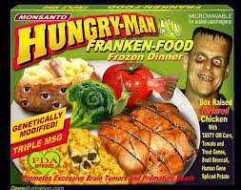
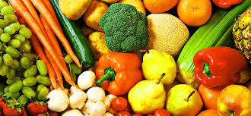
Language and Values
Emotionally Laden Language
Terrorist / Freedom Fighter
Genetically Modified Food/ Franken-food
Free speech/ Hate Speech

Slide 22
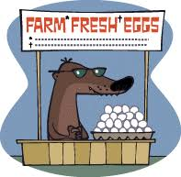
Language and Values
Weasel Words
Words like ‘many’, ‘should’, and ‘probably’ which people slip into sentences to give themselves an escape route.
What are the weasel words below?
“Our product can restore up to 25% of lost hair.”
“Probably the best lager in the world.”
“Our toothpaste helps fight tooth decay.”

Slide 23
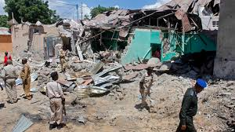
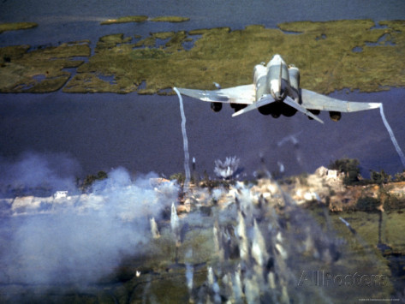
Language and Values
Grammar/ Passive Voice
“Many villages were bombed”
“We bombed many villages”

Slide 24
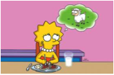
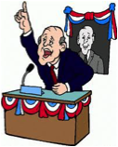
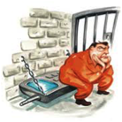
Language and Values-Revealing and Concealing
I have invited an Austrian to my party
I have invited a vegetarian to my party
I have invited an artist to my party
I have invited a politician to my party
I have invited an criminal to my party

Slide 25
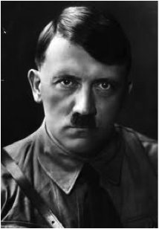
In revealing some things, something else was concealed.

