Slide 1
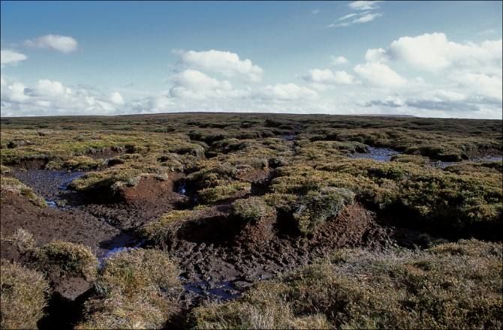
All About Irish Bogs: Which Covers 1/6th of Ireland

Slide 2
Topics to be Covered:
Acid, Base/Alkali & pH
What is Peat and What are Peatlands?
How Peat, Fens, Raised Bogs and Blanket Bogs are Formed
Bog Plants
Bog Animals
How Bogs were/are Used by the Irish

Slide 3
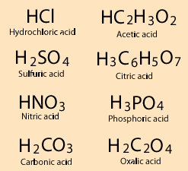
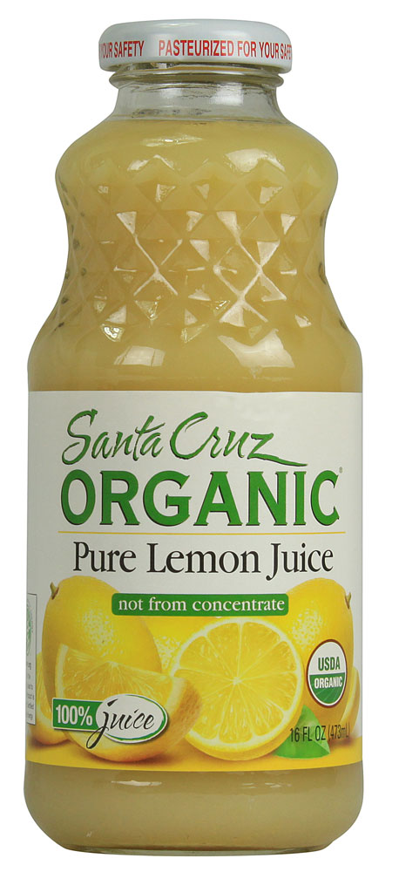
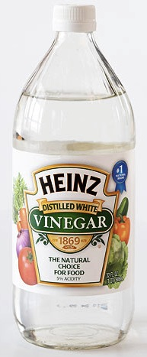
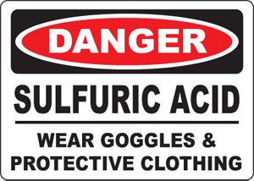
What is an Acid?
An acid is typically a substance that has Hydrogen ions (H⁺). The more acidic positive ions there are in a substance, the more acidic the substance is.
Food/drink that taste sour are usually acidic. For example, citrus fruits/drinks have citric acid (H₃C₆H₅O₇) in them. Other common acids are acetic acid (in vinegar – HC₂H₃O₂), sulfuric acid (used in car batteries and found in acid rain - H₂SO₄) and hydrochloric acid (which helps digest our food and used heavily in industrial facilities - HCl).
A strong acid can chemically burn or kill living organisms.

Slide 4
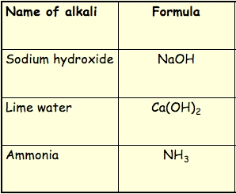
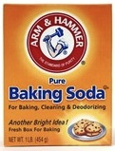
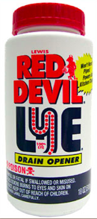
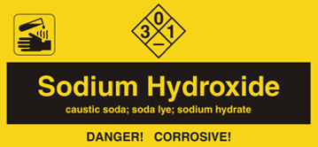
What is an Alkali?
An Alkali is similar to an acid, but is also the opposite of an acid. Instead of having a positive ion that determines its alkali level, it has a negative ion that determines it’s level of alkali. The most common negative ion for an alkali is Hydroxide – OH⁻. The more Hydroxide, or other negative alkali ions a substance has, the more alkaline they are. Not all alkalis have Hydroxide.
Common alkalis are Sodium Bicarbonate (baking soda – NaHCO₃), Sodium Hydroxide (lye – used to make soap, detergents, and clean clogged drainage pipes – NaOH), Potassium Hydroxide (potash – used to make soft soap – KOH), Calcium Hydroxide (lime – used in water and sewage treatment - Ca(OH)₂)
Strong alkalis can chemically burn or kill living organisms.

Slide 5
What is pH?
pH is the measurement of how acidic or alkaline a substance is. “pH” is an acronym of “power” of “Hydrogen”. The range of pH is 0 to 14.
A pH of 0 to < 7 is acidic, with 0 being the most acidic level and 6.9999… being the least acidic level.
A pH of 7 is neutral… neither acidic or alkaline.
A pH of > 7 to 14 is alkaline, with 7.00…001 being the least alkaline level and 14 being the most alkaline level.

Slide 6
pH Scale

Slide 7
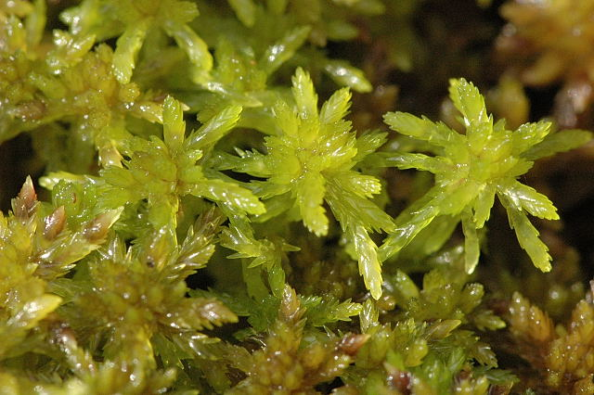
What is a Bog?
A bog is a wetland that accumulates peat through the deposit of dead plant material. Most of the dead plant material does not decompose – only 10% decomposes. Also, there isn’t much nutrients in bogs upon which plants can survive due to the massive amounts of liquid.
The most common plant in bogs is Sphagnum Moss.
Bogs are acidic (pH = 3.2 to 4.2).
The reason bogs are acidic is that the Sphagnum Moss offers Hydrogen ions (H⁺) to the water in order to take in other ionic nutrients it needs: Calcium, Potassium, etc.
By supplying the water with so many Hydrogen ions, it significantly increases the acidity of the water, which makes bogs inhospitable to normal plants and animal species, including species that decompose dead plants.

Slide 8
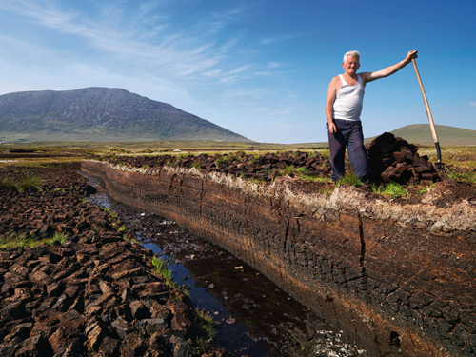
What is Peat and Peatlands?
Peat is soil made up of only partially decomposed dead plants and mostly non-decomposed dead plants which have accumulated on top of each other in waterlogged places for thousands of years.
Areas where peat accumulates are called peatlands. Peat is brownish-black in color and in its natural state is composed of 90% water and 10% solid material.
The solid material consists mostly of Sphagnum moss, but also of the roots, leaves, flowers and seeds of heathers, grasses and sedges (sedges are grass-like plants often found on wet ground or in water, having usually triangular, solid stems).
Occasionally the trunks and roots of trees such as Scots pine, oak, birch and yew and dead animals are also present in the peat.

Slide 9
Two Types of Peatlands
There are two types of Peatlands in Ireland: Bogs and Fens. Here are the similarities and differences between Bogs and Fens:
Fens are alkaline, not acidic, with a pH of 7 to 8. Bogs are acidic with a pH of 3.2 to 4.2. Fens can support a more diverse environment with a milder alkali level.
Fens and Bogs are waterlogged habitats.
Fens are minerotrophic, which means their water comes from the mineral rich ground water. Bogs are ombrotrophic, which means their water comes from mineral poor rain water.
Fen peat has a higher ash content, 10% or more ash (potash, Potassium Hydroxide: KOH). Bog peat has low ash content, 3% or more. Ash is an alkali. This is the reason fens are alkaline.
Average peat depth for a fen is up to 2 meters (6.56 ft). Peat depth in a bog varies from 2 to 12 meters (6.56 to 39.4 ft).

Slide 10
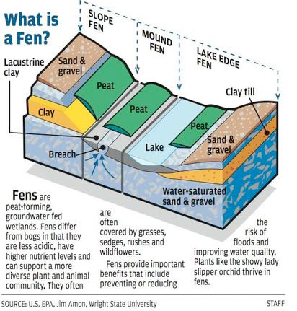
A Fen
Fens form in lake
basins.
Typically Fens
are 2-3 meters
deep
Due to the
higher nutrient
level, Fens can
support a more
diverse plant
and animal
community.

Slide 11
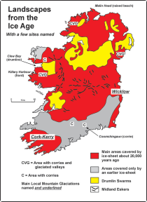
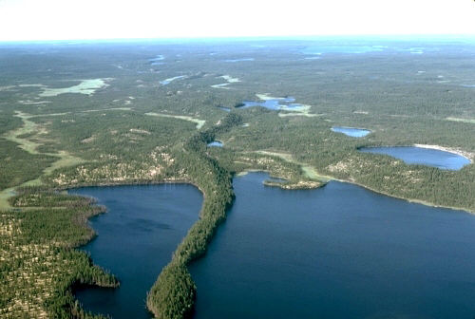
Fen History
Fen formation started at the end of the last ice age, 10,000 years ago, when glaciers had melted and retreated northward.
After glaciers had melted, much of central Ireland was covered by shallow lakes left behind by melting ice.
Lakes also formed where glacial ridges, such as eskers, trapped the water. Eskers are ridges of sand and gravel that were frozen in the glaciers and left behind when the glaciers melted.

Slide 12
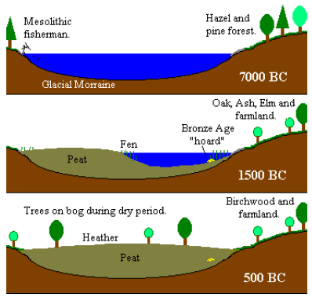
Fen Formation
These lakes were fed by mineral-rich groundwater and springs and supported floating plant communities, which sometimes produced a thin peat layer just above the glacial moraine. A moraine is any glacially formed accumulation of unconsolidated glacial debris (soil and rock).
The lake edges were dominated by tall reed and sedge beds. As these plants died, their remains fell into the water and were only partly decomposed. They collected as peat on the lake bed. Over time this process formed a thick layer of reed peat that rose toward the water surface. As the peat surface approached the upper water level, sedges invaded, and their remains added to the accumulating fen peat.

Slide 13
Bogs: Raised & Blanket
There are two types of Bogs: Raised Bogs and Blanket Bogs.
Raised Bogs and Blanket Bogs often form above Fens.
There are two types of blanket bogs, depending on the altitude: Atlantic blanket bog (below 200m) and mountain blanket bog (above 200m).

Slide 14
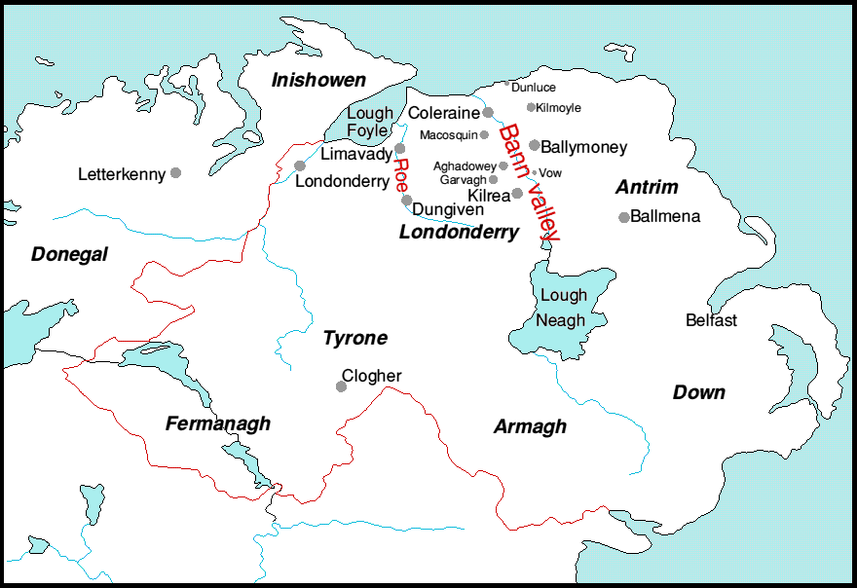
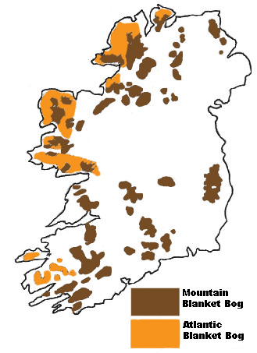
Where are the Bogs?
Raised bogs occur in the midlands of Ireland and in the Bann River Valley where rainfall is between 800 and 900 mm (31.5 – 35.4 in) per year.
Blanket bogs are found along the west coast of Ireland and in mountainous areas around the country where rainfall is 1,200 mm per year or more (> or = 47.2 in).

Slide 15
Raised Bog Formation
As the fen peat grew higher and higher, plants were no longer able to get access to the mineral rich groundwater.
Plants such as Sphagnum Moss, carnivorous plants and others that can handle a mineral poor environment started to grow.
Sphagnum Moss is the most critical species in bogs because it wicks water to the surface so plants can get access to water.
As plants die, bog peat starts to accumulate into a mound above the fen peat and starts the creation of a raised bog.

Slide 16
Mnt. Blanket Bog Formation
Blanket bogs began forming when glaciers melt 10,000 years ago.
The process accelerated 4000 years ago when the climate became wetter and accelerated again when people began deforesting the land in 2500 BC for farming and grazing.
They cut down trees on the highest ground because they were the thinnest. Once trees were gone, rainwater washed away the nutrients in the soil, Heather started to grow and the soil became acidic.
Leached iron deposited at a lower depth and created a barrier that prevented water from filtering through. The soil became waterlogged.
Bog peat started to build up and blanket bogs began to form.

Slide 17
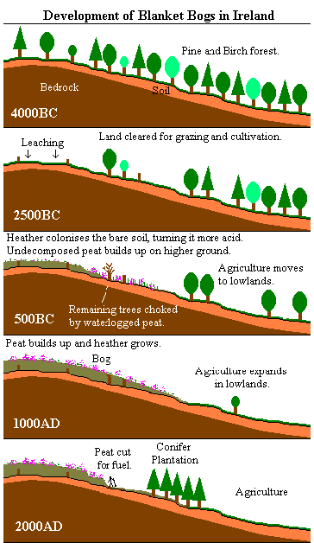
Atlantic Blanket Bog Formation
By 500 BC, farmers were forced to clear lower forests because the uplands were no longer usable.
As forests were removed, bogs extended down the hills and the layer of peat began to build up.

Slide 18
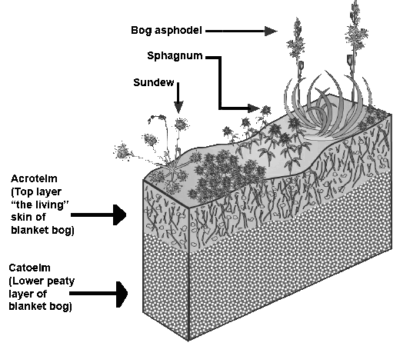
Bog Structure
Walking on a bog is not easy… it involves walking on a very soft and bumpy surface which floats on a material which is nearly all water. A raised bog can have up to 98% water and a blanket bog can have up to 85% water.
The water is held within the Sphagnum Moss dead fragments. The ability for the Sphagnum moss to retain the water makes Sphagnum peat the prized bog plant.
A bog consists of two layers. The upper layer is Acrotelm, which means “the living layer”. The lower layer is Catoelm, which is the peaty layer of the bog.

Slide 19
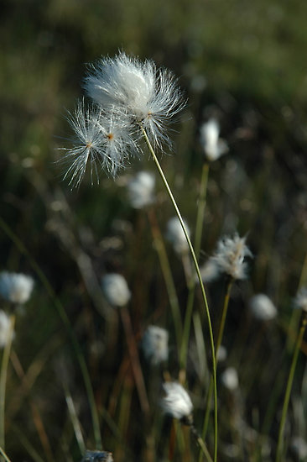
Bog Plants
Bog Cotton: grows on blanket and raised bogs.
It grows in two forms: single headed and many headed. Many headed bog cotton grows in bog pools and is able to do so by “snorkeling”. The stems gets oxygen down to the roots. Single headed bog cotton grows on the drier surface of the bog and doesn’t need to use its stems as air canals.
Bog cotton distributes its seeds as the wind blows. In winter the leaves of single and many-headed bog cotton die back from their tips. All of the food in the plant is recycled and stored over the winter in underground bulbs ready for the spring growth. This is a special adaptation to the nutrient poor bog environment.

Slide 20
Ling Heather:
This bushy evergreen plant with tiny, scale like leaves, flowers in autumn and grows on the drier hummocks of the bogs. Its leaves are coated with wax to conserve water.
Its flowers produce a nectar which is a favorite of bog insects. Its green shoots are eaten by bog animals. The fruits are like capsules and contain seeds. The roots of Ling Heather have a mesh of fungal threads that assist the roots in obtaining minerals and water from the peat in exchange for sugars produced in the leaves of the heather.
Ling Heather conserves nutrients on the bog by having evergreen leaves and uses the leaves to make food for more than one year.
In the past Ling Heather was tied into bundles to make brooms and brushes for use in the house.

Slide 21
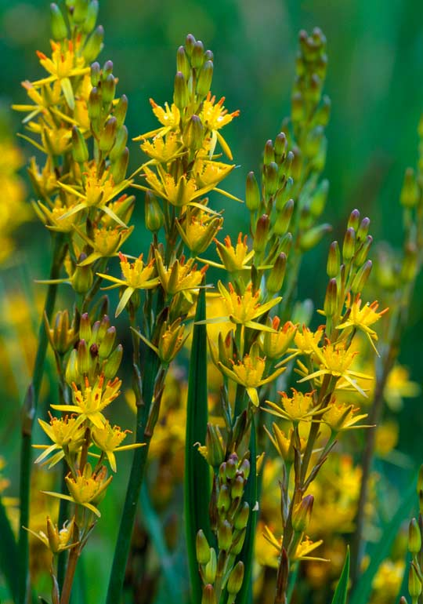
Bog Asphodel:
This plant has yellow star shaped flowers blooming in July/August.
Later, the spiky nut-like orange fruiting heads appear. The heads were harvested and used for dyeing.
The leaves are pointed and bright green in spring. At the end of summer they turn orange and die.
Nutrients are stored in bulbs along underground stems from which the new leaves grow.
This adaptation conserves nutrients. Bog Asphodel grows at the edge of pools in Sphagnum moss where water moves.

Slide 22
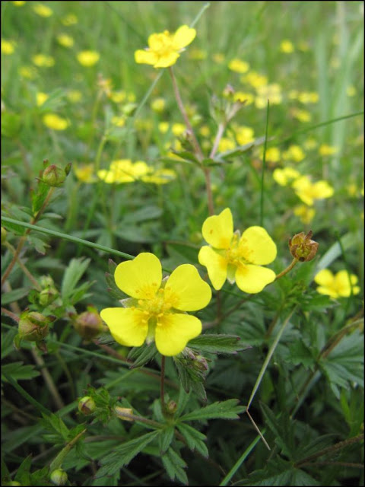
Tormentil:
A small plant, with bright yellow flowers and woody roots. Tormentil grows in the drier parts of blanket bogs.
The flower has 4 yellow petals and it flowers all summer long.
The leaves are divided into 5 and have toothy edges.
Tormentil has an underground stem that is reddish when cut and has a rose like smell. A red dye was extracted from it and used to tan hides in the past.
The English name for the plant comes from the Latin word tormentum meaning pain, which refers to the use of the underground parts of the plant to relieve stomach pains and toothaches.

Slide 23
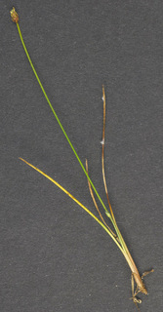
Deer Sedge:
Deer sedge has long needle like leaves with brownish grass like flowers at the tip.
It grows on blanket and raised bogs in clumps in drier parts of the bog.
In parts of bogs that are burned regularly deer sedge tends to dominate over other plants.
In winter the leaves of deer sedge die back from their tips. All of the food in the plants is recycled and stored over the winter in underground bulbs ready for the spring growth. This is a special adaptation to the nutrient poor bog environment.

Slide 24
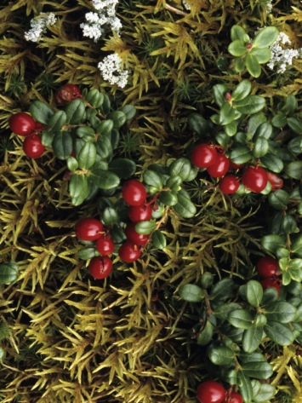
Cranberry:
This small plant produces the cranberry fruit in autumn, which lasts until spring and is eaten by many bogland animals and birds. It has small green leaves on a long stem which winds and creeps through other plants. The cranberry is found on raised bogs.
Cranberry leaves are rolled downwards at their margins and the pores on the underside of the leaves are protected by white hairs. These features of the leaf help the plant to avoid drying out and dying during the summer months when the surface of the bog becomes drier.

Slide 25
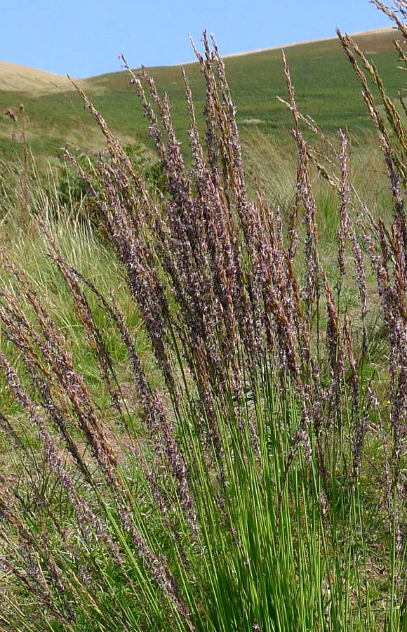
Purple Moor Grass:
This plant is a grass and is very common on blanket bogs. It has wiry stems and hairy leaves that taper to a point. The plant varies in height from 15 to 120 cm and may form large clumps.
The flowers appear in August and September and the flower spikes are about 15 cm long. These purple flower spikes give the plant its name. In autumn the leaves turn golden brown and are then very similar to straw.
At the base of each blade of grass an over wintering bulb is found. Each year a new blade grows from this bulb. This recycling of plant nutrients is a special adaptation to the nutrient-poor bog environment.

Slide 26
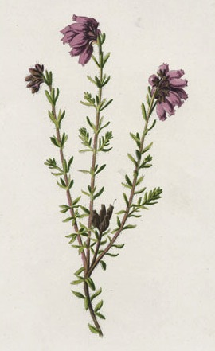
Crossed-leaved Heath:
Cross leaved heath is found on raised bogs growing at the edge of bog pools and through Ling Heather. It has a long stem with leaves that are evenly spaced and arranged in fours on the stem so that they resemble a cross.
On the underside of the leaves there are silky white hairs which help to reduce water loss from pores in the leaf by trapping air between them.
The flowers are tightly packed together at the top of the stem. They are pink and shaped like bells. The flowers can be seen from May to September.

Slide 27
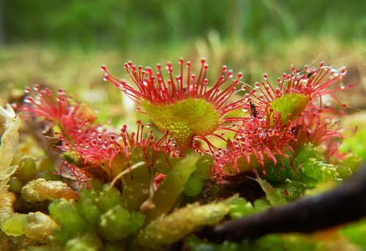
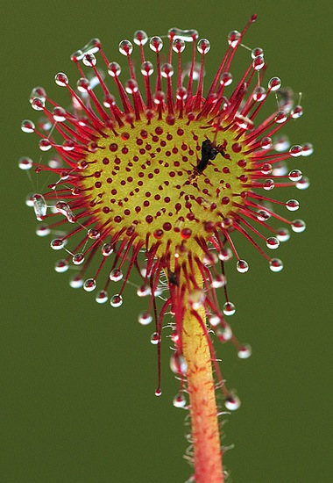
Sundew:
This is a small carnivorous plant that grows on blanket or raised bogs, in and around bog pools. It has green spoon shaped leaves covered with up to 200 red tentacles. These tentacles produce a sticky substance which attracts insects which are trapped on the hairs. Within 3 minutes there is no escape for the insect. The whole leaf bends over and closes within a day. The soft parts of the insect’s body are digested by the plant. After one or two days the leaves open and the hard parts of the insect are all that remain. On average a sundew plant traps up to 5 insects a month.
The tiny white flowers appear on flowering stems about 7cm tall in July and August. The fruit is a capsule.
Long ago the sundew was used as a cure for warts.

Slide 28
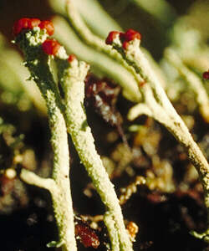
Cladonia Lichen:
A lichen is a combination of an algae and a fungus. The algae provides the fungus with food and the fungus absorbs water for the algae. Lichens are blue, green or grey in color.
Lichens can be found growing on a low mound on the bog, rocks and dead wood in bogs.
Lichens are crisp when dry and soft when wet. Bogs include cup shaped lichens, bearded lichens, antler horn lichens and match stick lichens.
Lichens have no roots or pores. They need to absorb water and air through the plant walls. For this reason they are sensitive to pollution.

Slide 29
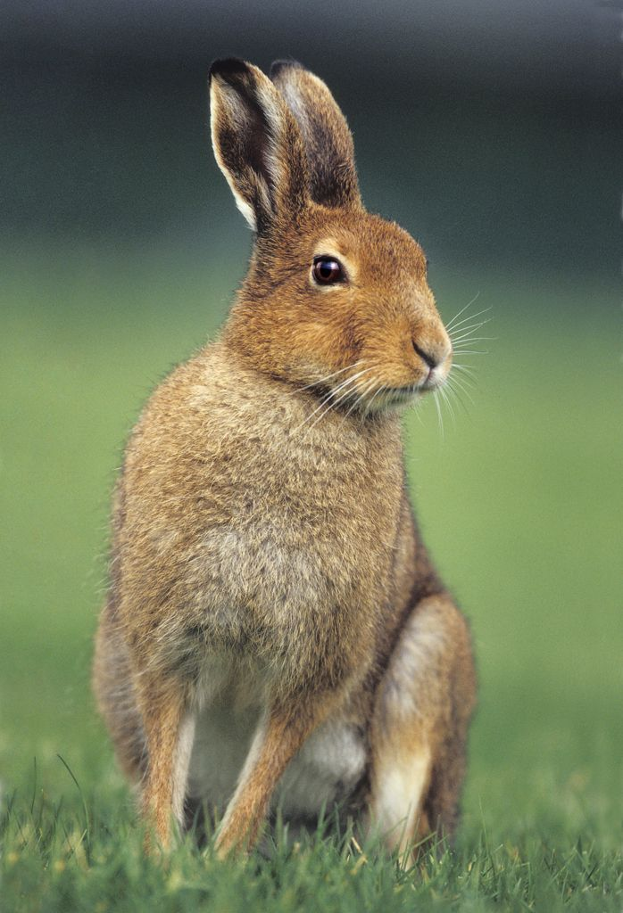
Bog Animals
The Irish Hare:
The Irish hare is found on blanket and raised bogs, is larger than a rabbit, has long black tipped ears and longer hind legs. The ears are highly sensitive and the hare will run away as fast as possible if threatened.
Hares do not burrow but dig shallow resting hollows or forms out of hummocks of bog moss. The form is made to protect the animal from the wind.
The hare grazes on bog plants mainly at night. Hares usually breed in spring. The females have several litters each year with an average of 2 to 3 in a litter. The young, called leverets are born in the open unlike rabbits, and kept in several different forms. At sunset the female visits and feeds the young in each form and may even feed another hare's young if they have wandered into one of her forms.

Slide 30
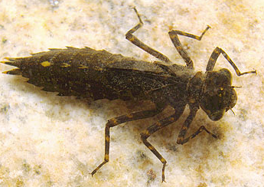
Dragonfly:
Dragonflies are found at most permanent water sites. They have long slender brightly colored bodies and two pairs of wings. Each wing moves independently of the other. This allows the dragonfly to fly fast, make sudden turns as it hunts for other flying insects and catch and eat their prey in flight. They have extending jaws to catch the prey and hooked legs held to the front of the head to trap the prey in a kind of basket while in flight.
Dragonflies lay their eggs in bog pools. These hatch to form nymphs. They are fierce hunters and have specially adapted mouth parts for catching and eating prey. They are aquatic creatures with a fat brown body. They live in the pools for three years and then they will crawl up a plant stem to emerge as an adult dragonfly. At first they pause to harden their skin and pump blood into their wings. They then fly off in search of food or a mate. Adult dragonflies only live for about a month or two.

Slide 31
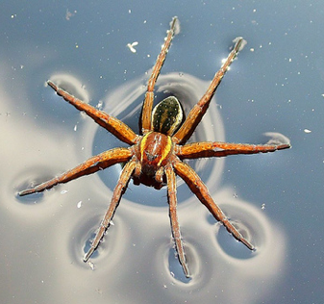
Raft Spider:
The raft spider is a large spider that lives around bog pools and hunts on the surface of the bog pool. The spider has long legs which help to spread its weight as it walks on the water. It oils its legs with water repellent which also helps to keep it buoyant.
It will sit on dry land with its four front legs in the water waiting to detect movement caused by insects. The insect is grabbed and injected with poison from the spider's fangs. It will go under the water if it is alarmed but it prefers to leave the scene using web lines spun around the pool.
It has a brown or black body with a distinctive bright stripe on each side. The body can be up to 3 cm long but the leg span can be 8 to 10 cm. Female are bigger than males. Females spin silken balls into which eggs are laid. The ball is carried until the young hatch.

Slide 32
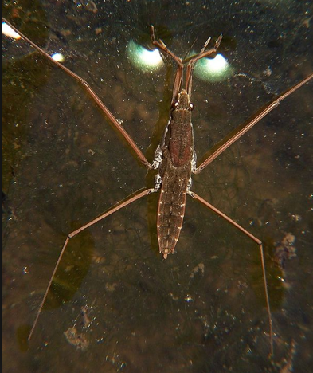
Pond Skater:
Pond skaters are found on bog pools. They have 6 long legs. They use their middle legs to move on the water. Their hind legs act as a rudder steering the pond skater to its target and the smaller front legs are used to catch the prey, usually small insects that fall onto the water surface.
They have wings which enable them to move between ponds.
They lay eggs between March and April and attach them in small groups to plants under the water. The young resemble their parents in everything but size.

Slide 33
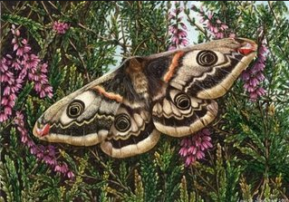
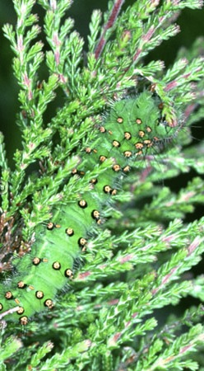
Emperor Moth:
The emperor moth has purple and grey wings with two large eye spots to frighten predators away.
The male flies by day and can detect a female up to 2 km away. The female flies by night and lays her eggs on ling heather.
These eggs hatch into larva. The larva or caterpillars are green with pink spots which camouflages the caterpillars while they feed on the leaves of ling heather. The caterpillar makes a beautiful silk cocoon, which is attached to the base of the heather bush near the bog surface. Inside the cocoon the caterpillars go through a process called metamorphosis which is to change into the adult moth.

Slide 34
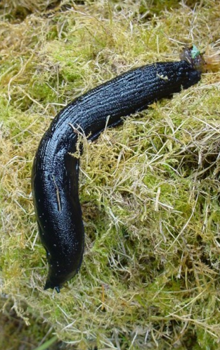
Black Slug:
Black slugs are found on blanket and raised bogs. Not having a shell enables it to get into smaller spaces than a snail and in dry weather it burrows down into the damp bog undergrowth.
Slugs feed on bog plants. They can measure from 12 to 15 cm.
They breathe through a respiratory pore or opening towards the front right side of their body.
Slugs are hermaphrodites which means they have both male and female reproduction organs. The eggs are laid in the spring and autumn but sometimes in the winter. They are laid in loose soil or under decaying vegetation. When they hatch the young slugs resemble their parents in everything but size.

Slide 35
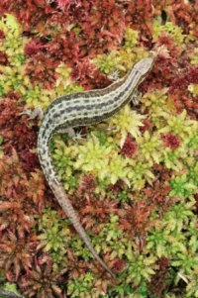
Lizard:
Lizards can be seen on hot days basking on rocks or hummocks in bogs.
Lizards feed on spiders, flies, beetles, ants and moths. The male can measure five inches in length and a female eight inches in length.
The young are born alive and are tiny replicas of the adult. They can fend for themselves within a few minutes of birth.
A lizard caught by the tail by a predator can detach itself from its tail and escape.

Slide 36
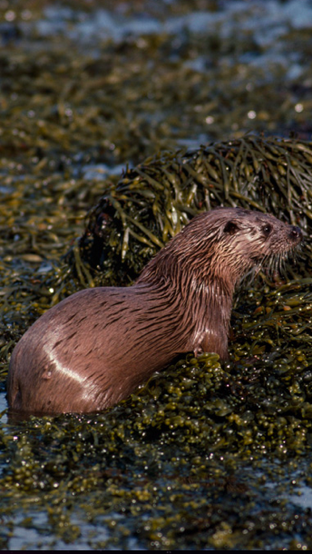
Otter:
The otter has a body designed for swimming: long, slender with a flat head, tapering tail and webbed feet and a very dense grey-brown fur coat that helps to insulate against the cold water. All these help the otter catch its food.
The otter lives close to water in a holt, built in a bank. Otters usually have 2-3 cubs that are born in the holt. Both parents feed the cubs who will stay in the holt for 6-8 weeks.
Otters are shy and mostly nocturnal, so Ireland’s remaining bog lands are ideally suited to the otter's lifestyle.

Slide 37
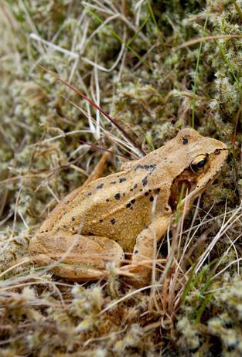
Frog:
Frogs are amphibians, creatures that can live equally well in water and on land. A frog's skin is smooth and moist. Its eyes are set at the top of its head and stick up so they are above the water when the rest of the body is below.
The nostrils are also on the top so the frog can breath while swimming at the surface. Frogs breathe through their skin when fully under the water.
Behind the eyes are circular eardrums for hearing.
Frogs move on land by jumping and in the water by swimming. Its strong hind legs and webbed feet help both types of movement.
Frogs change the color of their skin to mimic their surroundings.
Frogs feed on beetles, spiders and other insects.
During the winter frogs hibernate and in the spring the female lay eggs or frog spawn that will hatch as tadpoles.
Tadpoles take about 10 weeks to grow into tiny frogs. Some frogs can then live up to 12 years.

Slide 38
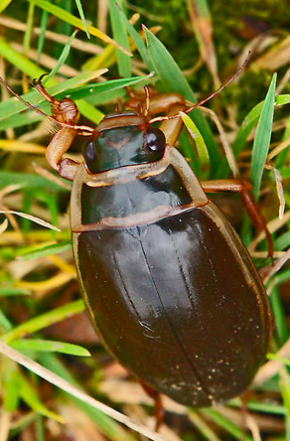
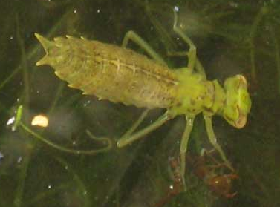
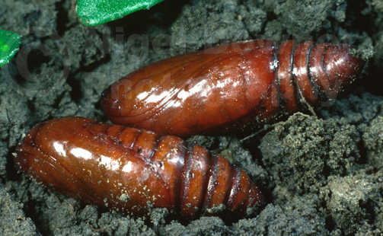
Great Diving Beetle:
The great diving beetle is one of the largest insect predators in bogs. The adult has a black body with orange underside and edges. Its back legs are fringed with hairs for swimming.
The beetle breathes through an air store on the top of its abdomen, which it renews by swimming to the surface of the pool and sticking its rear end out of the water.
In spring, the female beetle lays her eggs inside the stems of water plants. The eggs hatch into hungry larvae which are fearsome hunters. When the larva is a year old, it crawls out of the pond and burrows into damp soil, where it changes into a pupa. After about three weeks, an adult beetle comes out of the pupa and heads back to the pond.
Both the adult beetle and the larva will attack other bog pool creatures. They usually manage to kill insects and newts for food. This fierceness has given the beetle another name "the water tiger". The beetle can also fly and if the pond dries up it will simply fly to another pond.

Slide 39
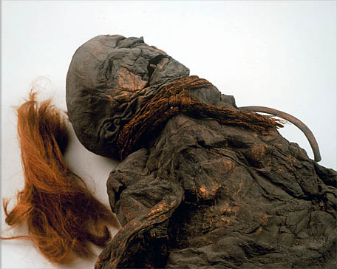
Bog Preservation
More than 80 human bodies from hundreds to 10,000 years ago have been found preserved in bogs.
Their skin and organs are preserved. These bodies are preserved by the remarkable properties of Sphagnum Moss.
Anything buried in the Sphagnum Moss peat bogs decays extremely slowly.

Slide 40
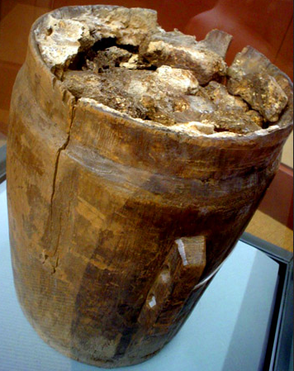
Bog Preservation
Bog Butter: More than 270 barrels of Bog Butter have been discovered.
The preservative qualities of bogs may have acted as primitive refrigerators for the ancient people of Ireland , where most examples of bog butter have been found.
But recent tests suggest that while some of these "butters" were in fact dairy, some were meat-based.
The practice of preserving meat and dairy in bogs dates back to at least the 2nd century AD.

Slide 41
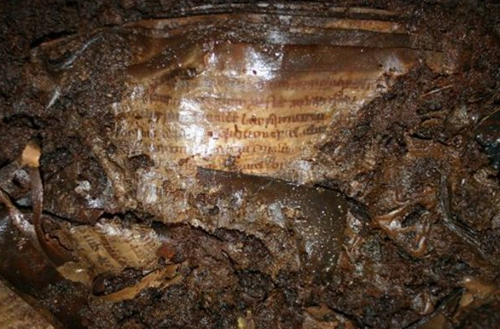
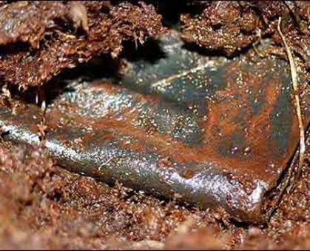
Bog Preservation
Books: Book of Psalms, a 1200 year old prayer book was discovered by a man operating a backhoe in an Irish peat bog in 2006.
The book, its writing still legible, had been buried more more than a thousand years, and a leather carrying pouch for the book was found nearby.

Slide 42
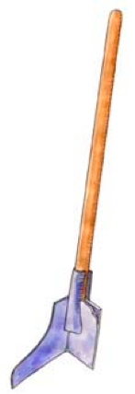
Peat/Turf
One of the primary uses of peat in Ireland is fuel for heating and cooking. People have been using peat for heating and cooking as far back as the 8th century AD.
With very little of the plants having decomposed, the peat can be burned.
Long ago before motorized machines existed, peat was cut from the peatlands using a sleán (pronounced “shlawn”). Businesses remove peat using machines these days, but individuals in Ireland often still use the sleán.

Slide 43
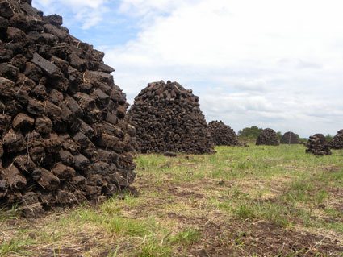
Removing the Peat
During the Spring, people head to the bogs to remove the peat in 3 dimensional rectangles. Due to the bog’s significant percentage of water, they stack them and let them dry all summer long. When the peat has dried, it has a new name: Turf.
The turf is used to heat homes in Autumn, Winter and Spring and cook food all year round.

Slide 44
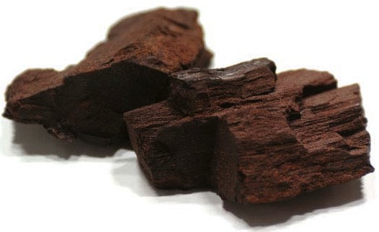
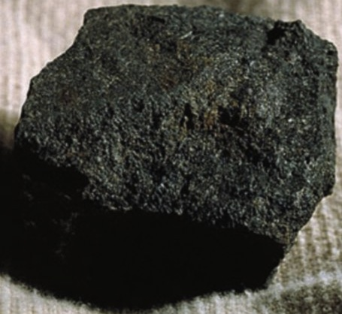
Coal
Coal is fossilized carbon.
Coal forms when dead plant matter is converted to peat, which when it is left in the ground it then converts to lignite (lowest rank of coal) which is a soft brown fuel with characteristics that put it somewhere between peat and coal – no longer peat and not coal, but in the process of converting to coal.
The next step is the lignite becoming sub-bituminous coal, then bituminous coal and then anthracite (highest rank of coal).
This process takes thousands to millions of years to go from peat to coal.

