Slide 1
Congress
#12- What Does The Legislative branch Do? How is it organized?
Ch 10

Slide 2
What is Congress?
The Legislative Branch is CONGRESS; it is the law-making branch of US gov’t.
CONGRESS-
Is made up of House of Reps & Senate
Congress is the part of government closest to the people—
*Because members are elected by the people and in order to represent citizens in our republic.

Slide 3
What does Congress Do?
The main functions of Congress are to
Write and pass laws –
*Laws are government policies and rules to serve the people / their constituents = citizens they represent from their state.
Ex- Health care, tax reform, immigration, safety…
2. Provide oversight-Makes sure laws are being carried out faithfully by the President; investigate problems (Ex-Russia election interference probe)

Slide 4
How is Congress Structured?
The US Congress is bicameral-
The U.S. Legislative branch or Congress is bicameral which means two houses or chambers:
Our bicameral Congress consists of the
House of Representatives (435 members; membership based on population) and
The Senate (2 per state/100)

Slide 5
What are the Constitutional Qualifications for House of Representatives?
The Constitution says that a member of the House-
(1) Must be at least 25 years old
(2) Must have been a citizen of the United States for at least seven years
(3) Must be a legal resident of the State and district they represent
1
3
4
Chapter 10, Section 2

Slide 6
When are House of Representatives Elections?
House members are elected by district every TWO years
There is ONE district for every seat in the House and 435 total.
The # of seats/ districts per state is based on population.

Slide 7
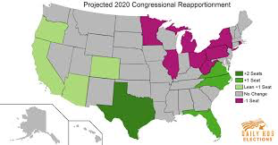
What is Reapportionment?
Reapportionment-
Is the redistribution of seats / districts per state based on population changes.
Population changes are measured EVERY 10 YEARS in the CENSUS and House seats are redistributed / reapportioned based on the census results.
Next census takes place in 2020. House seats are set until then.

Slide 8
Current Numbers In House

Slide 9
Oregon’s Districts

Slide 10
Activity- Oregon’s seats in the House
Get a map handout and your computer
Complete the activity to learn about Oregon’s districts and elected members to the US House of Representatives.
Answer the Q’s in your INB.

Slide 11
Thursday
How are members to the House of Representatives elected?
What is Gerrymandering? How does it affect government and politics?

Slide 12
Warm-Up (LEFT Side)
The US has a bicameral Congress. What does that mean?
How many members are in the US HOUSE?
How many House districts are in Oregon? In the U.S.?
How often does the House REAPPORTION or refigure the number of seats each state gets?
Does the House favor small or large states? Why?

Slide 13
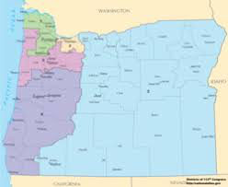
House Elections- Who draws the Districts?
State legislatures draw House district boundaries
What effect might this have on how districts are drawn in Oregon and who wins seats in the House from each district?

Slide 14
What are the politics of drawing House Districts?
Are there any requirements to how they draw them? YES!
Districts must have similar population
Districts must be contiguous (not fragmented).

Slide 15
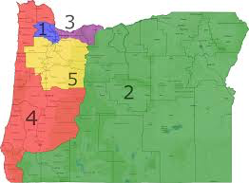
In Oregon, who wins each district?
In many states, district lines favor the dominant party in the state.
Are Oregon’s districts drawn fairly?

Slide 16
Case Study-- Gerrymandering
2012 Presidential Election Results from three swing states…
State % for Obama House Seats Won
Ohio 51% 12 Rep 4 Dem
Pennsylvania 52% 13 Rep 5 Dem
Michigan 54% 9 Rep 5 Dem
TOTAL 34 R 14 D

Slide 17
More Data from 2012…
In 2012, Republicans LOST the overall popular vote for House of Reps by 1.1 million votes…
But beat Democrats in seats won by a margin of 234-201 in the House…
How can this be?????
…GERRYMANDERING!!

Slide 18
What is Gerrymandering?
Why are these districts so oddly shaped?
This is the Cartoon that started the phrase “gerrymander.”

Slide 19
What is Gerrymandering?
Gerrymandering is
Drawing House district boundaries to the advantage of one party;
Done by the dominant party in a state legislature usually; leads to unfairness.
This is still an issue today!!
Republicans and Democrats BOTH do it…but Republicans are currently more dominant at state levels so have more influence overall today on gerrymandering.

Slide 20
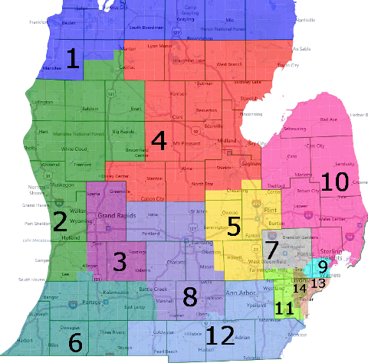
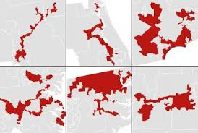
Examples of Gerrymandering
GERRYMANDERING NON-Gerrymandered

Slide 21
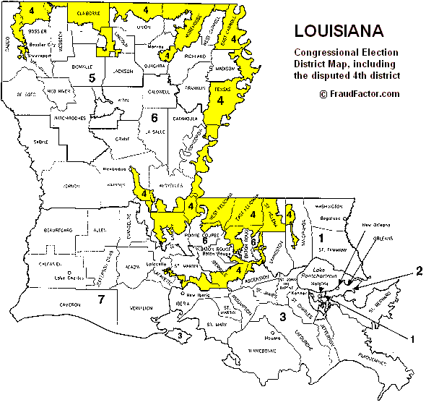
Louisiana 4th District

Slide 22
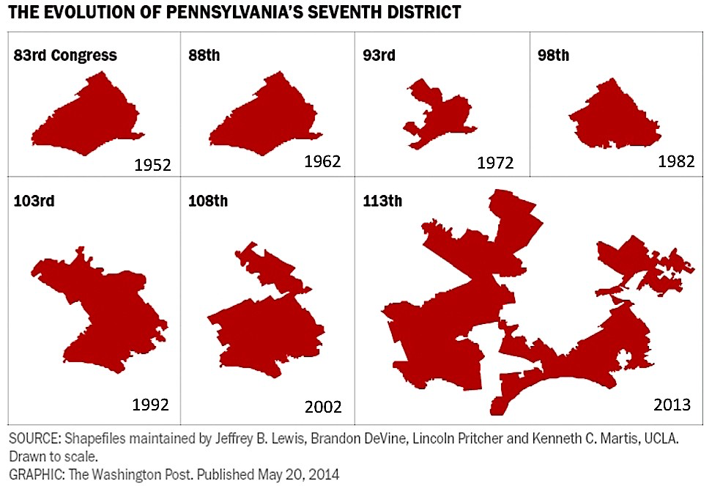

Slide 23
What is Gerrymandering?
Gerrymandering Explained- https://www.washingtonpost.com/news/wonk/wp/2015/03/01/this-is-the-best-explanation-of-gerrymandering-you-will-ever-see/?tid=a_inl&utm_term=.028860029f4b
Read the article. Show film clip after.
Answer the Guiding Questions in INB. Cite paragraph where you found info, please!
What is redistricting?
How is gerrymandering different than redistricting?
How does gerrymandering affect elections?
What is cracking? Packing?

Slide 24
What is Redistricting?
REDISTRICTING
Is the process of redrawing state district boundaries.
Is done by state legislatures
Done after the census if the state gains or loses a seat in the House; can be done fairly.
GERRYMANDERING-
Is redistricting that is UNFAIR as it favors the majority party in the state legislature

Slide 25
Are there any rules against gerrymandering?
To try to make it more fair, the Supreme Court has said US House districts drawn in each state must be -
1) Contiguous (one continuous land area) and
2) Have roughly the same number of voters in each district.
This hasn’t solved the problems of gerrymandering!

Slide 26
Gerrymandering Activity
Complete the Gerrymandering Activity

Slide 27
Gerrymandering EXIT TICKET
Who is responsible for drawing House districts within each state?
What is gerrymandering?
How did it get its name?
Describe TWO effects of gerrymandering on elections and congressional membership.
*Take the True / False Quiz to check for understanding.

Slide 28
Friday 11/1
What are we doing today?
Wrap-up of Gerrymandering – Last notes
Gerrymandering T/F Quiz- Use notes and each other. Check and put in your INB.
Notes on SENATE
Work time to finish Oregon House Districts guided questions and #6 on SENATE.
INB due today EQ #6-11 graded!!

Slide 29
S E C T I O N 3 How is the Senate Organized?
How does the Senate compare to the House in terms of
# of Members
Elections
Term length
Constitutional Qualifications
Responsibilities
1
2
4
Chapter 10, Section 3

Slide 30
How are Senators elected?
There are TWO Senators from each State for a total of 100 Senators.
Originally, the Constitution required that senators be chosen by the State legislatures, NOT the voters.
The Seventeenth Amendment (1913) changed the rule;
Now Senators are chosen by voters from each state in an at-large election.
1
2
4
Chapter 10, Section 3

Slide 31
Senate-Elections & Term
Election-
Senators are elected in a state-wide, at-large election; all voters in the state vote; represent MORE citizens
Term-
Senators serve for a six-year term.
The Senate is a continuous body, meaning that every two years, only 1/3 of Senators are up for election. 2/3 are NOT up for election.
This adds stability to the Senate

Slide 32
What are the Advantages to 6 year term?
Stability
Senators can learn their jobs
Avoid constant political pressure to be re-elected
Take stronger stances on issues since they don’t face quick re-election

Slide 33
Qualifications for Senators
The requirements for the U.S. Senate are higher than for the House of Representatives.
The Constitution says that a Senator
(1) must be at least 30 years of age,
(2) must have been a citizen of the United States for at least nine years, and
(3) must reside in the State they represent
1
2
4
5
Chapter 10, Section 3

Slide 34
Is the Senate more prestigious?
Senate is considered MORE prestigious-
Members serve longer terms and there are fewer positions.
Represent more citizens
Qualifications are stricter
Senate works with the President to approve Presidential appointments & advises President on foreign policy issues- this is called Advice & Consent to the P

Slide 35
Activity- Research Oregon’s Senators
Find out about Oregon’s two senators.
Complete the prompts (#6 on handout) using Oregon’s Blue Book and
Answer in your INB on the LEFT side.
MONDAY
Complete the GRID comparing House and Senate
Glue it in your INB on a LEFT side for 10 pts.

Slide 36
Monday
Warm-Up- Compare House and Senate
EQ #13- Who are members of Congress?

Slide 37
Compare the House and Senate
Make a GRID in your INB that compares the House and Senate based on the following criteria
How many Members?
How are they Elected?
Who do they represent?
Length of Term in Office?
Constitutional Qualifications?
Degree of relative Prestige and why?

