Slide 1
EQ # 25- What are the key roles or jobs of the U.S. President?
And who supports him in his leadership?

Slide 2
The President’s Job-2008 & Now

Slide 3
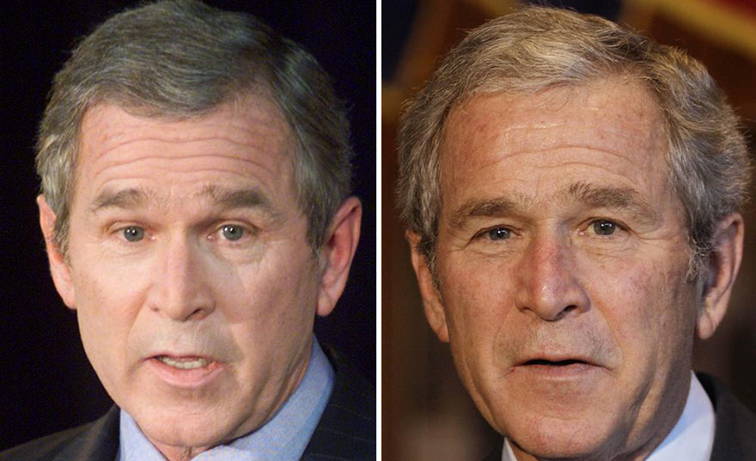
Bush at in 2000 and 2008

Slide 4
The President’s Job
Bill Clinton
"Being president is like running a cemetery; you've got a lot of people under you and nobody's listening.”
George W. Bush
"Eight years was awesome, and I was famous and I was powerful. But I have no desire for fame and power anymore."
Lyndon B. Johnson
"Being president is like being a jackass in a hailstorm. There's nothing to do but to stand there and take it."

Slide 5
The President’s Job
Martin Van Buren
"As to the Presidency, the two happiest days of my life were those of my entrance upon the office and my surrender of it."
Harry Truman
"The Presidents who have done things, who were not afraid to act, have been the most abused... and I have topped them all in the amount of abuse I have received."

Slide 6
Presidential Roles
The job requires long hours, high energy, high visibility and is stressful!!
Commander in Chief-head of military
Chief Executive-Leads the executive branch in carrying out laws
Head of State- One visible “face” of America
Chief Diplomat- Leads negotiations with other nations
Chief Legislator- Works with Congress on policy agenda
Head of Party- Most important and visible in his party
Chief Citizen- Is scrutinized for good character and integrity

Slide 7
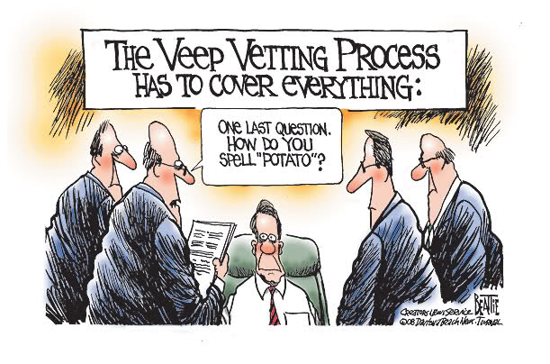
What does the Vice Pres Do?
VP is next in line to assume presidency; this is his/her MOST important role!
Officially
1. Serves as president of the Senate (Constitution)
2. Helps determine presidential disability (25th Amdmt)
Some recent presidents have given their VPs important jobs.

Slide 8
What is the Cabinet- The P’s Support Team
The President chooses his/her Cabinet
They are key Presidential advisors that head a department in the executive branch that deals with a different policy area (state, treasury, etc.)
There are 15 cabinet members
Cabinet was NOT mentioned in Constitution
Washington started the tradition of a cabinet by appointing Secretaries of State, Treasury, War and Attorney General
All are appointed by the P and confirmed by the Senate

Slide 9
Cabinet Departments
Department of State
Treasury Department
Department of Defense
Department of Justice
Department of the Interior Department of Agriculture Department of Commerce Department of Labor Department of Transportation Department of Housing and Urban Development Department of Health and Human Services Department of Energy Department of Education Department of Veterans Affairs Department of Homeland Security

Slide 10
Presidential Succession
The Vice President Mike Pence
Speaker of the House Nancy Pelosi
President pro tempore of the Senate
Secretary of State
Secretary of the Treasury
Secretary of Defense
Attorney General
Secretary of the Interior
Secretary of Agriculture
Secretary of Commerce
Secretary of Labor
Secretary of Health and Human Services
Secretary of Housing and Urban Development
Secretary of Transportation
Secretary of Energy
Secretary of Education
Secretary of Veterans Affairs
Secretary of Homeland Security

Slide 11
Others who advise the P: The Executive Office
National Security Council (NSC): coordinates matters of national security
Includes P, VP, Secretary of State, Secretary of Defense
Council of Economic Affairs (CEA): advises P on economic issues; includes three appointees
Office of Management and Budget (OMB): reviews the budgetary implications of federal programs and legislation

Slide 12
Others who advise the President
The White House Staff
Chief aides and staff for the president - some are more for the White House than the president
Presidents rely on their information and effort
Chief of Staff is a key advisor/personal friend
These appointments don’t require Senate approval

Slide 13
How are the WH Staff & Cabinet managed?
Organizing the White House Staff & Cabinet
Presidents rely heavily on these staff for information
Most manage with a traditional hierarchical model-chief at top and others down have less authority
Some (Carter) choose Wheel and Spokes model-less top down and more equal status and balance

Slide 14
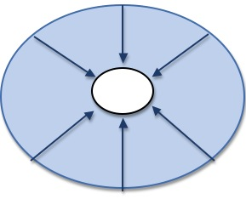
Wheel and Spokes v. Pyramid
Wheel and Spokes-Less common, & egalitarian
Pyramid- Traditional, top-down.

Slide 15
The First Lady
The First Lady
No official government position, but many get involved politically
Recent ones focus on a single issue
Laura Bush- Literacy
Michelle Obama-Healthy eating and exercise
Melania Trump- “Be Best,” a children-focused policy platform.

Slide 16
Wednesday 1/23
Finish notes
Analyze writing prompt

Slide 17
Presidential Leadership of Congress: The Politics of Shared Powers
1. Acting as Chief Legislator
Veto: Sending a bill back to Congress with his reasons for rejecting it. Can be overridden. 2/3
Pocket Veto: Letting a bill die by not signing it - only works when Congress is adjourned.
Line Item Veto: The ability to veto parts of a bill. Some state governors have it, but not the president.
Threat of a vetoes can be used to prevent legislation.

Slide 18
Presidential Vetoes

Slide 19
Presidential Leadership of Congress: The Politics of Shared Powers
2. Relying on Party Support
President and members of Congress from his/her party often share political priorities
Party Support: Presidents support members of Congress who support them.
Presidents rely on members of Congress to introduce key legislation and pass it

Slide 20
Presidential Leadership of Congress: The Politics of Shared Powers
3. Relies on Public Support
Is tied to Congressional Support
Public Approval
Public approval gives the president leverage, not command
A President who is considered weak (has LOW approval ratings) is often abandoned by members of Congress from his party

Slide 21
Presidential Leadership of Congress: The Politics of Shared Powers
4. Uses Legislative Skills
Strategies to influence the legislative process
Variety of forms: bargaining, making personal appeals, consulting with Congress, setting priorities, etc.
Most important is bargaining with Congress.
Presidents can use their “honeymoon” period (right after election) to their advantage.
President is the nation’s key agenda builder

Slide 22
The President and National Security
The P is commander-in-chief of the armed forces
This includes
Deciding if and when to use weapons of mass destruction / nuclear weapons
Sending troops into conflict (engaging in war)
Authorizing military actions during war
War Powers Act, 1973- Intended to limit this power by requiring troops to be withdrawn within 60 days unless Congress declares war or gives extension

Slide 23
Summary -
Complete a summary for EQ #25

